Slide 1

Bureau of Fleet Management
Ramona Jones, Director
Alicia Adams, Contract Analyst
Arnitra Douglas, Contract Analyst
Woolfolk Building
Suite 701A
501 North West Street
Jackson, MS 39201
601.359.3409

Slide 2
Purchasing State-Owned Vehicles: Approval
No Department or Agency of the State of Mississippi may purchase any motor vehicle, regardless of funds used, without first obtaining approval from the BFM!!!!
No requests shall be approved if the agency has not properly maintained vehicle data in MAGIC
Inadequacies or discrepancies must be corrected prior to approval

Slide 3
Purchasing State-Owned Vehicles: Approval
Required Documents
CONTRACT PURCHASE
VR-1 (Appendix A) forms must be completed in entirety
Option sheet from contract located on the website
TYPE I, TYPE II EMERGENCY PURCHASES
Descriptive letters addressed to DFA Executive Director (Liz Welch) on agency letterhead
Describe the Type of Emergency (found in MS Code, Section 37-7-1), cause of emergency signed by agency’s Executive Director
Accompanied by Quotes to include all options and standard equipment along with vehicle’s Manufacturer sticker showing the vehicle is in stock and ready for delivery
OFF-CONTRACT PURCHASE
Completed VR-1 form (Appendix A)
Two signed comparable quotes accompanied by vehicle’s manufacturer sticker showing the vehicle is in stock and ready for delivery
Descriptive letter addressed to DFA- OPTFM Director (Danny Lynch) on agency letterhead signed by agency’s Executive Director

Slide 4
Purchasing State-Owned Vehicles: Justification
Agencies must submit with request the lowest cost vehicle possible to carry out its intended use
Requests shall be in writing from agency head, certifying it’s the lowest cost option available
The requesting agency should ensure that the intended use and justification of need is as specific and detailed as possible the first time it is submitted

Slide 5
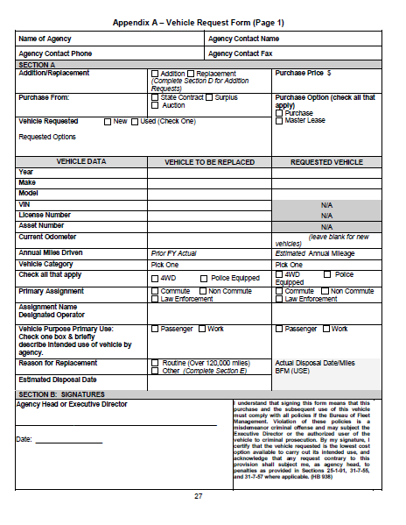
Vehicle Request Form

Slide 6
Purchasing State-Owned Vehicles: Vehicle Replacement
When “vehicle replacement” is the justification for a new purchase, the vehicle being replaced must be disposed of within 60 days of delivery of the new vehicle
Agencies should identify the vehicle to be replaced with the information required by Section 3.101.03 of the Fleet Manual

Slide 7

Purchasing State-Owned Vehicles: Vehicle Purchase Records
The department or agency shall maintain proper purchase documentation which provides the intended use of the vehicle and the basis for choosing the vehicle.

Slide 8
Purchasing State-Owned Vehicles: Title Process
Vehicle Titles should be titled as:
State of Mississippi/Department of Finance and Administration – Agency Number
See Appendix H
Title application shall reflect the requesting agency’s current address as the mailing address on the title with the titles being retained on file at the Agency.
DFA does not retain copies of titles. For questions regarding titles, contact MS DOR.

Slide 9
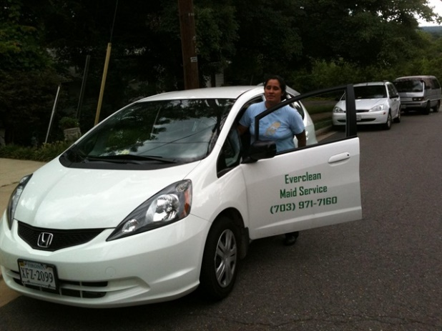
Purchasing State-Owned Vehicles: Marking of State-Owned Vehicles
State Vehicles should have :
Permanent Decal
Or Painted on both sides of the vehicle in letters at least three inches in height and on the rear in letters no less than one-half inches in height, Stating the name of the Agency
Must be in color that contrasts with the vehicle
Refer to Section 25-1-87 of the MS Code

Slide 10
Vehicle Use Policy: Operating a State-Owned Vehicle
Authorized users include:
State employees
State contract workers
Elected and/or appointed officials
Independent contractors (where approved on a case by case basis)
Section 5.201.04 Fleet Manual
Authorized users must have:
A valid driver’s license (Mississippi residents must have a Mississippi Driver’s License)
Acceptable driving record (see UA – 1 Form, Appendix B)
Authorized by their agency to operate a state-owned vehicle

Slide 11
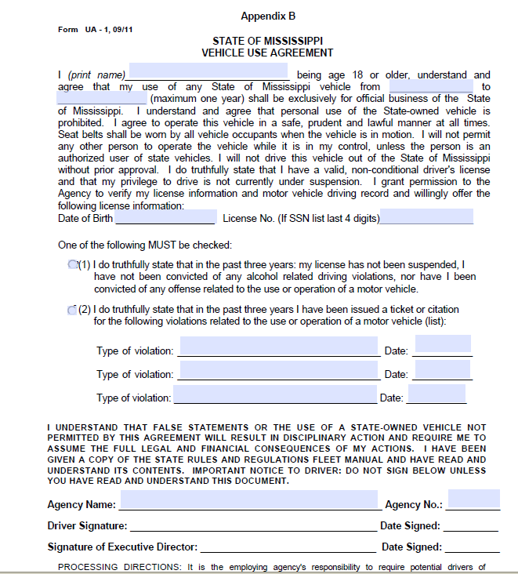
Vehicle Use Agreement

Slide 12

State-Owned Vehicles: Logs
A daily log of all trips must be recorded for each state-owned vehicle. (See Appendix G for Sample Daily Trip Log.)
Each daily trip log shall contain:
the operator of the vehicle,
date of vehicle use,
beginning and ending odometer reading,
total miles traveled,
purpose of each trip,
and the business locations visited each day

Slide 13
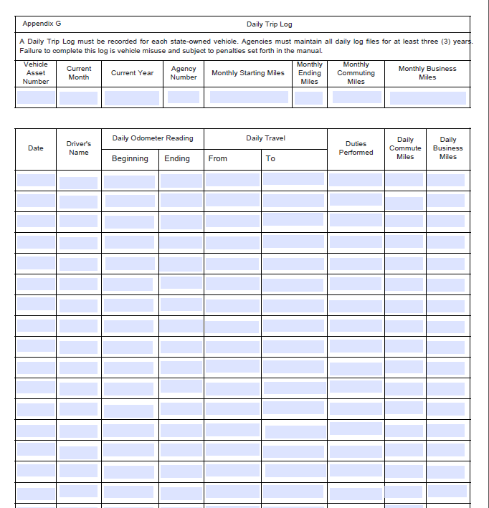
Daily Trip Log

Slide 14
Vehicle Use Policy: Misuse or Inappropriate Activities
Inappropriate activities or misuse include, but are not limited to:
Using the vehicle for personal use outside of the employees’ scope of employment
Failure to maintain accurate daily trip log (Appendix G)
Use of alcohol in state-owned vehicles
Use of drugs in state-owned vehicles
Use of tobacco products in state-owned vehicles

Slide 15
Vehicle Use Policy: Misuse or Inappropriate Activities
Inappropriate activities or misuse include, but are not limited to continued:
Improper vehicle assignment
Failure to report changes in driving status;
Falsification of documents
Failure to comply with vehicle safety laws (ex: speeding and /or reckless driving)
Failure to take proper care of the vehicle
Failure to comply with any policy or procedure otherwise set forth herein
Violation of vehicle replacement policy

Slide 16

State-Owned Vehicles: Unauthorized Usage
Sightseeing or trips for pleasure unless the trip is part of the official agenda for a business conference
Transporting family members, dependents or friends to school, daycare, medical appointments, social events or other personal activities
Conducting other personal business outside the authorized user’s scope of employment

Slide 17
Vehicle Use Policy: Vehicle Classification
State Vehicles Assignments are classified as:
Law Enforcement : a state-owned vehicle assigned to a sworn law enforcement officer as defined in section 45-6-3 of the code, or a law enforcement trainee as defined in section 45-6-3 (e) of the code, to be driven in the daily performance of the duties of a sworn law enforcement officer or trainee if use of the vehicle is essential for the employee to carry out their job duties. Agencies must supply a copy of the official certification from the Mississippi Board on Law Enforcement Officer Standards and Training (BLEOST)
Commute: a state-owned vehicle assigned to be driven from an employee’s official duty station or temporary place of work to an employee's residence as needed
Non- Commute: a state-owned vehicle assigned to be driven to and from an employee's official duty station to any temporary place of work and returned to the official duty station on a daily basis. This vehicle must not be driven to and from the employee’s residence

Slide 18

State Vehicle Safety Operation Policy
Impaired Driving
Distractions
Fines
Seat Belts

Slide 19
State Vehicle Safety Operation Policies : Reporting Accidents
Call an ambulance if anyone is injured
Immediately notify the city police, sheriff’s office or highway patrol
Do not move either vehicle until an officer of the law advises you to do so
The Proof of Insurance number that should be entered on the police report is 11-46-15

Slide 20
State Vehicle Safety Operation Policies : Reporting Accidents
Do not make any statement of guilt to any party
Notify your immediate supervisor as soon as possible
Complete a State of Mississippi Liability Claim Report Form, available online
Submit the form, along with police report and any other applicable information to TORT

Slide 21
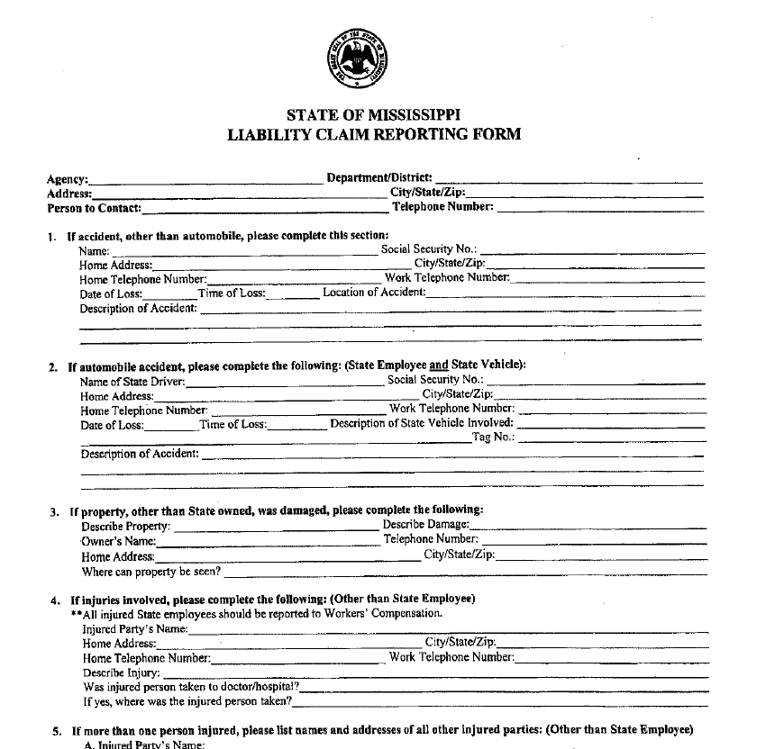
Liability Claim Reporting Form

Slide 22
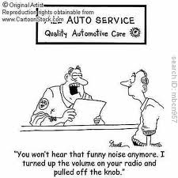
Maintenance and Care of Vehicles
All agencies are urged to establish a written policy which shall describe the planned maintenance program for its fleet
All maintenance and repairs performed on state-owned vehicles must be documented in MAGIC and retained for the life of the vehicle

Slide 23
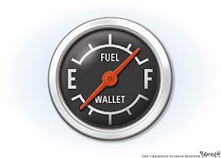
Maintenance and Care of Vehicles: Fuel Purchases
Gasoline purchases shall be obtained using the state-approved fuel access card from vendor facilities that accept the state-approved Fuel Access Card
Compare FuelMan pricing weekly on the OPTFM website
Only regular unleaded gasoline or diesel from self-service pumps should be used
No higher-octane gas is to be purchased

Slide 24

Maintenance and Care of Vehicles : Alternative Fuels
Each agency is encouraged to purchase alternative fuel vehicles and use alternative fuels when it is determined that it would be cost effective and would not cause harm to the state-owned vehicle
Purchase of alternative fuels are 100% reimbursable, where pre-approved by the operator’s agency

Slide 25
Vehicle Replacement and Disposition: Replacement Criteria
Vehicle | Years | Miles
Sedans and Wagons | 7 | 150,000
Light Trucks and Sports Utility Vehicles (8,600 GVWR or below) | 7 | 150,000
Passenger Vans | 7 | 150,000
Cargo Vans | 7 | 150,000

Slide 26
Vehicle Replacement and Disposition: Methods
State-owned vehicles which become surplus to the needs of a state agency may be disposed of in any of the following ways:
Sold
Traded
Transferred

Slide 27
Vehicle Replacement and Disposition: State-Owned Vehicle Disposal Specification
The specifications or instructions to prospective buyers should provide a listing of all items being offered and such listing shall provide:
Make/Model
Year of Manufacture
Mileage
Location (Where the vehicle may be inspected)
Date and time when vehicle may be inspected
Address of location to which the bids shall be delivered
Time and date set for the bid opening
Name of person to be contacted if additional information is necessary

Slide 28
Fleet Management Certification Program
The Bureau of Fleet Management has implemented a Fleet Manager Certification Program to ensure that Agency Fleet Coordinators have the necessary knowledge to complete Fleet Management tasks in MAGIC
All agencies are required to have a Certified Fleet Manager in order to procure vehicles
The Fleet Manager Certification Program consists of a lecture, demo, review, and exam. The Fleet Manager is required to attend the entire program and pass the exam in order to become a Certified Fleet Manager

Slide 29

Review??
What are examples of “justification” for a vehicle? ?
What is DFA ??
What do I want for dinner??
Why am I taking this class again??

Slide 30

?? Questions ?? See page 117 in the CMPA Manual

