Slide 1

Introduction to Information Technology Procurements
www.its.ms.gov

Slide 2


ITS Background
The Mississippi Department of Information Technology Services (ITS) was created by the legislature to maximize the use and benefit of information technology in state government by promoting full cooperation, coordination, cohesive planning, and maximum compatibility among all state agencies and Institutions of Higher Learning. State statute establishing ITS and outlining the duties and responsibilities of the agency is found in Miss. Code Ann. § 25-53-1 et. seq.
www.its.ms.gov

Slide 3

ITS Mission Statement
The Mississippi Department of Information Technology Services (ITS) is responsible for the establishment of information technology (IT) policy and planning, IT procurement and contracts, and providing the
computing and telecommunications infrastructure for all information systems technologies within
state government.
The Legislature has tasked ITS with providing statewide services that facilitate cost-effective IT and telecommunications solutions that can be
shared with all state agencies.
www.its.ms.gov

Slide 4

ITS Procurement
The Procurement Services Division provides professional IT services to state agencies and public universities by administering and supporting the acquisition of cost-effective IT solutions through the competitive procurement process to meet the business needs of State government while in accordance with State statute. This includes all phases of the procurement process, including assisting agencies with specification development, proposal evaluation, and contract negotiation.
This division works with partner agencies and shareholders to capture and report on technology initiatives.
www.its.ms.gov

Slide 5
ITS Law: Responsibilities and Authority
By Law, ITS must:
Adopt rules, regulations, and procedures governing the acquisition of computer and telecom equipment and services
Review and approve (or disapprove) all IT procurements by agencies and IHLs
Execute all contracts for IT equipment and services (ITS Executive Director is “contracting agent” for all technology contracts)
Advertise competitive specifications for dollar amounts established in 31-7-13(c) using total lifecycle cost
– ITS delegated to IHLs to issue procurement without ITS involvement up to $250,000
Award to the “lowest and best”
www.its.ms.gov

Slide 6

ITS Rules and Regulations
ITS website: www.its.ms.gov
Procurement Handbook – updated October 2022
  “Procurement” Channel
  “Procurement Handbook”
  Filed with the Secretary of State’s Office
www.its.ms.gov

Slide 7
ITS Purview and Scope
ITS Purview Includes:
State Agencies
Institutions of Higher Learning
Other political subdivisions (e.g., cities, counties, K-12 Schools, Community Colleges), on request
ITS Scope Includes:
All information technology (i.e. computers, telecommunications)
Hardware, software, and services
NOTE: If you ever question if something is ITS purview or not, please reach out to isshelp@its.ms.gov during your planning stage.
www.its.ms.gov

Slide 8

What About Local Government?
Local governmental entities (cities, counties, schools, etc.) are able to use ITS Purchasing Vehicles in lieu of conducting their own procurements, based on MS Code 31-7-13(m)(xi) that allows governing authorities to do so as an exception to the bidding requirements found in Public Purchasing Code.
As always, ITS Purchasing Vehicles are an option for use by local governmental entities; not a requirement.
www.its.ms.gov

Slide 9
Total Lifecycle Cost
Total committed costs of the project, not just the initial or up-front costs
Includes all costs associated with obtaining, maintaining and operating technology for its projected lifecycle:
  Initial costs: purchase price, freight, installation, training, etc.
  Ongoing costs: post warranty maintenance, support, upgrades, on-site vendor personnel, recurring usage charges, hosting, etc.
NOTE: There are situations where actual monies paid is not the sole determinant of the requirement for a competitive procurement process. The value of the goods and services and/or vendor profit must be considered.
www.its.ms.gov
Procurement Handbook Reference: 005-400 and 015-010

Slide 10
IHL Delegation
ITS has delegated to IHLs:
Non-telecom Projects < $5,000
Non-telecom Projects between $5,000 and $250,000
EPO purchases within EPO dollar limits
NOTE: IHLs are exempt from ITS purview for acquisitions using 100% federal funds.
www.its.ms.gov
Procurement Handbook Reference: 015-020

Slide 11
Agency Delegation
ITS has delegated to Agencies:
Non-telecom Projects < $5,000
Non-telecom Projects between $5,000 and $75,000, with 2 quotes (i.e., sole source certification is NOT delegated)
– Must select the low quote
EPO purchases within EPO dollar limits
NOTE: There is no exception to ITS purview for agency contracts that are federally funded, use grant money, or paid for via other nontraditional funding models.
www.its.ms.gov
Procurement Handbook Reference: 015-010

Slide 12
Board Approval Threshold
MS Code 25-53-5(k) allows the ITS Board to set rules and regulations governing the contracts/dollar amounts that require their approval; some are delegated to the ITS Executive Director.
  Lifecycle of Consulting Services Purchase > $500,000: requires ITS Board Approval
  Lifecycle of Purchase > $1,000,000: requires ITS Board Approval
ITS Board approval is required prior to issuance of a competitive procurement that is expected to exceed Director Approval limits
www.its.ms.gov
Procurement Handbook Reference: 018-030

Slide 13
Board Approval Threshold
To present to the ITS Board:
Customer must submit a Business Case to be included as a part of the Board Meeting materials.
  Completed Business Case must be received by the preceding month’s Board meeting (schedule is on our website)
  Blank Business Case template is on our website
Presenting agency must be in compliance with the Enterprise Security Policy and have obtained an IT Security Risk Assessment within 3 years.
  https://www.its.ms.gov/services/security/state-government-resources
www.its.ms.gov
Procurement Handbook Reference: 018-030

Slide 14
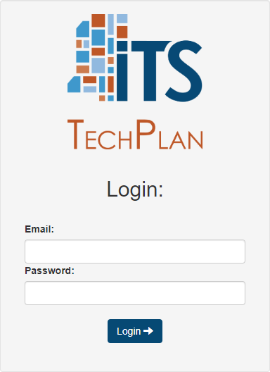
Director Approval Threshold
Lifecycle of Purchase < $250,000: approved by the ITS Executive Director
Lifecycle of Purchase > $250,000 but
< $1 million: requires an approved IT Plan; approved by ITS Executive Director
TechPlan System – used to submit IT Plans
– Use your state issued e-mail and a self-set password
www.its.ms.gov
Procurement Handbook Reference: 018-030

Slide 15
ITS Technology Plans
MS Code 25-53-21(a) requires the development of long-range plans by agencies, boards, and commissions for the efficient and economical performance of IT activities in state government.
Due by September 1 of each year
Reflect broad-based intentions and actions of using IT to fulfil the agency’s mission, enable governmental initiatives, and support business goals and objectives.
Helps ITS prepare the State of Mississippi Strategic Master Plan for Information Technology
www.its.ms.gov

Slide 16
Express Procurement Options (EPO)
What is an Express Procurement Option?
Formerly called an Express Products List (EPL)
Multi-vendor pool for “routine” technology items
EPOs meet state requirements for legal IT public purchases (advertised & awarded)
Customers can use EPOs free of charge, with no involvement from ITS (up to a certain dollar amount).
www.its.ms.gov
Procurement Handbook Reference: 011-030

Slide 17
Express Procurement Options (EPO)
What is an Express Procurement Option?
Each EPO has its own Instructions for Use that must be followed to be considered a valid procurement.
Some Purchase Orders in MAGIC will route to ITS for review. If under the threshold, ITS will not review and will “approve” for processing purposes.
ITS may require that you issue a Customer-Led Solicitation.
NOTE: EPOs are available for use in lieu of a traditional procurement. They are
not required state contracts.
www.its.ms.gov
Procurement Handbook Reference: 011-030

Slide 18
Customer-Led Solicitation
What is a Customer-Led Solicitation?
A procurement process initiated and managed by you, the purchaser.
  Leverage pre-approved Vendor pool and pre-negotiated Purchase Agreements.
  Ensure tailored solutions for specific needs without ITS involvement
  Provide flexibility and control throughout the procurement process while providing guidelines for a legal procurement
www.its.ms.gov

Slide 19
Customer-Led Solicitation
How is this better?
No requirement to obtain a certain number of quotes
Can use “lowest and best” to select your Vendor based on your needs
Can include recurring maintenance and services after the initial purchase
Can purchase equipment and services at one time with limited involvement from ITS
www.its.ms.gov

Slide 20
Customer-Led Solicitation
Which EPOs require a Customer-Led Solicitation?
Cloud Solutions Preferred Vendor (CSPV)
  IaaS, SaaS, PaaS
  Cloud Storage
  Related Services
  $1,000,000 threshold without ITS involvement
Public Safety Video and Communication Systems (PSVC)
  Body Cameras, Dashboard Cameras, and License Plate Readers
  Two-Way Radio Systems
  Surveillance Units
  Building Security Cameras and Access Control Systems
  Software, Equipment, and related Support Services
  $500,000 threshold without ITS involvement
www.its.ms.gov

Slide 21
Customer-Led Solicitation
Which EPOs require a Customer-Led Solicitation?
IT Hardware 4671
  Personal Computers
    Desktops, laptops, tablets
  Presentation and Conferencing Equipment
    Large displays, projectors, interactive displays/whiteboards, A/V equipment, video conferencing equipment
  Enterprise Equipment
Servers, storage devices, thin client systems, UPS, racks, network devices (routers, switches, etc.)
Does not include firewalls and other security devices
$500,000 threshold without ITS involvement
www.its.ms.gov

Slide 22
Solicitation Workbook
A comprehensive guide to Customer-Led Solicitations
Works side-by-side as a companion to the Solicitation templates – the workbook and templates match by sections for ease of use
Provides structure, best practices, and detailed requirements
Provides guidance on customizing the templates to meet your needs.
Includes exhibits listing specific requirements that the vendors have already agreed to – such as technical requirements and warranties
www.its.ms.gov

Slide 23

What About Reverse Auction?
ITS EPOs are the result of competitive procurements (i.e., RFPs) and, when used in accordance with the published Instructions for Use memos, meet all Mississippi purchasing laws and requirements.
Local governmental entities are able to use EPOs, rather than conducting their own reverse auction or electronic bid, if they choose to do so.
Regardless of ITS purview, if a governmental entity relies on an ITS purchasing instrument, the published Instructions For Use must be followed.
www.its.ms.gov

Slide 24
Express Procurement Options (EPO)
Other EPOs:
NASPO Software Value Added Reseller (SVAR)
  SaaS and COTS, maintenance, basic installation, configuration, training
  $500,000 threshold without ITS involvement
Microsoft SVAR
  Microsoft licenses, software maintenance, upgrades, support, training, Azure
  $500,000 threshold without ITS involvement
Cabling 4342
  Inside and outside cabling
  $150,000 threshold without ITS involvement
www.its.ms.gov

Slide 25
Express Procurement Options (EPO)
Other EPOs:
E-911 3748
  Public Safety Answering Points (PSAP) and related services
  $500,000 threshold without ITS involvement
Security Assessment Services
  Cloud Compliance
  Penetration Testing
  Security Risk Assessment
  $500,000 threshold without ITS involvement
www.its.ms.gov

Slide 26

Managed Service Provider (MSP)
What is the Managed Service Provider Program?
Resource for IT consulting services – includes over 200 IT Vendors
Contract with Guidesoft, Inc. dba Knowledge Services
Meets state requirement for a legal IT public purchase
  Periodically advertised to create a consulting service vendor pool
  Vendors within the pool are solicited for the services needed
Can be staff augmentation or milestone, deliverable, and/or service-based procurements
Can be used by any government entity, free of charge, with little to no ITS involvement
www.its.ms.gov

Slide 27

E-Government and Payment Services
What is the e-Gov contract?
Resource for digital services
  Website hosting
  Application development
  Mobile apps
  Social media integration
  Secure payment processor
Contract with Tyler Technologies aka NIC Mississippi
Meets state requirement for a legal IT public purchase
Over 400 Mississippi services in Production
Most services are offered at no cost to the State
www.its.ms.gov

Slide 28
Various ITS Awards Available
RFP No. 5000 – Telecommunication Services
  Various services provided by C Spire, AT&T, and ConvergeOne
Cellular Products and Services
  AT&T and C Spire (T-Mobile and Verizon – coming soon!)
FirstNet
  AT&T
MSWIN
  Motorola
www.its.ms.gov

Slide 29
Procurement Requests
An online request form is needed in order to initiate a project with ITS. ITS uses Smartsheet for project intake and tracking.
  “Procurement” Channel
  “Procurement Request Forms”
Anyone can submit a project to ITS but the project cannot be initiated until it is approved (via e-mail) by your Agency Head or designee.
Your Agency must designate Project Managers and Project Request Approvers.
ITS accepts designation letters to allow for designees in lieu of your Agency Head.
www.its.ms.gov

Slide 30
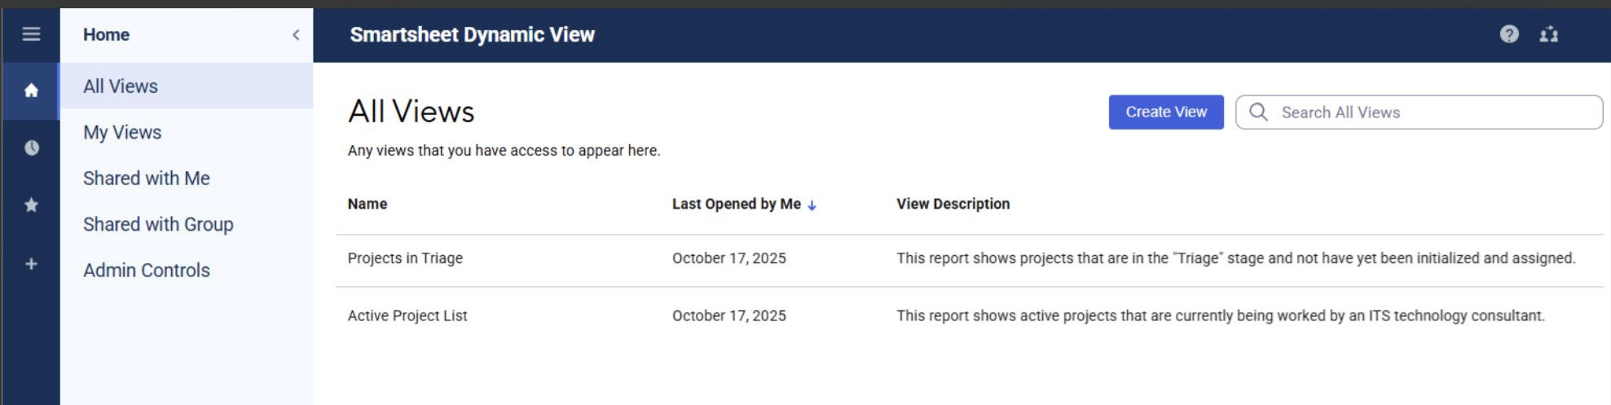
Smartsheet
ITS utilizes “Dynamic View” for agencies to view their submitted projects and project information.
  Project Managers, once determined, will have access to Dynamic View
Use of Smartsheet with ITS does not require a license.
All communication for submitted projects will be done via Smartsheet
www.its.ms.gov

Slide 31
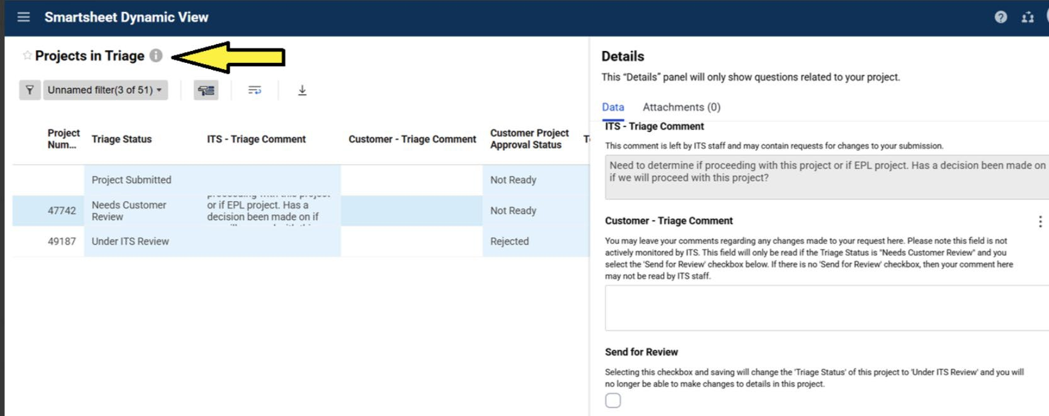
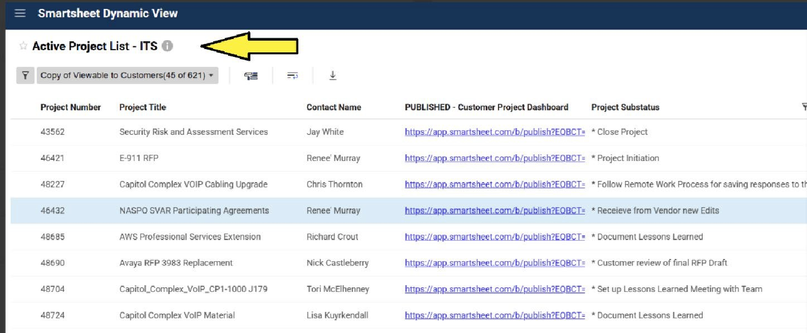
Smartsheet
Projects in Triage – shows the projects that you have submitted, answer questions, and upload documents for ITS review
Active Project List – shows the projects currently assigned and the associated Dashboard
www.its.ms.gov

Slide 32
Planned Purchase
The Planned Purchase Procedure allows an agency to make purchases that exceed the cost “limit” of an Express Procurement Option (EPO).
The Planned Purchase Procedure is limited to:
  Projects in the agency's current technology plan
  Equipment or software appearing on a current EPO
ITS will do a thorough review of the documentation to ensure that the purchaser following the Instructions for Use.
Customer must receive approval from ITS (in the form of an ITS CP-1 Acquisition Approval Form) before making their purchase.
www.its.ms.gov

Slide 33
Competitive Procurement
Utilized for specialized/unique purchases that require public advertised by law.
ITS Project Manager will facilitate the procurement process and will guide agency from beginning to end.
ITS typically uses:
  Project-specific Request for Proposals (full technical review with
public advertisement)
  General RFP and Letter of Configuration (full technical review to a
vendor pool; can shorten timeframe)
  Invitation for Bid (awarded solely on cost)
www.its.ms.gov

Slide 34
Competitive Procurement
Proposal Evaluation and Scoring
Requires open and competitive specifications to ensure maximum competition, to the fullest extent practicable.
Awards to “lowest and best” i.e. cost + technical score
“Best” is determined by compliance of vendor’s proposal
with the technical specifications
ITS is not required to do blind evaluations.
Consensus scoring: ITS + customer team determine one score for each requirement; better representation of a true score rather than a numerical average of evaluator scores.
www.its.ms.gov

Slide 35
Exemption
An agency wishes to conduct their own procurement without ITS – must be granted before an advertisement is issued.
Cannot exempt a Sole Source
All Public Purchasing Laws must be followed.
CP-1 is issued for the estimated dollar amount; if proposals come in higher, agency must request a subsequent CP-1 to increase the authority.
Any resulting protests must be heard by the ITS Executive Director.
An Exemption should also be requested if the agency wishes to issue for Request for Information or Request for Quotes.
www.its.ms.gov

Slide 36
Sole Source
Item is only available from one source.
Purchase > $5,000 requires ITS approval since you cannot get 2 quotes (IHLs are delegated up to $250,000).
ITS reviews agency justification and vendor declaration to conduct research to verify that no other competing product/service exists.
– Product or service being purchase must have unique functionality.
ITS, with customer approval, advertises and publishes a notice giving interested parties a chance to object to the sole source.
ITS advertises on Tuesdays; objections are due two weeks after the first advertisement.
www.its.ms.gov
Procurement Handbook Reference: 013-030

Slide 37
Sole Source
Sole Source Requirements
The product or services being purchased must perform a function
for which no other product or source of services exists.
The purchaser must be able to show specific business objectives
that can be met only through the unique product or services.
The product or services must be available only from the manufacturer and NOT through resellers who could submit competitive pricing for the product or services.
An explanation about why the amount to be expended is reasonable.
An explanation regarding the efforts by the purchaser to obtain the best possible price.
www.its.ms.gov
Procurement Handbook Reference: 013-030

Slide 38
Revision
When a Revision is needed:
A change to an ITS approved procurement is needed:
  CP-1 and/or contract is about to expire
  Vendor name or address change
  Change Order for additional work or functionality
  Add funding
All Amendments and Change Orders of ITS contracts must be signed by the ITS Executive Director.
www.its.ms.gov
Procurement Handbook Reference: 013-030

Slide 39
Emergency
Two types of Emergency requests:
  Type 1 – threaten health, safety, or preservation/protection of property
    Prior approval from ITS is not needed
    Make purchase and submit documents to ITS afterwards
  Type 2 – detrimental to the interests of the State
    ITS must approve prior to a purchase being made
Emergency declaration must be made by your Agency
Head.
The emergency definition applies only to events that could not reasonably have been anticipated
Contracts cannot exceed a one (1) year term.
www.its.ms.gov
Procurement Handbook Reference: 013-030

Slide 40

Brand Specifications
Open and competitive specifications are encouraged.
Requests to issue brand specifications is permitted if allowed by an EPO Instructions for Use and/or approved on a case-by-case basis by ITS for use in a competitive procurement.
Customer presents a valid justification of a compelling business need to issue a solicitation for a specific brand.
Brand must have multiple resellers.
www.its.ms.gov

Slide 41
Contracts
ITS highly suggests contracts for equipment or software maintenance; the decision for a contract is up to the agency.
  ITS may have a Master Agreement or the underlying procurement & proposal may be enough to protect the agency.
  For equipment with no services, the Purchase Order may suffice
If a contract is needed, ITS will:
  Prepare a draft to be included in the procurement for vendors to review before responding to any solicitation.
  Provide experience in technology contracts; agency input and approval of the contract is crucial.
  Lead the negotiations with the awarded vendor
ITS has in-house General Counsel for negotiations.
www.its.ms.gov

Slide 42
Contracts
The ITS Executive Director acts as Contracting Agent
  Signs all technology contracts “on behalf of”
  Customer agency signature is at agency’s option
  Has the authority to limit a vendor’s liability when deemed to afford the State reasonable protection
Customer signs acceptance of contract
  ITS Executive Director, as Contracting Agent, must be party to
amendments, change orders, terminations, or other contract actions
  Agency is responsible for contractual obligations, financial, and other
  Agency responsible for day-to-day management of project and business decisions
www.its.ms.gov

Slide 43
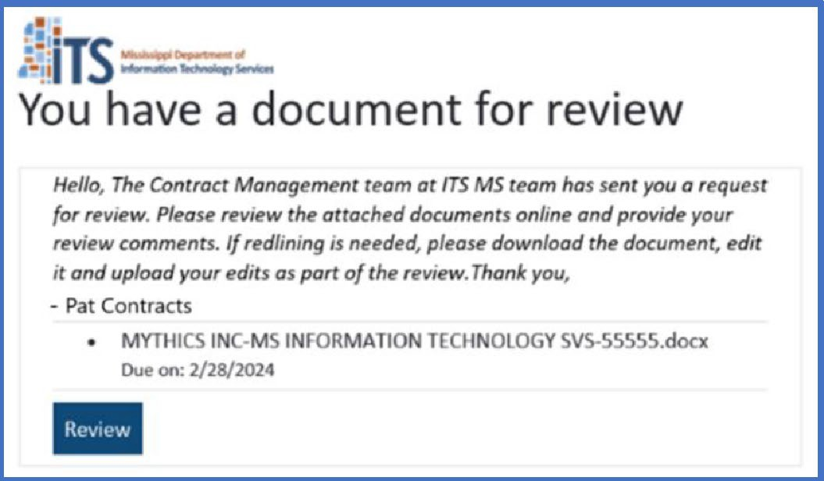
DocuSign
ITS utilizes DocuSign CLM for the review, negotiation, and signature process for contracts.
You do not need a DocuSign license to review an ITS contract.
Contracts can be downloaded, edited, and re-uploaded to send back to ITS.
Contracts can be reassigned to someone else for review and/or signature.
www.its.ms.gov

Slide 44
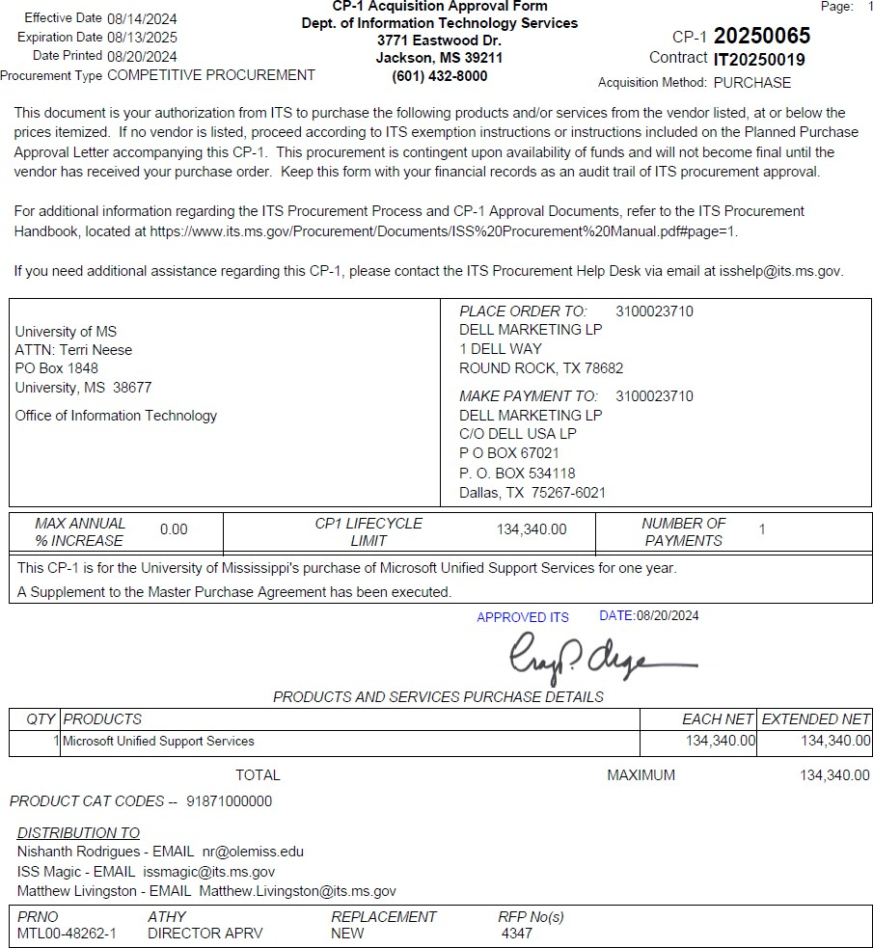
Final Steps
ITS will issue a CP-1, sent to you via e-mail, documenting the product being purchased, the amount, and timeframe. This document is the form used to notify the agency that ITS has approved the request for purchase.
ITS will create a MAGIC Contract on behalf of your agency for you to issue Purchase Orders and render payments.
The CP-1 will indicate that a contract, if applicable, is executed and ITS will upload the contract to Transparency via MAGIC.
www.its.ms.gov

Slide 45
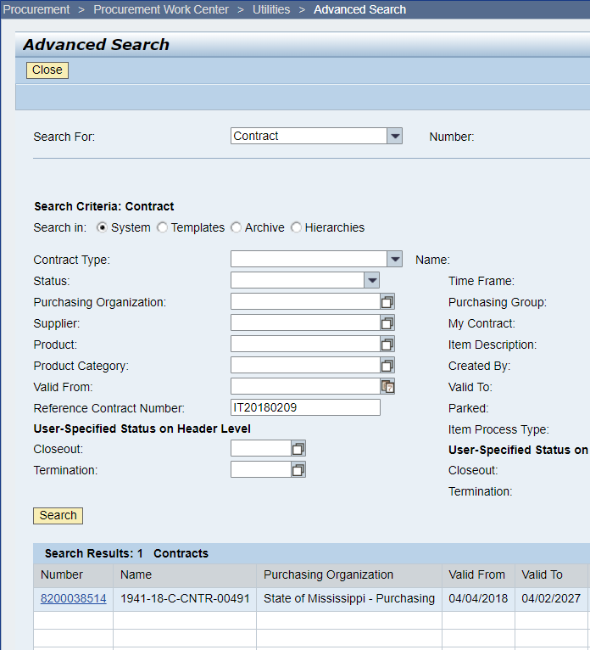
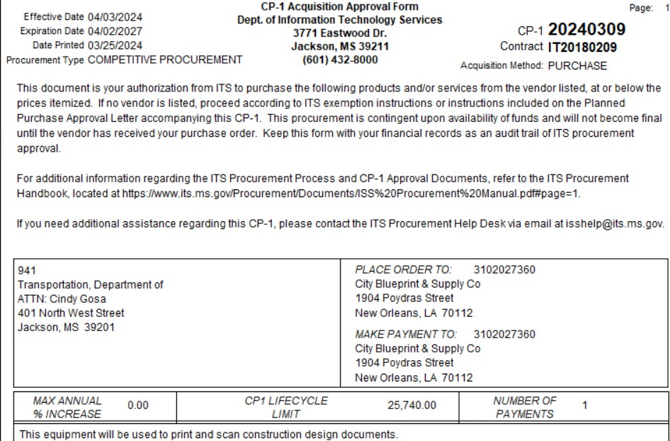
CP1 and MAGIC
If you are unsure of your MAGIC Contract Number, you can search MAGIC using the IT Contract Number in the top right of your CP1.
www.its.ms.gov

Slide 46
ITS Procurement Contacts
Renee Murray
Procurement Service Director
(601) 432-8072
Renee.Murray@its.ms.gov
Michelle Walker
Procurement Process Specialist
(601) 432-8057
Michelle.Walker@its.ms.gov
Alec Shedd Procurement Manager (601) 432-8162
Alec.Shedd@its.ms.gov
Robert Martinez
Quick Turn-Around Team Leader
(601) 432-8002
Robert.Martinez@its.ms.gov
Khelli Reed
Solicitation Team Leader
(601) 432-8194
Khelli.Reed@its.ms.gov
Kim White
Procurement Administration Team Leader
(601) 432-8211
Kim.White@its.ms.gov
www.its.ms.gov

Slide 47
Additional ITS Contacts
EPL Team E-mail
eplteam@its.ms.gov
ITS Website
www.its.ms.gov
Procurement User Group
https://mailman.ms.gov/mailman/listinfo/pug
Procurement Help Desk
isshelp@its.ms.gov
ITS Service Desk
Service.Center@its.ms.gov
ITS Telecom Request
Telecom.Request@its.ms.gov
www.its.ms.gov

