Slide 1

Bureau of Purchasing and Contracting

Slide 2
Ashley Smith
Alcorn State
Arts Commission
Boswell Regional Center
Contractors Board
Cosmetology Board
Examiners Licensure Board
Grand Gulf Military
Jackson State University
Motor Vehicle Commission
MS Dept. of Banking and Consumer Finance
MS Specialized Treatment Facility
Office of The State Auditor
Registration Of Pro ENG
Senate
Status of Women
Tombigbee
University of Mississippi
Veterans Home Purchase Board
Wildlife, Fisheries and Parks
James Brabston
Attorney General
Auctioneer Commission
Board of Nursing Home Administrators
Board of Public Accountancy
Central MS Residential Center
Charter School Authorizer Board
Department of Health
Department of Human Services
Ellisville State School
IHL Board
LBO
Legislative Joint Operations
Military
MS Dept. of Corrections
MS Development Authority
MS Funeral Services Board
Public Service Commission
Soil and Water
State Road Aid
University of MS Medical Center
Veterans Affairs Board
Yellow Creek
Shakrita Fields
Appraiser Licensure
Board of Dental Examiners
Board of Registered Professional Geologists
East MS State Hospital
Ethics
Library Commission
Marine Resources
Medicaid
MS Dept. of Archives and History
MS Dept. of Education
MS Dept. of Finance and Administration
MS Gaming Commission
MS State Personnel Board
MS Valley State University
Supreme Court
Transportation
University Press
LaShun Smith
Adolescent Center of MS
Board of Chiropractic Examiners
Board of Psychology
Bureau of Narcotics
Capital Past Conviction
Delta State University
Dept. Of Agriculture and Commerce
Dept. Of Environmental Quality
Judicial Performance
MS Coast Col
MS Department of Public Safety
MS Port Authority
MS State Hospital
MS State Oil and Gas Board
Physical Therapy
Real Estate Comm
Rehab Services
South MS Regional Center
State Public Defender
University of Southern Mississippi
Workers Comp
Kizzie Shorter
Easter Haimur
Architecture Board
Athletic Commission
Board of Animal Health
Ellisville School District
Gulf Coast Research USM
House of Representative
Insurance
ITS
Massage Therapy
Mental Health
MS Dept of Employment Security
MS Forestry Commission
MS State Hospital
MS State University
PEER
Registered Foresters Board
Revenue
Tax Appeals
Board of Barber Examiners
Board of Pharmacy
Child Protective Services
Community College Board
Examiners for Social Workers
Fire Academy
Hudspeth
Joint Legislative Reapp
Medical Licensure
MEMA
MS University for Women
North MS Regional Medical Center
Nursing Board
Pearl River Valley Water
Public Broadcasting
Public Employees Retirement System
Sec of State
Veterinary Medicine
Volunteer Services Commission

Slide 3
Mississippi Purchasing Process
Define Need
Identify the Need
Develop Requirements
Select Method
Open Market
Proposals
Solicitation
Reverse Auction/Competitive Bids
Transmit Requirements
Receive Submission
Check Surplus
State Contract
Bids
Receive Offers
Receive Bids
Evaluate and Award
Inspect and Accept
Contract Admin
Payment
Disposal
Look for Best Value
Select a Vendor
Execute a Contract
Issue Purchase Order
Receive Goods
Verify Content and Condition
Determine if Item(s) is Fixed Asset
Monitor Vendor Performance
Modify Contract if Necessary
Issue Warrant for Payment
Dispose of Item (s)
Surplus Property
Transfer to Other Agency

Slide 4
Method of Source Selection
Authority to Make Small Purchases $5,000.00 or Less
State Contract
Sole-Source Procurements
Emergency Procurements
Competitive Sealed Bids
Reverse Auctions
Traditional sealed bids

Slide 5
Purchases $5,000.00 and below
Check competitive state contract for item
Purchases may be made on open market. Purchasing agent will obtain pricing from multiple sources to ensure competition, quotes are not required
Purchase requisitions and purchase orders must be prepared and approved prior to making the purchase
Total cost must be used; items cannot be split up to avoid obtaining quotes or bids
Notes:
Encourage use of P-card for non-equipment items

Slide 6
Utilizing State Contracts

Slide 7
Types of Contracts
Competitive Contracts
Negotiated Contracts (Convenience)
State Agency Contracts
Cooperative Contracts

Slide 8
Competitive Bid Contracts
What items are they used for? Examples – office supplies, toner cartridges, office papers
How are they Developed? Competitive sealed bids
Who can use them? Governing authorities and state agencies
Who must use them? State agencies

Slide 9
Negotiated Contracts
(Convenience/Multiple Award Contracts)
What items are they used for? Examples – automotive parts, copiers, furniture, janitorial products
How are they Developed? Proposals from many vendors
Who can use them? Agencies and governing authorities
These are convenience contracts that are there for the buyers to utilize and users should negotiate the best possible price

Slide 10
Statewide Agency Contracts
What items are they used for? Asphalt, motor graders, paint striping machine, Sand and Gravel
How are they developed? Competitive bids by a specific agency
Who can use them? Agencies and governing authorities if permitted in the original bid.

Slide 11
Cooperative Contracts
What items are they used for? Floor covering, medical supplies, building supplies, pharmaceuticals
How are they developed? Cooperative contracts are procurements conducted by, or on behalf of, more than one public procurement unit, or by a public procurement unit with an external procurement activity
Who can use them? Agencies and governing authorities only when adopted by OPTFM
The only Cooperative Contracts allowed for use in the State of Mississippi by State Agencies and Governing Authorities are the ones that are adopted by OPTFM.
Notes:
.

Slide 12
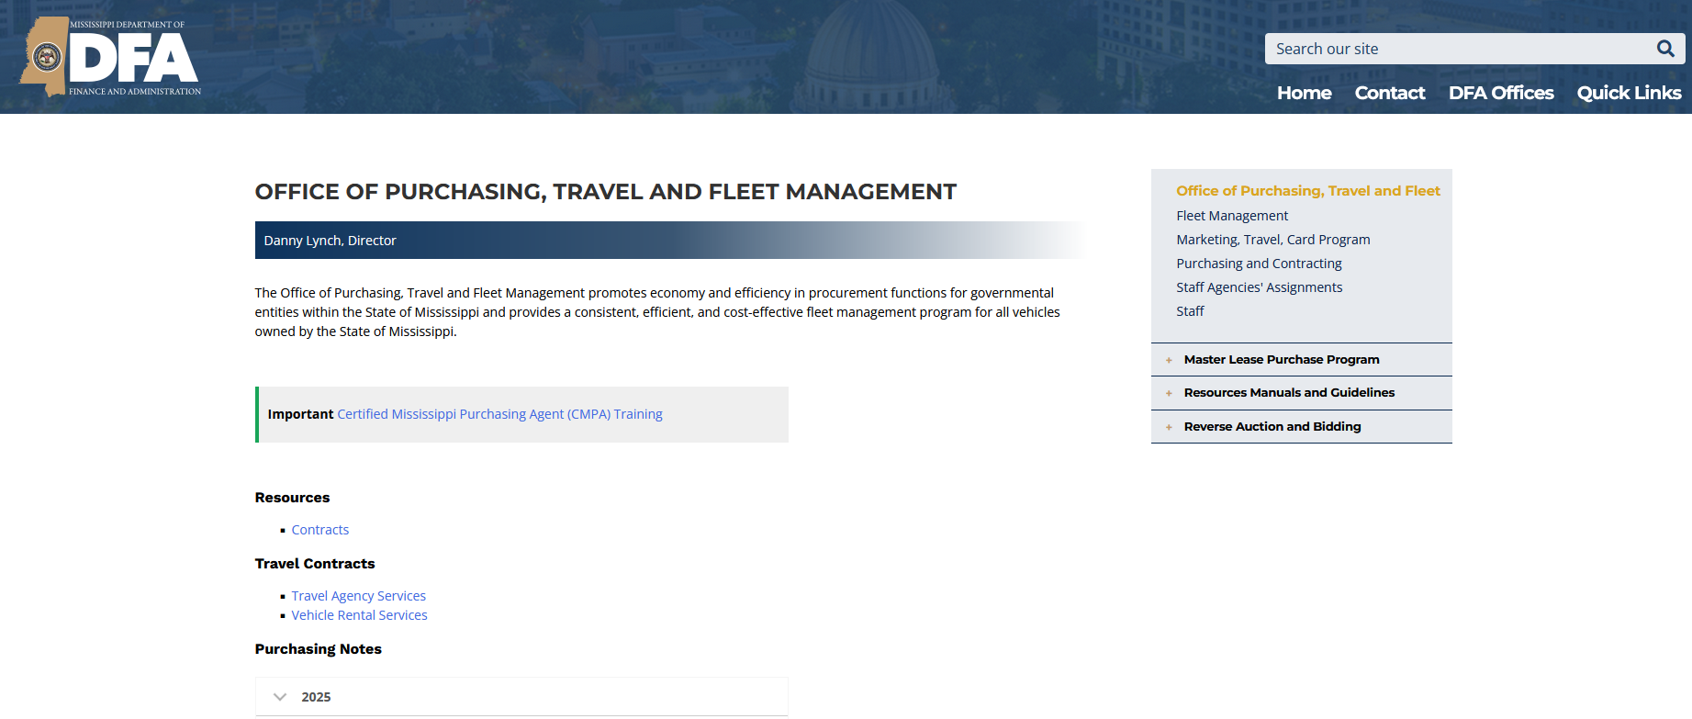
Locating State Contract Items

Slide 13
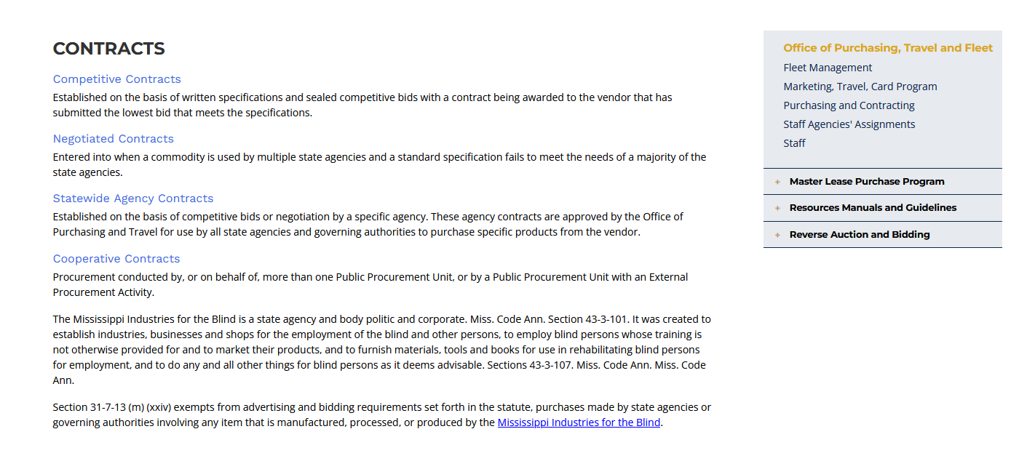
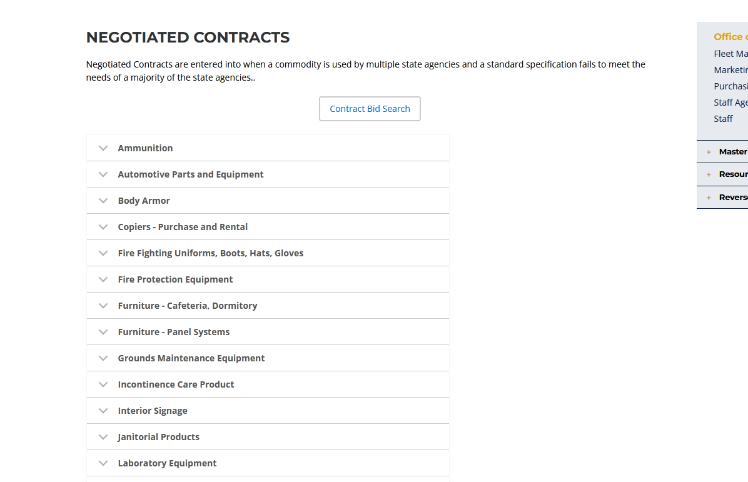
Contract Category List

Slide 14
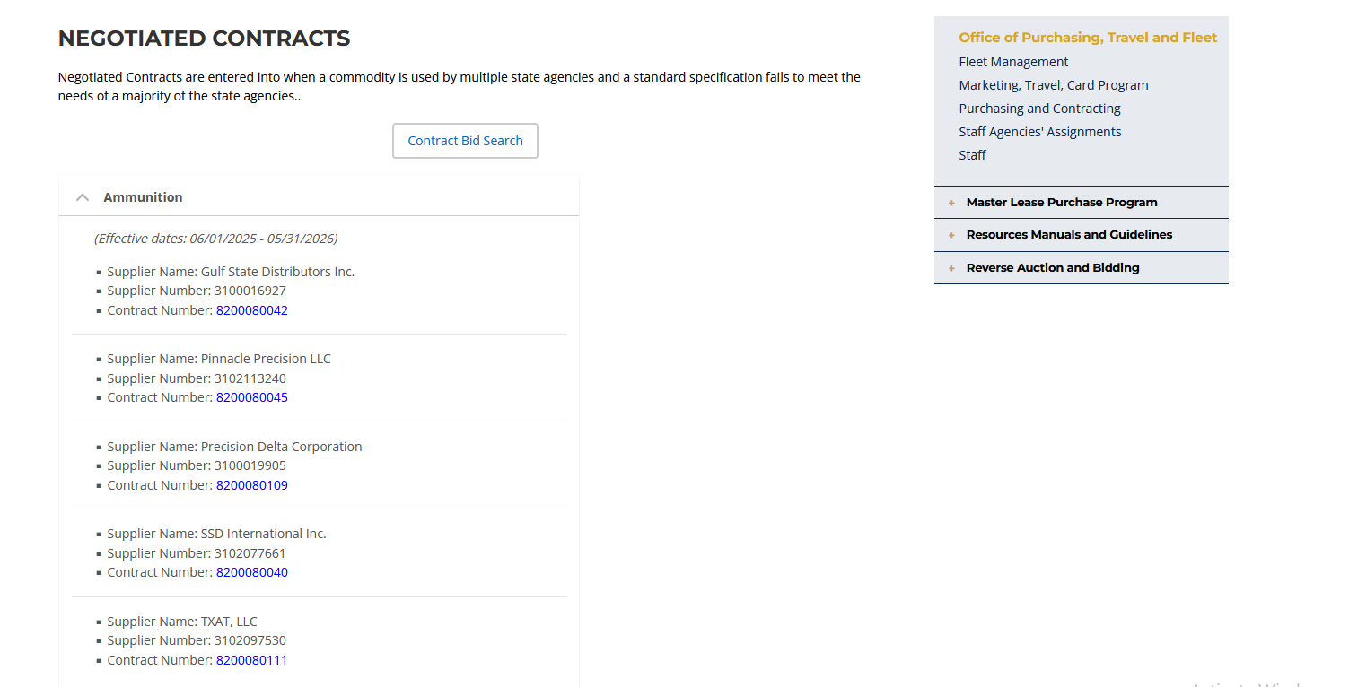
Category Selection

Slide 15
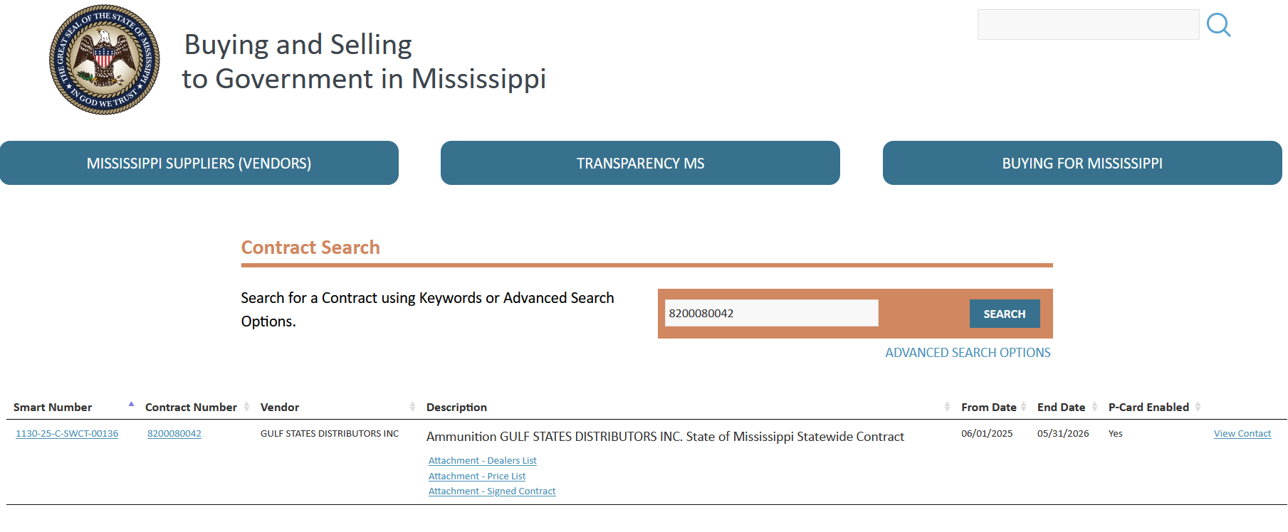
Contract Search

Slide 16
Sole Source and Emergency Procurements

Slide 17
Sole Source Procurements
Sole-source procurement is not permissible unless a requirement is available from only a single supplier. A requirement for a particular proprietary item does not justify sole-source procurement if there is more than one potential bidder or offeror for that item. The following are examples of circumstances which could necessitate sole-source procurement:
(1) Where the compatibility of equipment, accessories, or replacement parts is the paramount consideration (and manufacturer is sole supplier).
(2) Where a sole supplier's item is needed for trial use or testing.
(3) Where a sole supplier's item is to be required when no other item will serve the need of the user entity

Slide 18
Sole Source Procurements
Sole Source Procurements must be submitted to OPTFM for approval. Along with your P-1, you will need
Sole Source Determination Form
Valid Quote from Vendor
Justification Letter
Certificate of Publication
Objections

Slide 19
Emergency Procurements
“Emergency" - any circumstances caused by fire, flood, explosion, storm, earthquake, epidemic, riot, insurrection, or caused by any inherent defect due to defective construction, or when the immediate preservation of order or public health is necessary by reason of unforeseen emergency, or when the restoration of a condition of usefulness of any public building, equipment, road or bridge appears advisable, or in the case of a public utility when there is a failure of any machine or other thing used and useful in the generation, production or distribution of electricity, water or natural gas or in the transportation or treatment of sewage; or when the delay incident to obtaining competitive bids could cause adverse impact upon the governing authorities or agency, its employees or its citizens.
Emergency procurement shall be limited in scope to those supplies, services, or construction items necessary to meet the emergency and limited in term to the time necessary to meet the emergency; however in no event shall any emergency contract exceed a term of one (1) year.

Slide 20
Type 1 Emergencies
These do not require prior approval from OPTFM.
If such emergency threatens the health or safety of any person, or the preservation or protection of property, then the provisions of competitive bidding shall not apply. Any officer or agent of the agency having general or specific authority for making the purchase or repair contract shall approve the bill presented for payment.
Along with your P-1, you will need a quote from the vendor and a letter from the agency head, on agency letterhead.

Slide 21
Type 2 Emergencies
If the governing board or the executive head, or his designees, of any agency of the state shall determine that an emergency exists in regard to the purchase of any commodities or repair contracts, so that the delay incident to giving opportunity for competitive bidding would be detrimental to the interests of the state, then the head of such agency, or his designees, shall seek approval of the Office of Purchasing, Travel and Fleet Management using the electronic P-1 process.
These require prior approval from DFA. Along with your P-1, you will need a quote from the vendor and a letter from the agency head, on agency letterhead. This letter will be signed and approved by DFA’s executive director before the P-1 can be approved.

Slide 22
Competitive Purchases

Slide 23
Purchases between $5,000.00 & $75,000.00
Small purchases costing more than $5,000 but not more than $75,000 require quotes from two or more businesses.
Quotes
A quote submitted on a bid form or a bid submitted on a vendor’s letterhead or identifiable bid form and signed by authorized personnel representing the vendor.
This does not require an advertisement

Slide 24
Awarding Competitive Quote Between $5,000 and $75,000.00
Award shall be made to the lowest and best responsive quote provided at least two competitive quotes have been obtained.
Total cost must be used; items cannot be split up to avoid advertising for formal bids.
Purchase orders must be prepared and approved by OPTFM.

Slide 25
Competitive Bids over $75,000.00
Approval prior to award must be submitted to OPTFM on electronic P-1
All procurement manual rules and regulations must be followed
Reverse Auctions are the primary method
State agencies utilize MAGIC to perform auctions
Electronic bidding must be provided
“secure electronic interactive system” – MAGIC
Cannot require vendors to submit electronically
Awards should only be made as described in specifications
Advertisement must be done correctly
MMPTAP (MS Apex Accelerator) must be notified Reverse Auctions
MAGIC does this automatically

Slide 26
Competitive Bids over $500,000.00
Approval prior to award must be submitted to OPTFM on electronic P-1
All procurement manual rules and regulations must be followed
Reverse Auctions are the primary method
State agencies utilize MAGIC to perform auctions
Electronic bidding must be provided
“secure electronic interactive system” – MAGIC
Cannot require vendors to submit electronically
Awards should only be made as described in specifications
Advertisement must be done correctly
MMPTAP (MS Apex Accelerator) must be notified Reverse Auctions
MAGIC does this automatically
PPRB MUST APPROVE

Slide 27
Commodity Threshold Requirements
 | Open Market Purchase | 2 Quotes from Vendor | State Contract | Competitive Bid (Reverse Auction) | PPRB
$0.00 - $5,000 | X |  | X
Over $5,000.00 - $75,000 |  | X | X
Over $75,000.00 |  |  | X | X
Over $500,000.00 |  |  | X | X | X

Slide 28
COMMODITY ADVERTISING REQUIREMENTS
Published once each week for two consecutive weeks with the second notice being published on or after the 7th calendar date after the first notice was published
Opening date must not be less than seven (7) working days after the last notice in the newspaper (must not be sooner than the 8th day)
MPTAP (MS Apex Accelerator) must receive notice same day or prior to first publication in the paper

Slide 29
EXEMPTIONS FROM BID REQUIREMENTS
(1) Transactions listed in Section 31-7-13(m), Mississippi Code of 1972, Annotated
(2) Transfer, sale, or exchange of personal property between state agencies or between state agencies and governing authorities - (For transfer, sale or exchange of vehicles, see State Fleet Manual)
(3) Service contracts provided by businesses or persons which do not include the acquisition of a commodity or equipment and which are under the purview of the Office of Personal Service Contract Review
(4) Transportation of items (freight charges) - This exemption shall not apply to the travel contracts established by the Office of Purchasing, Travel and Fleet Management.
(5) Postage
(6) Workers Compensation Insurance and Personnel Bond required by law
(7) Utilities
(8) Commodities purchased for resale
(9) Highway right-of-way and highway construction contracts governed by specific laws dealing with such contracts
(10) Food and lodging reimbursable on a travel voucher
(11) Maintenance contracts under the purview of the Department of Information Technology Services or the Office of Personal Service Contract Review
(12) Live animals
(13) Textbooks
(14) Library books and other reference materials purchased by or for libraries
(15) Purchases of original artwork and artifacts by museums for public display
(16) Purchases of original artwork (paintings, statues, sculptures, etc.) for public display
(17) Subscriptions
(18) Purchases made from state operated industries such as Mississippi Industries for the Blind

Slide 30
Public Procurement Review Boared Required Approvals
Types of purchases requiring approval
Exemptions from Reverse Auction
Purchases made as the result of alternative process after exemption is granted
Purchases greater than $500,000

Slide 31
PPRB Agenda Item Deadline
P-1 requests must be submitted to OPTFM by the published deadline.
Deadlines for PPRB agenda items are on the prior meeting date.
Agencies must have a representative on the phone if you have submitted a P-1 for the previous month regardless if it has an agenda item or not.

Slide 32

P-1s

Slide 33
Different types of P-1’s
OREQ- Oversight Request
Multiple awards from a single bid solicitation (RFx)
Trade-in of Equipment with Purchase
Exemption from procuring state contract items
SOLC- Sole Source Purchase Order
All Sole Source awards
CNTR- Purchasing General
Single award from a bid solicitation (RFx)
Copier/mailing equipment rental agreements
EMEC- Emergency Contract
EMER (PO) – Emergency Purchase Order

Slide 34
Documentation Needed
OREQ- Oversight Request or CNTR- Purchasing General
Proof of Advertisement
Specifications
Bid Tabulation Sheet
Lowest Bidder Proposal
Winning Bid Submission
Signed Contract
SOLC- Sole Source Contract or PO
Sole Source Determination Form
Valid Quote from Vendor
Justification Letter
Certificate of Publication
Any Objections
EMEC- Emergency Contract or PO
Valid Quote from Vendor
Justification Letter

Slide 35
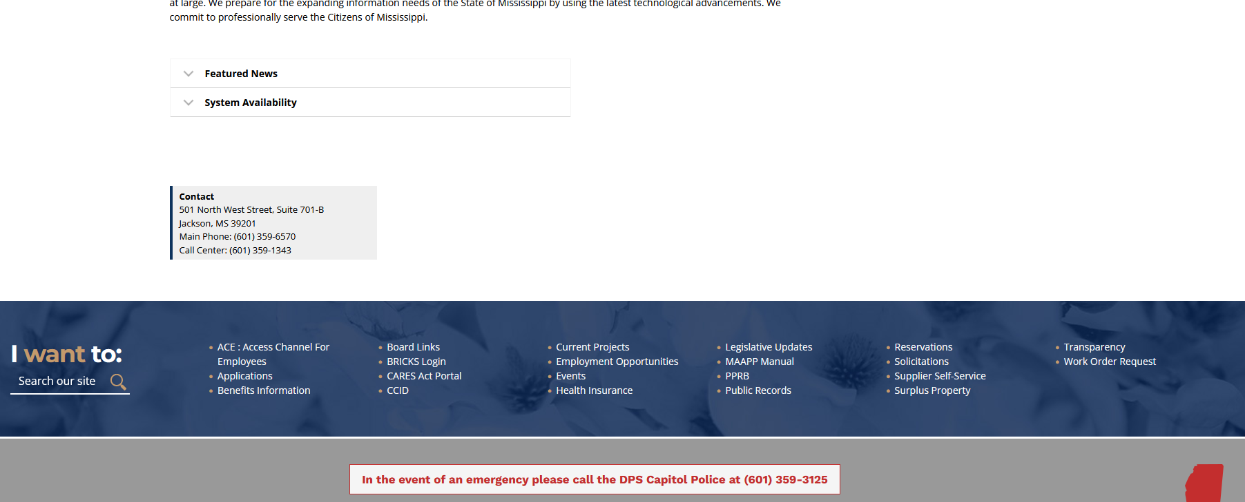
Vendor Registration
How to get a vendor registered with the State of Mississippi
Direct vendors to DFA’s website
Notes:
When vendors call and ask how they can do business with the State of MS, send them to OPTFMs website
Also tell them to make sure that they are not already registered. If they are, they need to modify their existing profile, not create a new one!

Slide 36
Thank you!!

