Slide 1

State of Mississippi
Procurement Card Program
OFFICE OF PURCHASING, TRAVEL & FLEET MANAGEMENT

Slide 2
Procurement Card Staff
Candice Hay
Procurement Card Administrator
Office of Purchasing, Travel and Fleet Management
601-359-5099
Candice.hay@dfa.ms.gov
Demetra Hayes
Travel Coordinator
Office of Purchasing, Travel and Fleet Management
601-359-3912
demetra.hayes@dfa.ms.gov
Yolanda Thurman, Director
Marketing, Travel and Card Programs
Office of Purchasing, Travel and Fleet Management
601-359-2016
Yolanda.thurman@dfa.ms.gov
Niki Hobkirk
Contract Analyst
Office of Purchasing,Travel and Fleet Management
601-359-9373
Niki.Hobkirk@dfa.ms.gov

Slide 3
Procurement Card Staff
Continued
Tiffany Frazier
Contract Analyst
Office of Purchasing, Travel and Fleet Management
601-359-5041
Tiffany.Frazier@dfa.ms.gov

Slide 4


QUIZ TIME!!

Slide 5

What is a P-Card?
The Procurement Card Program is a Small Purchasing Card, that can be used to replace the traditional method of purchasing goods & services for your entity.
Purchase
Orders
0%

Slide 6
BENEFITS OF THE P-CARD
*Replaces the traditional purchasing method of requisition, purchase order, delivery, invoicing, check disbursement and storage.
*Reduction in issuing small dollar PO’s
*Reduces time spent processing large number of requisitions
*Increase in processing efficiency
*Increase in purchasing flexibility
*Improve customer service
*Suppliers benefit from prompt payment
*Fewer duplicated invoices

Slide 7
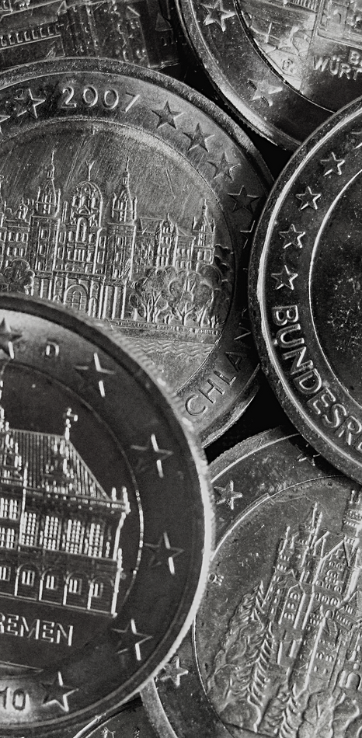
FUN FACT
$50-$1000
According to the ChatGPT (The Center for Advanced Procurement Systems ) CAPS they estimated this what it could cost to cut a PO from Procurement2Payment process.

Slide 8
USES FOR P-CARD FOR....
*Conference Registrations
*Food for traveling students with teachers & coaches
*Memberships
*Software, provided you are not signing a Licensing Agreement
*Box Truck Rentals to move equipment (not while in Travel Status)
*Freight/Shipping Charges
*Postage/Post Office Box Rental Subscriptions/Publications Reprints
*Advertising
*Space Rental at Conferences/Conventions/Hotels
*Charter Buses – for group tours/university trips including the reservation

Slide 9


Prohibited Purchases
Fuel
Gifts
Generators
Entertainment
Motorized vehicles
Alcoholic beverages
Cash Advancements
Reoccurring Monthly Charges
Items on back order
Items for personal use
Travel related expenses
Camera and Camera Equipment (greater than $250)
Televisions (greater than $250)
Radioactive, Explosive, or other Hazardous material
Contractual Services to an Individual, Sole Proprietor, Partnership or LLC-Partnership
Computer and Computer equipment (greater than $250) (central processing unit, terminal, printer, external hard drive)

Slide 10

Did you get a...
100%

Slide 11
Program Coordinator Responsibilites
Establish internal procedures consistent with the guidelines/policies
Identify cardholders authorized to purchase on behalf of the agency/department
Set single transaction limits and over all monthly credit limits for cardholders
Approve, copy, and submit completed applications/forms to OPTFM
Conduct orientation/training session of authorized cardholders and provide cardholders with information concerning the procurement card program and state purchasing laws
Responsible for distribution of pertinent information to agency/department staff
Communicate with Program Administrator for any updates to the cards that need to be made

Slide 12
Cardholder Responsibilites
SIGN CARDHOLDER AGREEMENT
GET ITEMIZED RECEIPTS FOR ALL YOUR PURCHASES
RECONCILE YOUR OWN MONTHLY STATEMENTS
KEEP YOUR CARD IN A SAFE PLACE
FOLLOW YOUR PROGRAM COORDINATORS INSTRUCTIONS
DO YOUR DUE DILLEGENCE ON PRICING
COMMUNICATE!!

Slide 13
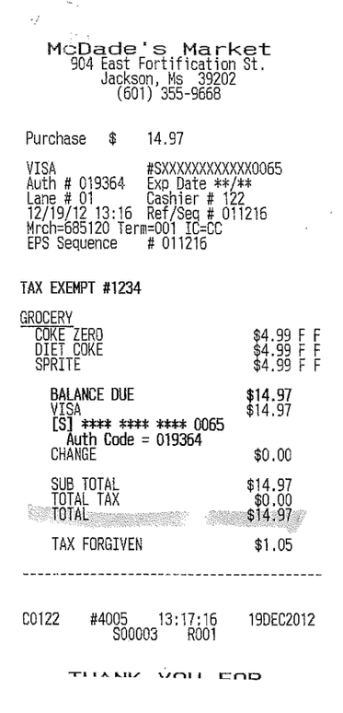
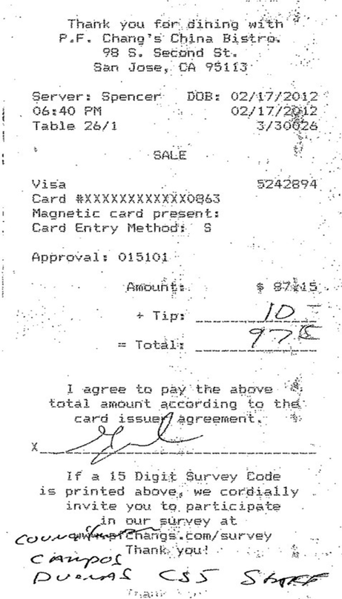
Good vs. Bad Receipts

Slide 14

If a receipt cannot be obtained, complete a Missing Document Affidavit Form. This form is located on the OPTFM website

Slide 15


Food Purchases on the P-Card
Food may be purchased in restaurants, grocery stores or any location where food is sold
Food purchases for business meetings may be purchasedon the procurement card provided the following requirements aremet
◦An agenda is needed
◦The purchase of food must serve a legitimate business purpose
◦More than one person must be present for the purchase of food
◦No alcohol may be purchased
◦Any gratuity over 20% requires a written
◦Food Form located on the OPTFM website

Slide 16

!
Taxes
State of Mississippi Sales Tax should not be charged to the procurement card
Internet & Out-of-State purchases are exempt from the sales tax rule
It is the responsibility of card user to inform the vendor of tax exempt status
If taxes are charge, cardholder should attempt to obtain a credit
If no credit is obtained, cardholder must submit payment to their entity for total tax amount for that transaction on which taxes were applied

Slide 17
Surcharges
Surcharge is when a vendor charges an extra fee for using a credit card as a form of payment instead of cash
MS Code Section 31-7-9 (1)(d) prohibits a vendor form imposing a surcharge of State of MS P-Card
If a surcharge is assessed cardholder should do ask vendor for a credit

Slide 18

*No hotel charges are allowed on the P-card for State of Mississippi employees
The only hotel charges allowed on the P-card are for the following:
-Visitors of the State
-For conference rooms/meeting spaces within the hotel

Slide 19


Split Purchases
The maximum amount for a P-card purchase is $5000
Split purchases is taking one purchase totaling more than $5000
and dividing it into several purchases to circumvent the $5000
limit
Purchases over $5000 must be on a purchase order and requires two written quotes
Subheading

Slide 20
Program Reviews
REVIEWS ARE CONDUCTED TO ENSURE THAT
CARDHOLDERS ARE UTILIZING THE PROGRAM
CORRECTLY
ENTITIES WILL RECEIVE A NOTICE FROM OPTFM NOTIFYING THE PROGRAM COORDINATOR OF WHICH ACCOUNTS WILL BE REVIEW AS WELL AS THE TIME FRAME TO HAVE ALL RECEIPTS AND STATEMENTS SUBMITTED
IF ANY INCONSISTENCIES OR FINDINGS ARE NOTED DURING YOUR REVIEW THE ENTITY IS REQUIRED TO:
SUBMIT ANY DEPARTMENT MEMOS TO ANSWER ANY QUESTIONS
SUBMIT A PLAN ON HOW THE ERRORS WILL BE CORRECTED IN THE FUTURE
SUBMIT PROOF SHOWING CARDHOLDER HAS REIMBURSED ENTITY FOR ANY TAXES, SURCHARGES OR UNAPPROVED EXPENSES
COMPLETE ADDITIONAL PROGRAM TRAINING IF REQUESTED
SURRENDER CARD IF NECESSARY

Slide 21
Balances on
Accounts
Balances should not be carried over month to month
Balances on the p-card should be paid at the receipt of each monthly statement
Per Section 31-7-305, MS Procurement Manual, amounts unpaid can incur interest and late fees from the credit card vendor

Slide 22

Rebates
REBATES ARE ISSUED TO ALL PARTICIPANTS IN THE
STATE P-CARD/TRAVEL PROGRAM
THEY ARE BASED ON THE OVERALL SPEND OF THE ENTITY AND THE AMOUNT OF TIME IT TAKES FOR THE ENTITY TO PAY THEIR BILLS.
THE MORE YOU USE THE CARDS THE HIGHER THE
REBATE

Slide 23

How can I get a State of MS P-Card

Slide 24


Go to www.dfa.ms.gov
Then click DFA Offices>Purchasing Travel & Fleet Management>Marketing, Travel & Card Programs>Procurement Card Services>Forms

Slide 25


Forms You Need...
P-Card Checklist for Existing & New Entity
Agency Invite and Managing Account Information
P-Card Cardholder Spreadsheet
Cardholder Agreement
Program Coordinator Setup/Maintenance Form

Slide 26
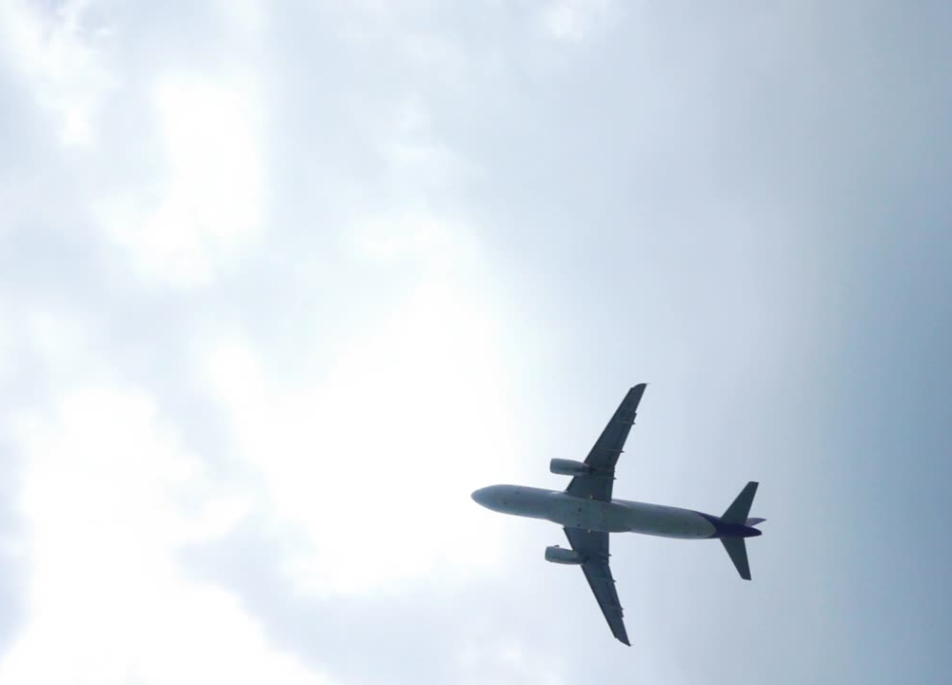
STATE OF
MISSISSIPPI
TRAVEL CARD PROGRAM
Business Travel the Smart Way
SKINCARE
BEAUTY
FITNESS

Slide 27

TYPES OF TRAVEL CARDS
GHOST
Only available for Travel Cards
Departmental
Multiple Approved Users
Program Coordinator or Assigned Designee is responsible for the card
Individual
Only assigned individuals allowed to use card

Slide 28

AUTHORIZED TRAVEL EXPENSES
Airfare
Registration Fees
Lodging (room only, no incidental expenses allowed)
Rental Vehicles
Taxi’s
Shuttles
Fuel for rental vehicles
◦Note: Dates of fuel shall match the time period in which a vehicle was rented for payment of this expense. Fuel is considered an unauthorized expense when purchased for personal vehicles, fleet vehicles, etc.)
Tolls
Parking
Business Related Internet Service

Slide 29
UNATHORIZED EXPENSES
Travel expenses for non-entity employees on the individual or department card.
Business Related Airfare Combined with Personal Airfare
Fuel for any other type vehicle than a rental, such as personal vehicles, fleet vehicles, etc.) as outlined in Section 110 of the Travel Manual.
Authorized Expenses
Cash Advances
First Class and Business Class Travel
◦Note: Preferred seating, business, first-class service may be authorized if at least one of the flight segments exceeds 6 hours. A flight segment is defined as time in the air between layovers, changing aircraft, or change of airline. Preferred seating, business or first-class travel is not reimbursable unless approved in advance. A waiver signed by the entity head (or his designee) must be submitted and approved by OPT prior to the trip.

Slide 30
UNATHORIZED EXPENSES CONT’D
Travel expenses for traveling companions or spouses
Food and beverages
Personal Items
Laundry
Personal Calls
Any purchase for which the entity does not receive direct benefit
Unauthorized Hotel Incidentals
Movies
Meals
Alcohol
Room Service
Any non-lodging expense

Slide 31

CREDIT CARD AUTHORIZATIONS
When using the travel card for lodging, the Program Coordinator must contact the hotel to inquire if the hotel has a Credit Card Authorization Form that can be completed in advance
The card does not have to be presented upon arrival if this form is completed and submitted to the hotel prior to travel
The hotel may require that a faxed copy of the travel card be sent
No personal expenses can be charged to any account in this travel account program
Incidentals Security Holds are to be done with a personal card

Slide 32

Want One?

Slide 33

Go to www.dfa.ms.gov
Then click DFA Offices> Purchasing, Travel & Fleet Managment>Marketing, Travel & Card Programs> Travel

Slide 34
Forms You Need...
Travel Checklist for Existing & New Entity
Agency Invite and Managing Account Information
Travel Cardholder Spreadsheet
Cardholder Agreement
Program Coordinator Setup/Maintenance Form

Slide 35
Thank You
For Your Time!

