Slide 1

MISSISSIPPI PURCHASING CERTIFICATION PROGRAM
Certified Mississippi Purchasing Agent (CMPA)

Slide 2
Introduction/General Information
Agenda
Housekeeping Reminders
  Cell Phones
  Lunch and Breaks
  Restrooms
Test
Be Engaged!!
Notes:
Agenda
Housekeeping Reminders
Computer Usage
Log in information is on the board to your right
Remember to turn off cpus, monitors, keyboards, and your mouse at the end of each day
Cell Phones
Food and Beverages
Please put a lid on all open cups/glasses
Lunch and Breaks
Test
Multiple choice
Questions that we don’t cover in class are on test
You should have read the procurement manual by now and that is the source for all questions on the test
Be Engaged!!

Slide 3
ICE BREAKER!!!
Name
Agency
Years in Procurement
Procurement Duties

Slide 4
Mississippi Procurement Organization
Information Technology Services Board (ITSB)
Public Procurement Review Board (PPRB)
Mississippi Department of Information Technology Services (ITS)
Mississippi Department of Finance and Administration (DFA)
Procurement Services
OPTFM
OPSCR
BOB
RPM
Notes:
The 3 main procurement organizations that CMPA training will cover will include: OPTFM, PSCRB & ITS
DISCUSS IN DEPTH WHO PPRB IS? They set rules and regulations
We will hear from ITS on Wednesday and they will discuss how their Board works along with their rules/regs
PSCRB will also be here tomorrow to discuss their information
My main focus will be on DFA – primary agency responsible for State government financial and administrative operations including employee payroll, vendor payments, employee insurance, construction, maintenance, and protection of State buildings in the Capitol Complex, financial information management systems, management of the State’s vehicle fleet, and numerous other related activities. DFA is composed of eighteen (18) offices with a total staff of approximately 400 employees.
PPRB – approves all purchasing regulations for commodities over $500,000 (construction over $5m, master lease acquisitions, and cancellation of MDOC contracts on minutes)
What you need to remember is – (1) purchases over commodities over $500,000 (2) that they meet the first Wednesday of every month and (3) that you need an item on the Agenda, it must be submitted to OPT no later than noon on the third Thursday prior to the first Wednesday.

Slide 5

Composition of PPRB eff. 1/1/18
DFA Executive Director, ex officio & Nonvoting Member
3 appointees by the Governor
2 appointees by the Lieutenant Governor
Staggered Terms
Chair, Rita Wray(elected)
Duties include approving contracts for commodities, construction, personal and professional services, leases, professional A/E appointments, Master Lease Purchase acquisition schedules, regulations promulgated by DFA offices, deviations from regulations, and hearing protests.
Notes:
*Mississippi Code Annotated § 27-104-7 (1) provides that the PPRB is to be composed of the three (3) individuals appointed by the Governor with the advice and consent of the Senate; two (2) individuals appointed by the Lieutenant Governor with the advice and consent of the Senate; and the Executive Director of the Department of Finance and Administration, serving as an ex officio and nonvoting member.
*The members of the PPRB shall elect a chair from among the membership, and he or she shall
preside over the meetings of the PPRB.

Slide 6
Office of Purchasing, Travel and Fleet Management (OPTFM)
OPTFM has most direct involvement with the daily purchasing activities of State Agencies (commodities non-IT)
Staff of 18
Main purpose: to promote economy and efficiency in procurement functions for governmental entities within the State
Provide a consistent, efficient, and cost-effective fleet management program for all vehicles owned by the State
Notes:
MAIN purpose of the Office of OPTFM is to …….
OPTFM – has the most direct involvement with the daily purchasing activities of State Agencies. Main purpose is to promote economy and efficiency in procurement functions for governmental entities within the State of Mississippi and to provide a consistent, efficient, and cost effective fleet management program for all vehicles owned by the State of Mississippi.

Slide 7
Major Roles
Establish and administer commodity state contracts
Monitor agency compliance
Oversee disposals/trade-ins
State’s Card Programs (P-card, Travel, EEF)
Manage Certification Program
Responsible for keeping Procurement Manual up to date with any new laws or regulations
Assist agencies with the utilization of the State’s accounting and e-procurement system (MAGIC)
Notes:
Asks for suggestions and comments from agencies about ways to make the purchasing of contracts more efficient.
Keep abreast of legal and legislative issues that might affect procurement rules, regs, laws
Submit vehicle purchases and disposals each year to Legislature
Provide informative material, updates, and changes in regulations and laws.

Slide 8
Purchasing Notes (P-Notes)
Monthly newsletter sent out by OPTFM
Highlights state contracts, travel, P-card, surplus property, fleet, any changes in regulations or laws
Great way to stay updated on what is changing in public procurement
To be added to the P-Notes list, send your email address to purchasingandtravel@dfa.ms.gov and request to be added

Slide 9



PROFESSIONAL PURCHASING ORGANIZATIONS
Mississippi Association of Governmental Purchasing/Property Agents (MAGPPA)
NIGP: The Institute for Public Procurement
National Association of State Procurement Officials (NASPO)
Notes:
The two organizations that you are most familiar with are the first 2 (MAGPPA and NIGP) – participation and involvement in these organizations is strongly encouraged!

Slide 10
State Agency
“Agency” means any state board, commission, committee, council, university, department or unit thereof created by the Constitution or statutes if such board, commission, committee, council, university, department, unit or the head thereof is authorized to appoint subordinate staff by the Constitution or statute, except a legislative or judicial board, commission, committee, council, department or unit thereof; except a charter school authorized by the Mississippi Charter School Authorizer Board; and except the Mississippi State Port Authority. An academic medical center or health sciences school as defined in Section 37-115-50 is not an “agency” for those purchases of commodities as defined in this section that are used for clinical purposes and (i) intended for use in the diagnosis of disease or other conditions or in the cure, mitigation, treatment or prevention of disease, and (ii) medical devices, biological, drugs and radiation emitting devices as defined by the United States Food and Drug Administration.

Slide 11
CMPA Statute
Pursuant to Section 31-7-9, OPTFM is charged with developing the State’s first training and certification program for purchasing professionals
Its goal is to certify all State Agency Purchasing Officials while providing them with the necessary tools to perform their job in an ethical, efficient, and effective manner
Notes:
Certification lasts for 5 years

Slide 12
Purchasing Agent/Official
Any person authorized to enter into and administer contracts and make written determinations with respect thereto. The term also includes an authorized representative acting within the limits of authority. If a person has the authority to issue purchase orders, issue invitations to bid, requests for proposals, receive and accept bids, negotiate contract clauses, etc., they should be considered a purchasing agent for the purposes of this policy.
  If an employee has the authority to issue purchase orders, issue invitations for bids, receive and accept bids, negotiate contract clauses, etc., they should be considered a purchasing agent for the purpose of being counted in those required to complete the CMPA program as well as those that may need national certification to be considered a Certified Purchasing Office.

Slide 13
Purpose of Procurement Manual
Sets forth all laws and regulations, and any pertinent information resulting from Title 31, Chapter 7
Applies to commodities and equipment either bought, leased, or rented with any funds, regardless of source, by those agencies which are under the purview of DFA
Thorough representation of procedures relative to purchasing by all state entities
Source of information for vendors on proper procedures that must be followed in doing business with the State

Slide 14
Chapters in the Manual
Chapter 1: General Provisions
Chapter 2: Procurement Organization
Chapter 3: Source Selection and Contract Formation
Chapter 4: Specifications
Chapter 5: Modifications and Terminations of Contracts for Commodities
Chapter 6: Legal and Contractual Remedies
Chapter 7: Intergovernmental Relations
Chapter 8: Disposal of Personal Property
Chapter 9: Ethics in Public Contracting
Chapter 10: Special Procedures

Slide 15

PUBLIC PURCHASING OVERVIEW
Let’s Paint the Picture

Slide 16
What’s the Difference?
  Purchasing - buying, renting, leasing or otherwise acquiring.
  Procurement - buying, purchasing, renting, leasing, or otherwise acquiring any commodities, equipment, services, or construction. It also includes all functions that pertain to the obtaining of any commodities, equipment, services, or construction, including description of requirements, selection and solicitation of sources, preparation and award of contract and all phases of contract administration.
Purchasing
Procurement
Notes:
Purchasing is buying, renting, leasing or otherwise acquiring
Procurement is all the same things, but also includes all functions that pertain to obtaining the items/services. Other functions include writing the specs, soliciting, awarding and all phases of the contract administration
Overall, the goal is to achieve the “Rights” in procurement!
Right quality
Right quantity
Right place
Right time
Right supplier
Right price

Slide 17
Values & Guiding Principles of Public Procurement
Accountability
Ethics
Impartiality
Professionalism
Service
Transparency
Notes:
Accountability – Take ownership of your role in public purchasing, know the rules, regulations and laws and be a good steward of public funds
Ethics – be honest and have integrity – AVOID any appearance of impropriety
Impartiality is – don’t show favoritism – treat all your vendors the same and be consistent in your treatment of them.
Professionalism – means upholding high standards in your job performance; continue to develop professionally and seek certifications, find someone to be your mentor
Service – develop and maintain relationships with your stakeholders – be customer focused and protect your organizations interests
Transparency – disclose as much information as possible while protecting any confidential information; read your bids out loud (why do we do this? -- good test question – helps to avoid protests! They become public record once they are received, opened, reviewed and awarded. IMPORTANT NOW BECAUSE OF MAGIC – EVERYTHING GOES OUT TO TRANSPARENCY (REMOVE TO REDACT ANY CONFIDENTIAL INFORMATION)
WHEN ALL OF THESE PRINCIPLES ARE APPLIED THEY ENCOURAGE COMPETITION!!!

Slide 18
Goals of Procurement Professionals
Purchase the goods and services needed by the end user which are the:
  Right Quality
  Right Quantity
  Right Place
  Right Time
  Right Supplier
  Right Price
  Remember … Competition encourages vendors to provide the most favorable pricing, quality, delivery, and terms of service.

Slide 19
Commodity
Goods, merchandise, furniture, equipment, automotive equipment of every kind, and other personal property purchased by the agencies of the state and governing authorities, but not commodities purchased for resale or raw materials converted into products for resale

Slide 20
Equipment
"Equipment" shall be construed to include: automobiles, trucks, tractors, office appliances and all other equipment of every kind and description

Slide 21
Furniture
Desks, chairs, tables, seats, filing cabinets, bookcases and all other items of a similar nature as well as dormitory furniture, appliances, carpets and all other items of personal property generally referred to as home, office or school furniture

Slide 22

Review Questions
Page -27-

Slide 23

IT’S THE LAW
Mississippi Purchasing Laws
Legal and Contractual Issues

Slide 24
Unit Objectives
Identify the most common laws from the Mississippi Code of 1972 Annotated pertaining to purchasing
Explain the applicability of each section of law
Discuss protests and actions required by agencies
Understand suspensions and debarment
Legal and Contractual Remedies

Slide 25
Primary Laws Governing Purchasing
MS Code section 31-7-1
  Defines common terms used in purchasing
MS Code section 31-7-3
  Grants administrative authority to DFA
MS Code section 31-7-5
  Directs DFA to establish rules and regulations governing its operations, establishes OPTFM
MS Code section 31-7-7
  Prescribes duties for the Office of General Services (DFA)
MS Code section 31-7-9
  Grants authority to OPTFM to develop purchasing regulations for agencies and governing authorities, subject to approval by PPRB

Slide 26
Primary Laws Governing Purchasing
MS Code section 31-7-10
  Lease purchase program for state agency equipment; participation by school districts; Master Lease-Purchase Program Fund
MS Code section 31-7-11
  Directs agencies to report purchasing practices to DFA, authorizes DFA to supervise purchasing practices of agencies
MS Code section 31-7-12
  Establishes the terms for use of state contracts for agencies and governing authorities
MS Code section 31-7-13
  Establishes bid requirements and exceptions for agencies and governing authorities
MS Code section 31-7-15
  Narrowly written preferences for awarding contracts for commodities to MS suppliers when price, quality, and service are equal; requires procurement of products made from recovered materials required when within 10% of low bid, and requires products purchased from MIB when “economically feasible”
Notes:
On 31-7-10 please stress any state agency purchasing from Master Lease must notify OPTFM
This has not been done in the past
On 31-7-13 STRESS that every purchasing official must know this code inside and out
Also where all exemptions are found
Test questions are related to this code

Slide 27
Primary Laws Governing Purchasing
MS Code section 31-7-38
  Establishments of Group Purchasing Agreements for public hospitals and regional health centers
MS Code section 31-7-55
  Penalties for intentional, willful, and knowing violation
  Misdemeanor and fines
MS Code section 31-7-57
  Individual liability for unlawful expenditures; may be penalized up to 3 times amount of expenditure
  Vendor Recovery
Notes:
On 31-7-303, please note that payment is due upon receipt but you have 45 days before 1 ½% interest can be charged by the vendor

Slide 28
Primary Laws Governing Purchasing
MS Code section 31-7-303
  Time for filing requisition for payment of invoice; time for mailing
MS Code section 31-7-305
  Recordkeeping and notice requirements; time for mailing check in payment of invoice
  MS Code sections 31-7-401 thru 31-7-423
  Standards and procedures for the issuance of Requests for Proposals/Qualifications
  MS Code section 27-104-7
  PPRB statute; establishes purview over commodities, services, construction, leasing
Notes:
When discussing 31-7-305, make sure to address:
Requisitions for payment of invoices submitted to a public body are to be paid not later than how many days after receipt of the invoice?
What is the interest rate per month that a vendor is allowed to charge to an agency if the payment is not made for a duly submitted invoice within 45 days?

Slide 29
Protests
Who has the Right to Protest?
How does the Vendor file a protest?
Stay of Procurement
Who has the Authority to Resolve Protests?
What should the Agency do once a decision is made?
Vendors can Appeal to PPRB
Remember this is the OPTFM Procurement Manual process. Processes governing protests under the purview of the BOB, OPSCR, and ITS are contained within their regulations.
Notes:
Who has the Right to Protest?
Any actual or prospective bidder, offeror, or contractor who is aggrieved in connection with the solicitation or award of a contract may protest in writing within 7 days after becoming aware of the potential offense.
How does the Vendor file a protest?
Protestant must file protest in writing with the agency and DFA within seven (7) days of becoming aware of the perceived offense
Protest should be placed in an envelope labeled “Protest”
Protest must include:
The name and address of the protestor
Appropriate identification of the procurement and if a contract has been awarded, its number
A statement of reasons for the protest
Supporting exhibits, evidence, or documents to substantiate any claims unless not available within the filing time, in which case the expected availability date shall be indicated.
Stay of Procurement
Note: No award can be made during protest period (unless the stay is lifted by the Chief Procurement Officer)
Authority to Resolve Protests
The Chief Procurement Officer, agency head, or a designee shall have the authority to settle and resolve a protest
Decision
If the protest is not resolved by mutual agreement, a decision in writing will be issued. The decision shall:
State the reasons for the action taken
Inform the protestant of its right to administrative review
A copy of the decision shall be mailed or otherwise furnished immediately to the protestant and any other party intervening.
A decision shall be final and conclusive, unless fraudulent, or any person adversely affected by the decision appeals administratively to the Procurement Review Board.

Slide 30
Key Terms
Interested Party - an actual or prospective bidder, offeror, or contractor that may be aggrieved by the solicitation or award of a contract, or by the protest
Protestor - any actual or prospective bidder, offeror, or contractor who is aggrieved in connection with the solicitation or the award of a contract and who files a protest
Attorney General - the individual assigned by the Attorney General to provide legal assistance to the Department of Finance and Administration
Chief Procurement Officer – person holding the position as the Director of OPTFM

Slide 31
Sample Protests
Agency procured publication of state reference materials. After bids were received, Agency requested samples. Agency awarded to high bidder whose samples they preferred. Low bidder protested, stating that IFB did not indicate award would be based in part on samples. Who won?
Agency procured construction (fill dirt), using unit prices. Agency awarded to apparent low total bid, but an extension calculation error was discovered. Agency corrected unit prices to match total entered by bidder. Second low protested, claiming Agency impermissibly allowed changing of bid after opening. Who won?
Agency procured deployment of oyster cultch. LA contractor bid and did not include the LA preference law. Agency rejected the bid. At protest hearing, contractor argued the law was in its bid submission and that Agency removed it to conspire against LA contractor and award to a MS company. Who won?

Slide 32
Tips on Preventing Protests
Follow your own rules (consult applicable manuals before conducting procurements)
Treat all vendors equally
Conduct pre-bid meetings with vendors, get feedback on your bid packet and specifications
Hold vendor debriefings
Document, document, document

Slide 33
Contractor Suspension and Debarment
Suspension
  DFA or the Agency Head, after consultation with the AG, may suspend a contractor pending the outcome of an investigation regarding grounds for debarment
  Contractor will not be awarded any contracts during the suspension nor will any bids or proposals be accepted from the contractor
  Suspension remains in effect until ended by the officer who issued the suspension or after three (3) months
Debarment
  DFA or the Agency Head, after consultation with the using agency and the Attorney General, shall have authority to debar a person for cause from consideration for award of contracts.

Slide 34
Causes for Contractor Debarment
Debarment
  Causes for debarment
    Conviction of a crime in obtaining/attempting to obtain public contracts
    Conviction for an offense indicating a lack of business integrity or honesty
    Conviction for antitrust violations
    Contract violations deemed worthy of debarment
    Any other cause deemed worthy of debarment by DFA or the Agency Head
    Ethical violations

Slide 35
Debarment Hearings and Notification
Debarment
  Contractor may request a hearing after notification of debarment
  Hearing must be requested in writing within seven (7) days of the debarment notification
  Debarment should last for a period of two (2) years
  DFA will maintain a list of all debarred contractors
  Agency debarments apply to that agency’s contracts. DFA debarments apply statewide.

Slide 36
Contractual Remedies
The Mississippi Procurement Code establishes procedures and remedies to resolve contract and breach of contract controversies between the State and a contractor
It is the State's policy, consistent with the Code, to try to resolve all controversies by mutual agreement
Disputes Clause should be included in all Mississippi Contracts (6.103.07 of Procurement Manual)
Notes:
Discuss Authority to Resolve Contract and Breach of Contract Controversies (sections 6.103 - 6.209 of the procurement manual)
Scope of Regulations
Section 6.103, Authority to Resolve Contract and Breach of Contract Controversies, is applicable to controversies between the State and a contractor which arise under, or by virtue of, a contract between them. This includes without limitation controversies based upon breach of contract, mistake, misrepresentation, or other cause for contract modification, reformation, or rescission. The word "controversy" is meant to be broad and all-encompassing. It includes the full spectrum of disagreements from pricing of
routine contract changes to claims of breach of contract.
Disputes Clause
Language substantially similar to the following clause may be inserted in all Mississippi contracts:
"Disputes
All controversies between the State and the contractor which arise under, or are by virtue of, this contract and which are not resolved by mutual agreement, shall be decided by the Chief Procurement Officer in writing, within 60 days after a written request by the contractor for a final decision concerning the controversy; provided, however, that if the Chief Procurement Officer does not issue a written decision within 60 days after written request for a final decision, or within such longer period as may be agreed upon by the parties, then the contractor may proceed as if an adverse decision had been received.
(2) The Chief Procurement Officer shall immediately furnish a copy of the decision to the contractor, by certified mail, return receipt requested, or by any other method that provides evidence of receipt.
(3) Any such decision shall be final and conclusive, unless fraudulent, or: (a) within the 7 days from the date of receipt of the decision, the contractor mails or otherwise furnishes written notice of appeal to the Procurement Review Board.
(4) The contractor shall comply with any decision of the Procurement Officer and proceed diligently with performance of this contract pending final resolution by the Procurement Review Board of any controversy arising under, or by virtue of, this contract, except where there has been a material breach of the contract by the State; provided, however, that in any event the contractor shall proceed diligently with the performance of the contract where the Chief Procurement Officer has made a written determination that continuation of work under the contract is essential to the public health and safety."

Slide 37
Debriefings
The Agency Procurement Officer is authorized to provide debriefings that furnish the basis of the source selection decision and contract award
  Debriefings may only be conducted when utilizing the competitive sealed proposal process as authorized and no earlier than the 8th day after award
  A post-award debriefing may include:
(a) The agency’s evaluation of significant weaknesses or deficiencies in the proposal, if applicable;
(b) The overall evaluated cost or price (including unit prices) and technical rating, if applicable, of the successful offer or and the debriefed offer or;
(c) The overall ranking of all proposals, when any such ranking was developed during the source selection;
(d) A summary of the rationale for award;
(e) Reasonable responses to relevant questions about whether source selection procedures contained in the Request for Proposals and applicable law were followed.
Notes:
Discuss Section 6.210 of procurement manual

Slide 38
Review Questions
Page -76-

Slide 39





STEPS IN THE PROCUREMENT CYCLE

Slide 40
Mississippi Purchasing Process
Define Need
Identify the Need
Develop Requirements
Select Method
Open Market
Proposals
Solicitation
Competitive
Bids
RFP
Transmit Requirements
Receive Submission
Check Surplus
State Contract
Bids
Receive Offers
Receive Bids
Evaluate and Award
Receive Proposals
Inspect and Accept
Contract Admin
Payment
Disposal
Look for Best Value
Select a Vendor
Execute a Contract
Issue Purchase Order
Receive Goods
Verify Content and Condition
Determine if Item(s) is Fixed Asset
Monitor Vendor Performance
Modify Contract if Necessary
Issue Warrant for Payment
Dispose of Item (s)
Surplus Property
Transfer to Other Agency

Slide 41
Method of Source Selection
Authority to Make Small Purchases
Sole-Source Procurements
Emergency Procurements
Competitive Sealed Bids
  Reverse Auctions
  Traditional sealed bids
Competitive Sealed Proposals

Slide 42
State Contract Purchases
First method of source selection should always be State Contracts:
  Competitive
  Negotiated
  Cooperative
  Statewide Agency
Notes:
Don’t discuss details of each type of contract. This will be discussed later on.

Slide 43

EXEMPTIONS FROM BID REQUIREMENTS
Transactions from 31-7-13 (m)
  Refer to pg. 83 of CMPA manual
OPTFM approved exemptions
Notes:
Don’t Talk about Emergencies
Purchasing agreements approved by department
Outside equipment repairs
In-house equipment repairs
Raw gravel or dirt
Government equipment auctions
Intergovernmental sales and transfers
Perishable supplies or food
Single source items
Waste disposal facility
Hospital group purchase contracts
Information technology products
Energy efficiency services and equipment
Municipal electrical utility system fuel
Library books and other reference materials
Unmarked vehicles
Election ballots
Multichannel interactive video systems
Purchases of Prison Industries products by the Department of Corrections, regional correctional facilities of privately owned prisons
Undercover operations equipment
Junior college books for rent
Certain school districts purchases
Garbage, solid waste and sewage contracts
Municipal water tank maintenance contracts
Purchases of Mississippi Industries for the Blind products
Purchases of state adopted textbooks
Certain purchases under the Mississippi Major Economic Impact Act
Used heavy or specialized machinery of equipment for installation of soil and water conservation practices purchased at auction
Hospital lease of equipment or services
Purchases made pursuant to qualified cooperative purchasing agreements
School yearbooks
Design-build method and dual-phase method of contracting
Toll roads and bridge construction projects
Certain purchases under MS code section 57-1-221
Certain transfers made pursuant to the provisions of MS code section 57-105-1
Certain purchases or transfers entered into with local electrical power associations
Transfer, sale, or exchange of personal property between state agencies or between state agencies and governing authorities
Service contracts provided by businesses or persons which do not include the acquisition of a commodity or equipment
Transportation of items (freight charges)- This exemption shall not apply to the travel contracts established by OPTFM
Postage
Workers Compensation Insurance and Personnel Bond required by law
Utilities
Commodities purchases for resale
Highway right-of-way and highway construction contracts governed by specific laws dealing with such contracts
Food and lodging reimbursable on a travel voucher
Maintenance contracts except those under the purview of the Department of Information Technology Services
Live animals
Purchases of original artwork and artifacts by museums for public display
Purchases of original artwork (paintings, statues, sculptures, etc.) for public display
Subscriptions

Slide 44
Purchases less than $5,000.01
Check competitive state contract for item
Purchases may be made on open market. Purchasing agent will obtain pricing from multiple sources to ensure competition, written bids not required
Purchase requisitions and purchase orders must be prepared and approved prior to making the purchase
Total cost must be used, items cannot be split up to avoid obtaining written bids
Notes:
Encourage use of P-card for non-equipment items

Slide 45
Competitive Written Bid Between $5,000 and $75,000.01
Small purchases costing more than $5,000 but not more than $75,000 require written bids from two or more businesses.
  Written Bid
    A bid submitted on a bid form or a bid submitted on a vendor’s letterhead or identifiable bid form and signed by authorized personnel representing the vendor.
      Bids submitted electronically shall not require the signature of the vendor’s representative unless required by agencies or governing authorities.
Notes:
Quotes not requiring an advertisement

Slide 46
Awarding Competitive Written Bid/Quote Between $5,000 and $75,000.01
Award shall be made to the lowest responsive bid/quote provided at least two competitive written bids/quotes have been obtained.
Total cost must be used, items cannot be split up to avoid advertising for formal bids.
Purchase requisitions and purchase orders must be prepared and approved prior to making the purchase.
Notes:
The awarding of…

Slide 47
Competitive Bids over $75,000
Approval prior to award must be submitted to OPTFM on electronic P-1
All procurement manual rules and regulations must be followed
Reverse Auctions are the primary method
  State agencies utilize MAGIC to perform auctions
Electronic bidding must be provided
  “secure electronic interactive system” – MAGIC
  Cannot require vendors to submit electronically
  Awards should only be made as described in specifications
  Advertisement must be done correctly
  MPTAP (MS Apex Accelerator) must be notified
Notes:
This is where Chapter 3 is your FRIEND
ALL STATE AGENCIES ARE REQUIRED TO SUBMIT BIDS/RFX IN MAGIC (with the exception of IHLs)
When doing so, no MPTAP (MS Apex Accelerator notice is required since MAGIC will send automatically

Slide 48
COMMODITY ADVERTISING REQUIREMENTS
Period of time between date of publication of the ad and the time and date set for receipt of bids
Published once each week for two consecutive weeks with the second notice being published on or after the 7th calendar date after the first notice was published
Opening date must not be less than seven (7) working days after the last notice in the newspaper (must not be sooner than the 8th day)
MPTAP (MS Apex Accelerator) must receive notice same day or prior to first publication in the paper
If utilizing Reverse Auction, bids are used to qualify responsive bidders to invite to the auction and establish start price
Notes:
Ad must be published in county or municipality of which such agency or governing authority is located

Slide 49
Commodity Threshold Requirements
 | Open Market Purchase | 2 Quotes from Vendor | State Contract | Competitive Bid (Reverse Auction) | PPRB
$0.00 - $5,000 | X |  | X
$5,000.01 - $75,000 |  | X | X
$75,000.01 - Over |  |  | X | X
$500,000.01 - Over |  |  | X | X | X

Slide 50
Utilizing State Contracts

Slide 51
Types of Contracts
Competitive Contracts
Negotiated Contracts (Convenience)
State Agency Contracts
Cooperative Contracts
Notes:
Commodities and equipment listed on a competitive state contract shall be purchased from the contract, unless authority to do otherwise is granted by OPTFM
If a commodity is on a negotiated contract, state agencies may buy from any of the state contract vendors, or they may purchase the item from other than the contract vendor provided they follow 31-7-13 (a), (b), or (c) and that the price paid shall not exceed the negotiated contract price

Slide 52
Competitive Bid Contracts
What items are they used for? Examples – office supplies, auto batteries, toner cartridges, office papers
How are they Developed? Competitive sealed bids
Who can use them? Governing authorities and state agencies
Who must use them? State agencies
Notes:
The competitive bid contracts are established on the basis of written specifications and sealed competitive bids with a contract or contracts being awarded to the vendor or vendors that have submitted the lowest and best bid which meets the specifications. All state agencies are required to purchase from the awarded contract vendor unless written approval is obtained from OPT prior to obtaining quotes or soliciting bids regardless of the costs.
All of out competitive bid contracts are listed on our website: http://www.dfa.state.ms.us/Purchasing/StateContracts/Competitive.html

Slide 53
Negotiated Contracts
(Convenience/Multiple Award Contracts)
What items are they used for? Examples – automotive parts, copiers, furniture, janitorial products
How are they Developed? Proposals from many vendors
Who can use them? Agencies and governing authorities
These are convenience contracts that are there for the buyers to utilize and users should negotiate the best possible price
Notes:
The negotiated contracts are established on the basis of proposals from many vendors. These proposals are evaluated with contracts being awarded to all vendors whose prices are comparable.
The negotiated contracts do not have the best price. Very important that you negotiate for the best price. These prices are much higher than a competitive bid contract. The negotiated contract gives the buyer the power to negotiate for the best price.
All of negotiated contracts are listed on our website: http://www.dfa.state.ms.us/Purchasing/StateContracts/Competitive.html

Slide 54
Statewide Agency Contracts
What items are they used for? Asphalt, motor graders, paint striping machine, Sand and Gravel
How are they developed? Competitive bids by a specific agency
Who can use them? Agencies and governing authorities if permitted in the original bid.
Notes:
The statewide agency contracts are established on the basis of competitive bids by a specific state agency. The statewide agency contract must be approved by the OPT prior to any purchases being made. The availability of statewide agency contracts to various agencies is dependent upon the terms of the agreement and a determination by the OPT that the prices should be available to other agencies.
These contracts are developed by agencies with the option to be offered to other state agencies and/or governing authorities. This offer to extend to a statewide contract must be in the original bid specifications.

Slide 55
Cooperative Contracts
What items are they used for? Floor covering, medical supplies, building supplies, pharmaceuticals
How are they developed? Cooperative contracts are procurements conducted by, or on behalf of, more than one public procurement unit, or by a public procurement unit with an external procurement activity
Who can use them? Agencies and governing authorities only when adopted by OPTFM
Notes:
Cooperative Contracts are established on the basis of reviewing and selecting solicited contracts from written specifications and sealed competitive bids or by those on a multiple award scheduled by consortiums which show a demonstrative cost savings.
Make sure you address that a cooperative contract is not a contract that is bid or negotiated by OPTFM. OPTFM strictly “adopts” a contract from a cooperative.
For example: US Communities offers a plethora of commodities that they bid (office supplies, flooring, uniform rentals, school supplies, scoreboards, etc.) all of these commodities are bid by the cooperative. OPTFM handpicks only specific commodities to offer to state agencies/governing authorities.
No agency/governing authority can enter into a cooperative contract, only OPTFM can.
You can find these contracts on our website: http://www.dfa.state.ms.us/Purchasing/StateContracts/Cooperative.html

Slide 56
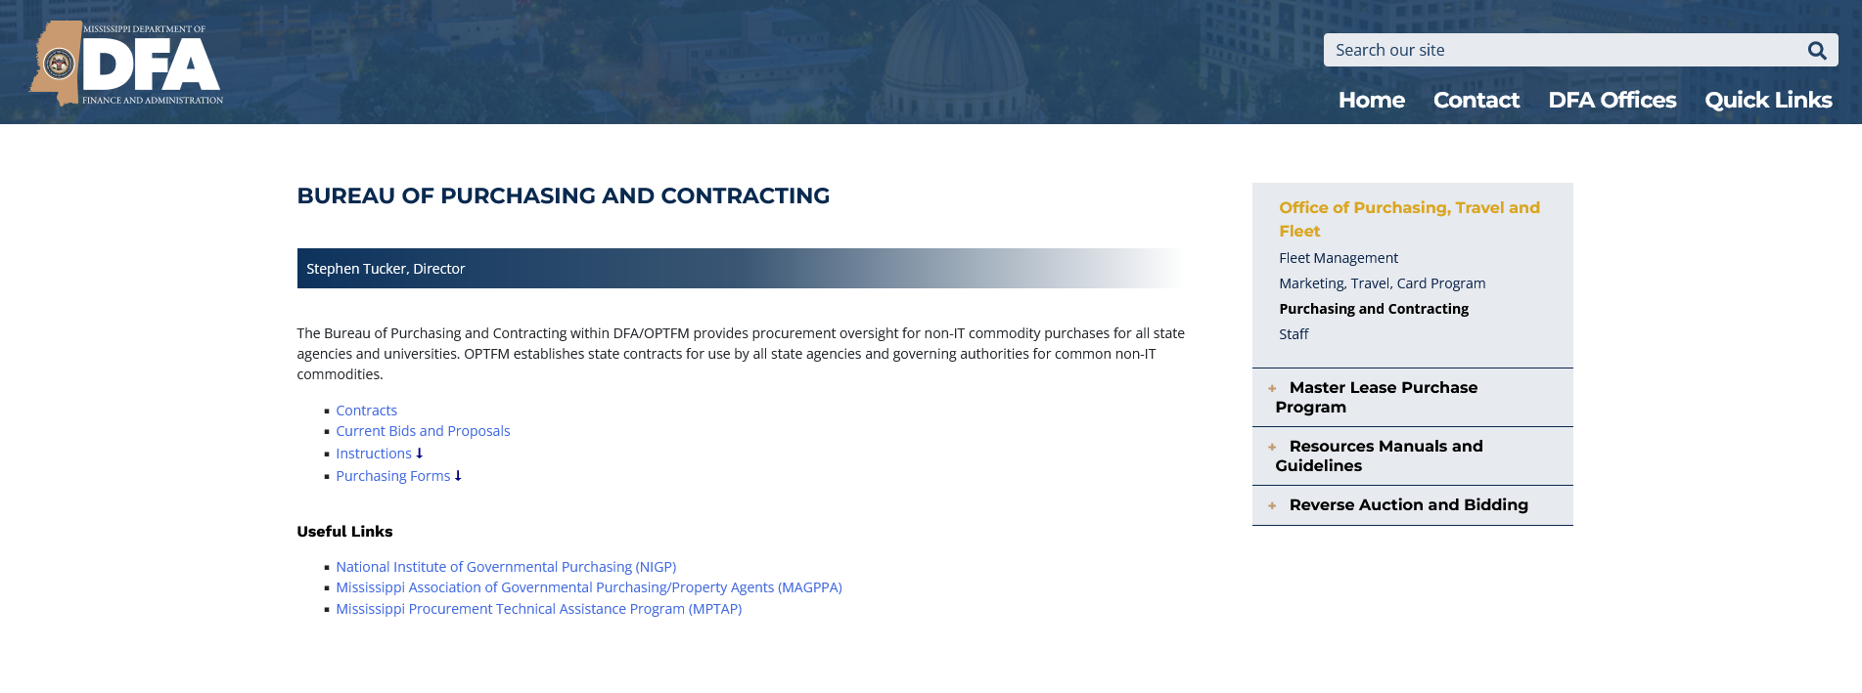
Locating State Contract Items

Slide 57
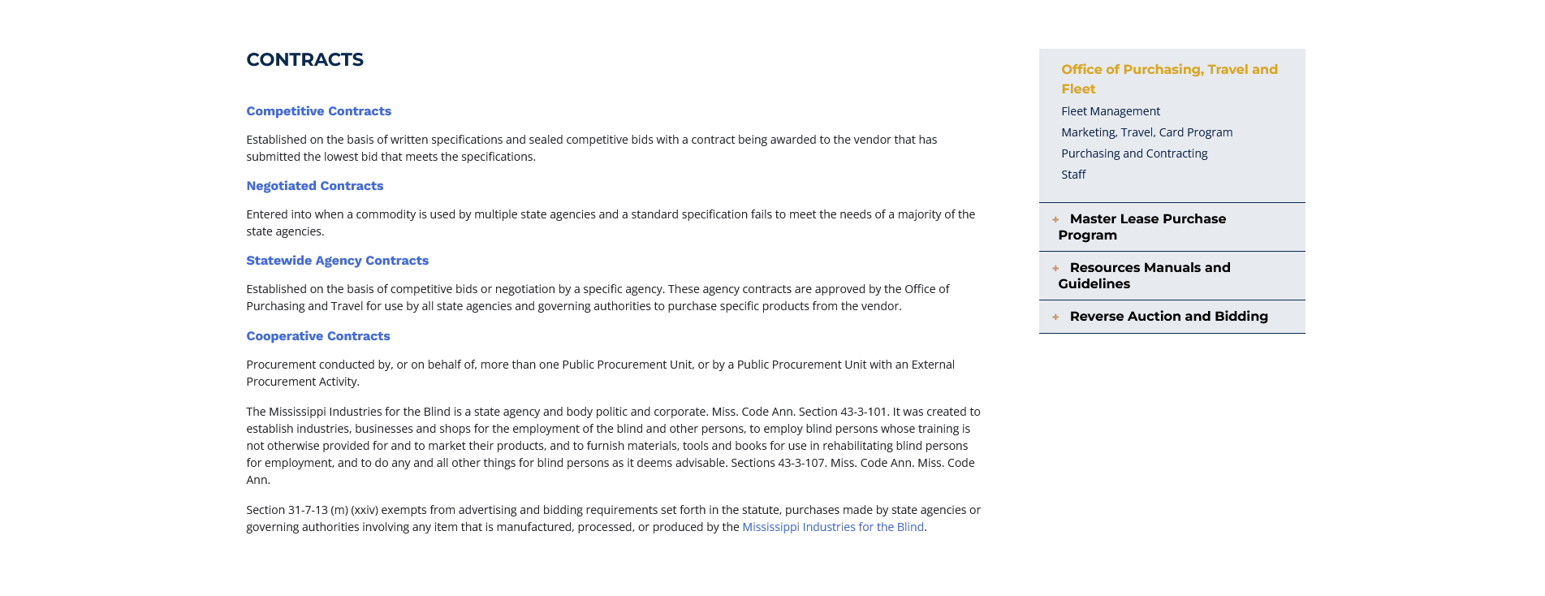
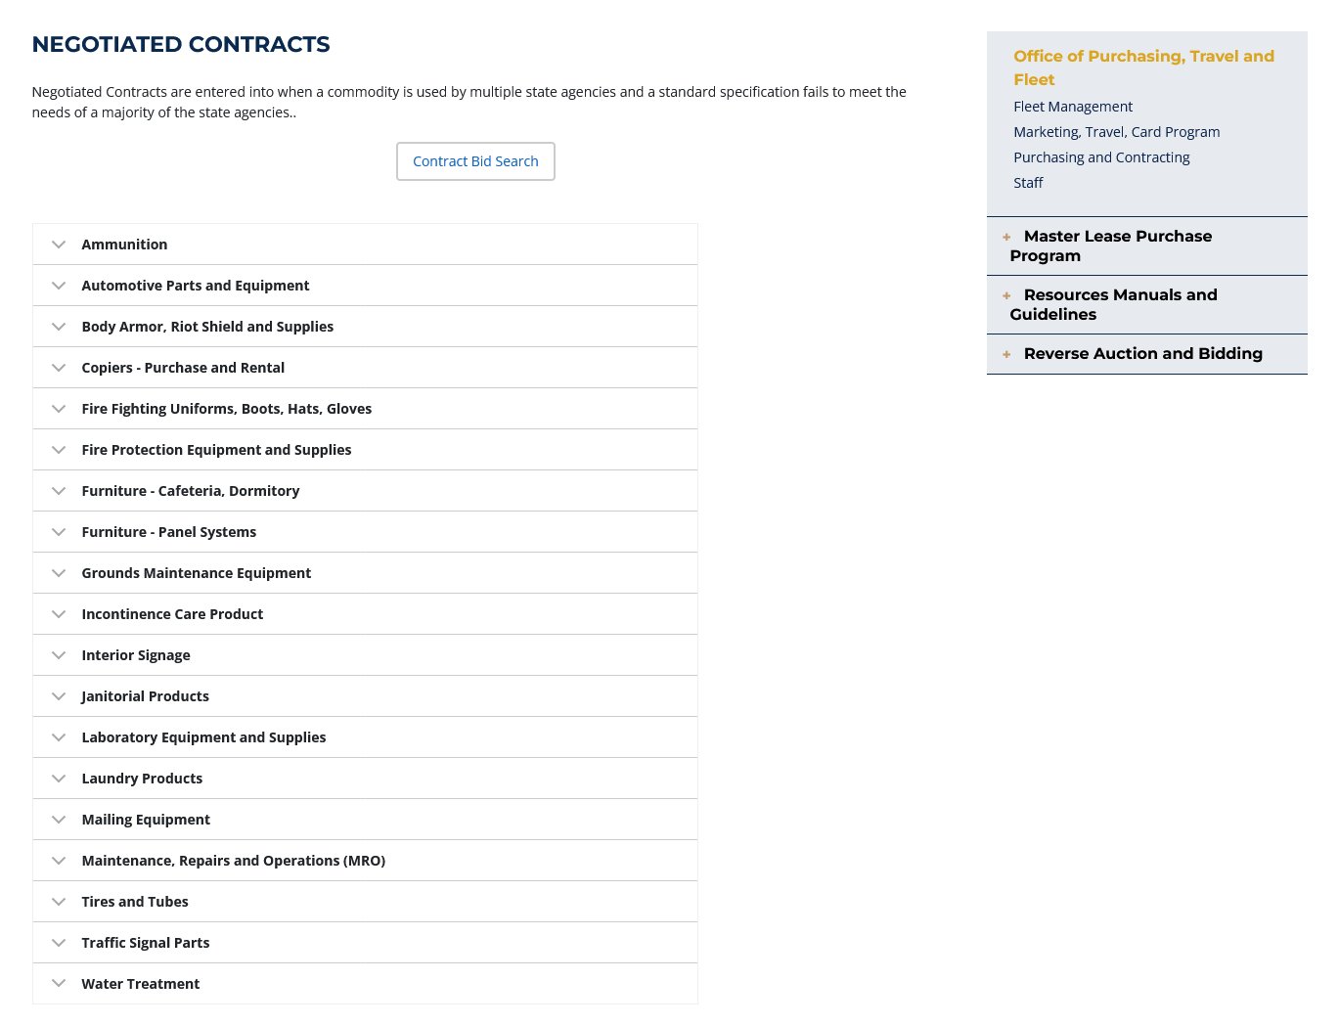
Contract Category List

Slide 58
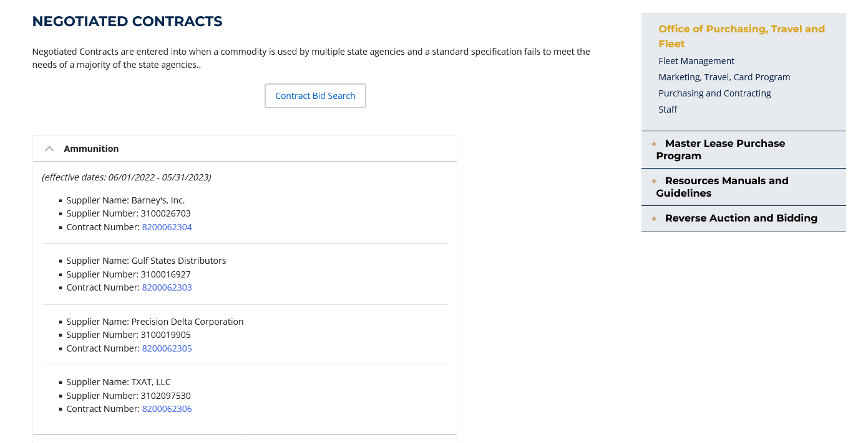
Category Selection

Slide 59
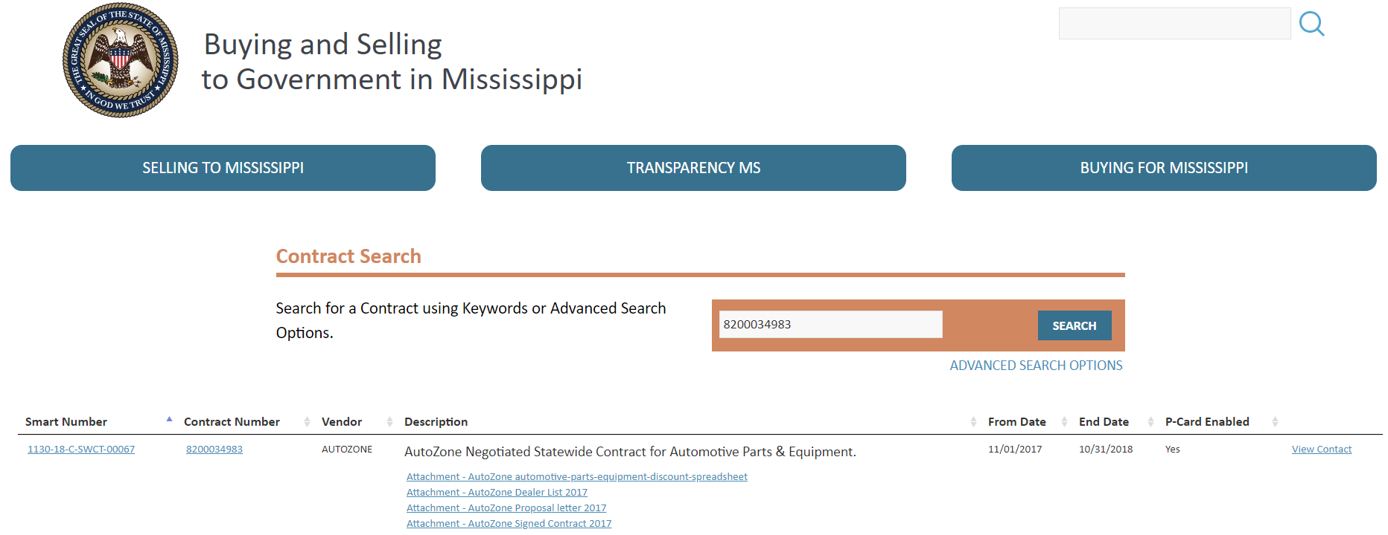
Contract Search

Slide 60
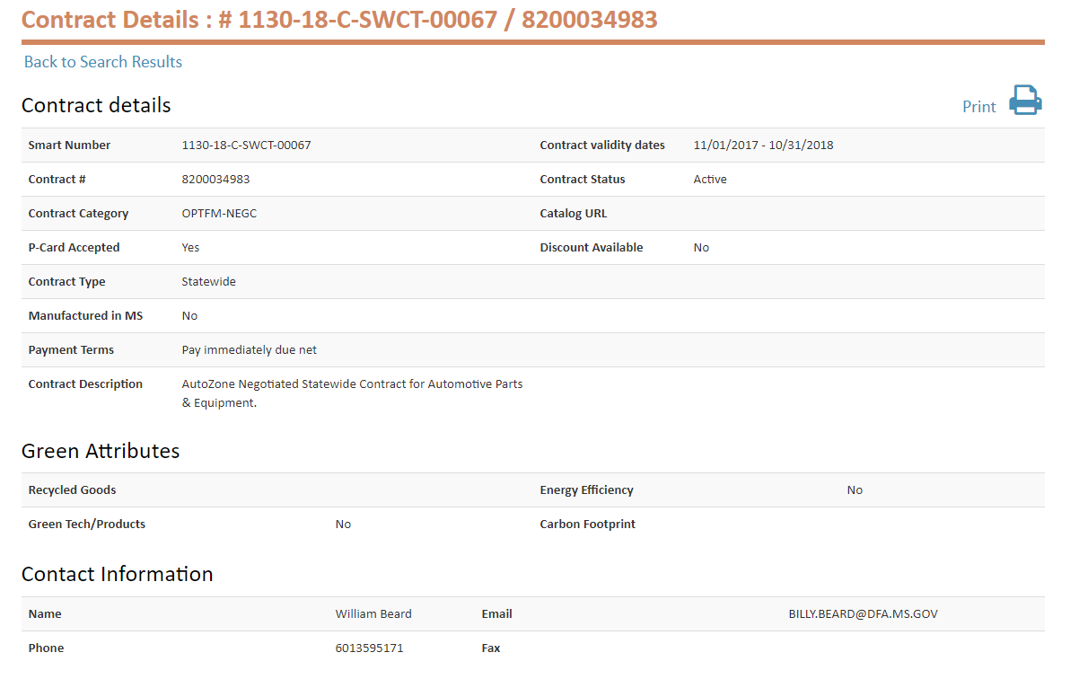
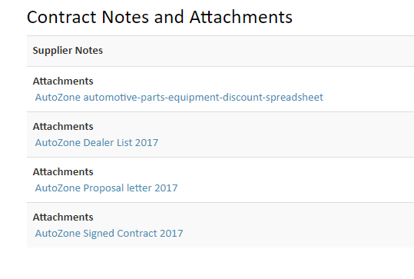
Contract Details

Slide 61
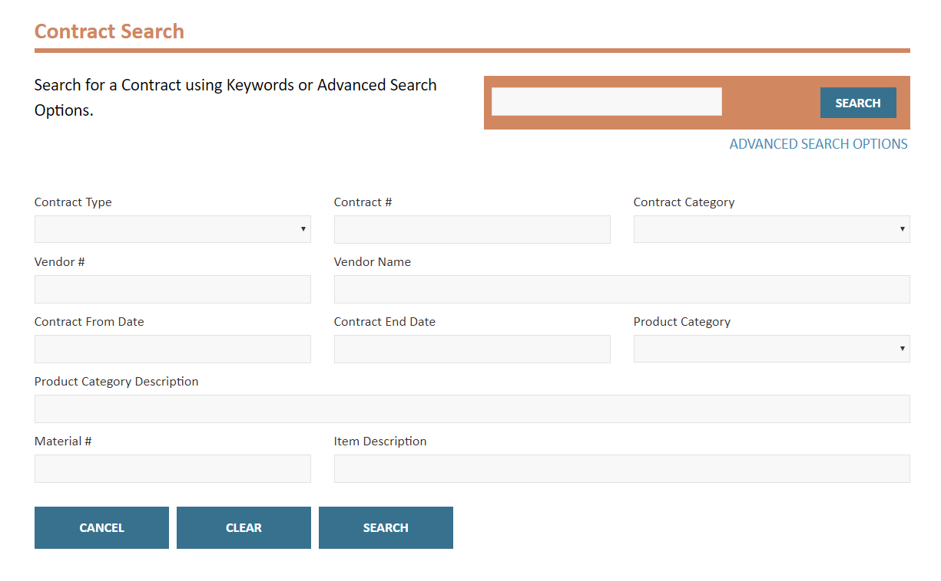
Contract Advanced Search Options

Slide 62
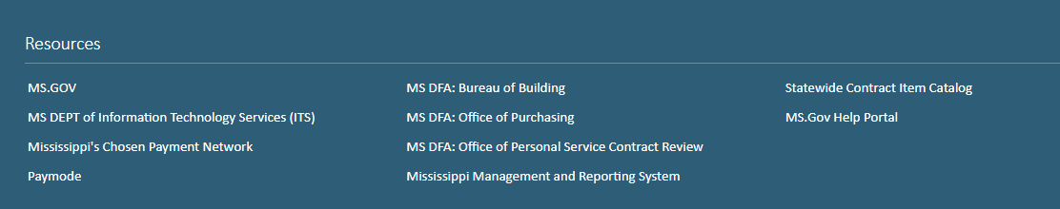
Statewide Contract Item Catalog

Slide 63
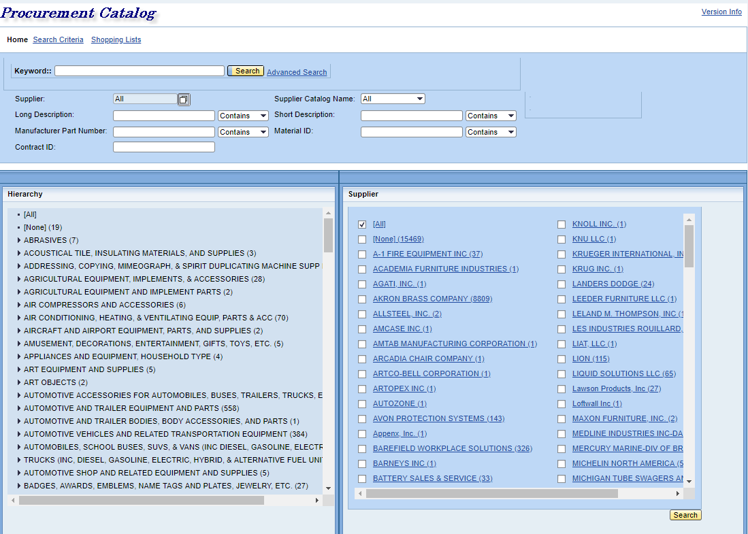
Statewide Contract Vendor Selection

Slide 64
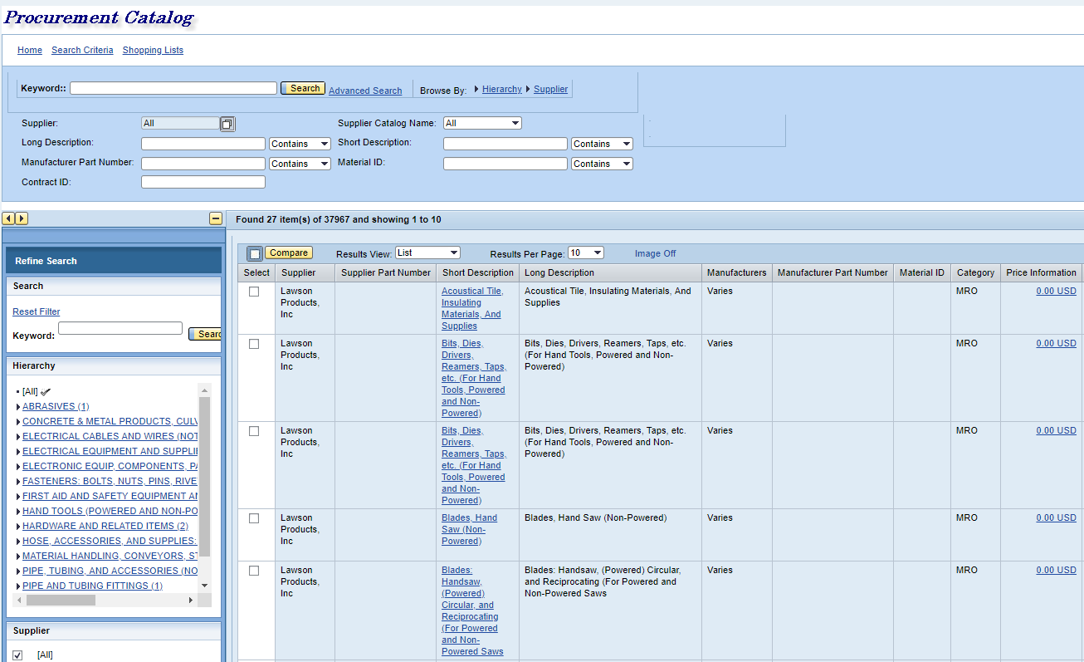
Statewide Contract Item Selection

Slide 65
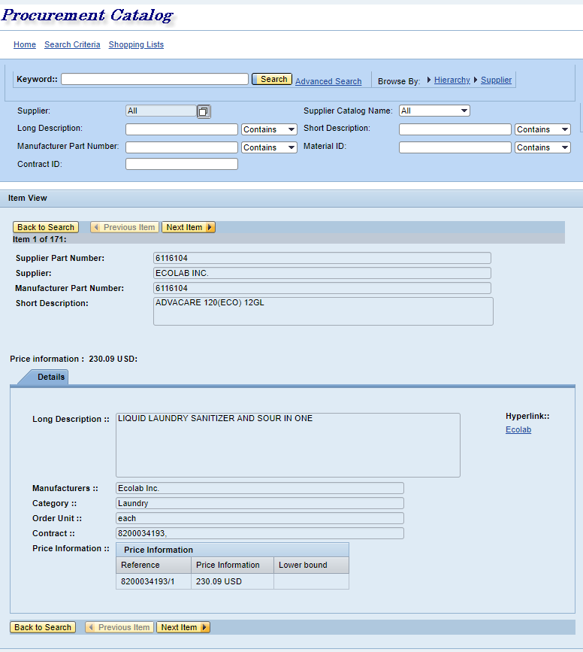
Statewide Contract Item Details

Slide 66
Vendor Registration
How can a vendor get registered to do business with the State of Mississippi:
Direct vendor to OPTFM website, Bureau of Marketing, Travel and Card Programs
Click on Vendor Information (middle of screen)
Click on “vendor registration”
Notes:
When vendors call and ask how they can do business with the State of MS, send them to OPTFMs website
Also tell them to make sure that they are not already registered. If they are, they need to modify their existing profile, not create a new one!

Slide 67
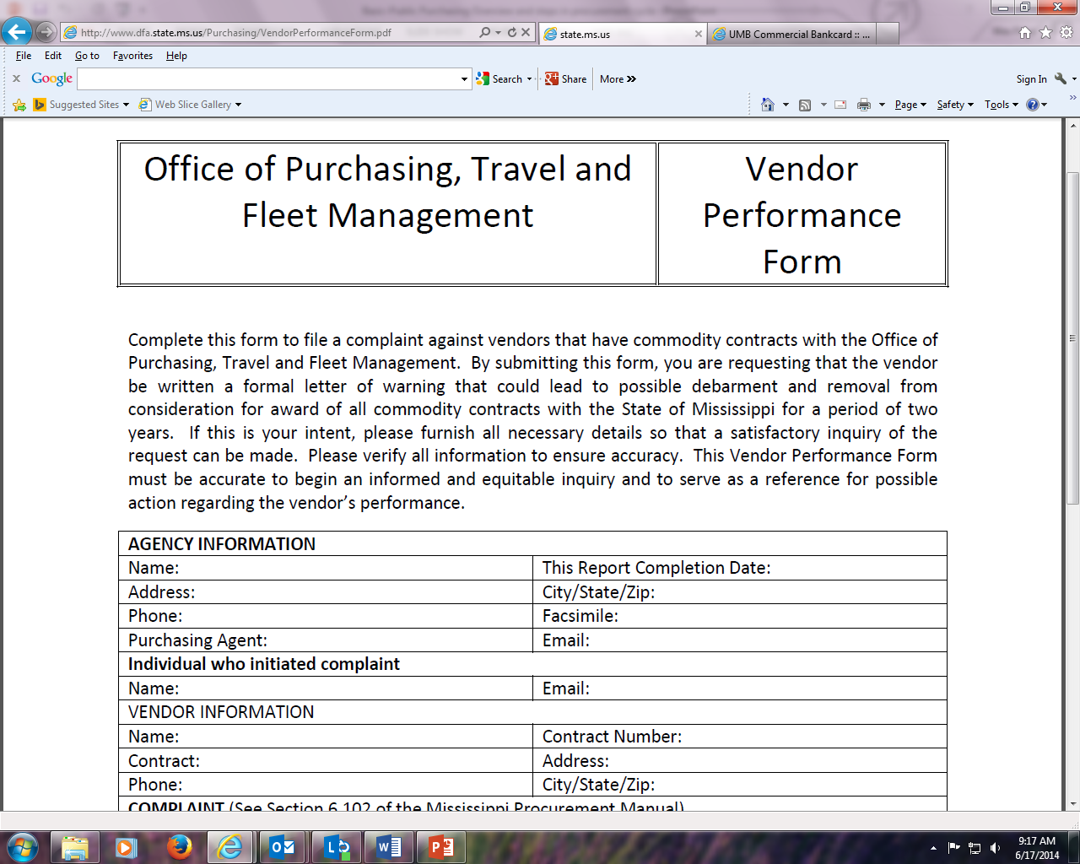
Vendor Performance Form
https://www.dfa.ms.gov/sites/default/files/Office%20of%20Purchasing%2C%20Travel%20and%20Fleet%20Home/Marketing%2C%20Travel%2C%20Card%20Program/Forms/vendorperformanceform.pdf
Notes:
Use the form as needed especially when you have an issue or problem with a vendor:
http://www.dfa.state.ms.us/Purchasing/VendorPerformanceForm.pdf
Very important that you use this form when you have a legitimate issue with a vendor.

Slide 68
Review Questions
Page -91-
Notes:
Questions?

Slide 69

Logistics

Slide 70
Objectives
Understand the difference in FOB Origin and FOB Destination
Explain the difference in FOB and freight
Discuss receiving procedures
Identify methods of disposing of personal property items

Slide 71
Shipping
FOB (Free on board)
  Two types
    FOB Origin – ownership (title) transfers from vendor to agency once goods are picked up by the shipper
    FOB Destination – ownership (title) transfers from vendor to agency once goods are delivered to the agency destination (always use FOB Destination)
Freight – states who pays shipping costs, does not address ownership (title)
Freight and shipping costs must be included in the total cost estimate for all goods and services
Notes:
Several different ways to pay for freight:
Freight prepaid and added
Freight prepaid and allowed
Freight prepaid and charged back
Freight collect

Slide 72
Receiving
Check shipping receipt for purchase order number and check the shipping receipt against the purchase order to verify accuracy
Does PO contain special instructions?
  If so, ensure that shipper follows those instructions

Slide 73
Inspection
Inspecting Shipments
  Look for visible damage to the outside of the package
  Check internal contents for accuracy and for damage
    Accept shipment
    Reject shipment
    Accept undamaged portion and return damaged portion
  Over shipment – only pay for ordered goods
  Shortage – pay for what is received only, contact vendor for remaining goods
Determine if the item(s) is a fixed asset. If so, alert Property Control to the item’s arrival after inspection

Slide 74
Disposal Methods
Disposal law – Section 29-9-9 MS Code annotated
Sold
Traded
Transferred
Surplus Property
Electronic Recyclers

Slide 75
Sales
Personal property can be sold by sealed bid or auction
If the item has a value of less than $1000 it can be sold by private treaty
Items valued between $1000 and $5000 can be sold after obtaining 2 written quotes
Items with a value over $5000 must be sold by sealed bid or public auction
Disposals by sale must be approved by OPTFM for state agencies – (Universities must gain approval by OPTFM)
Notes:
Items sold by private treaty can be sold to anyone.
Items can also be sold, traded or transferred to a state agency in another state.
You must look at the total value of group of items if disposing of more than one item.

Slide 76
Competitive Bid Sales
Must be advertised in newspaper one time each week for two consecutive weeks. Open no sooner than 8th day
No equipment should be released to successful bidder until inventory deletion form has been approved by OPTFM
IT products are disposed of in the same manner, but no approval is required by OPTFM or OSA

Slide 77
Private Treaty Sales
This is a sale where the buyer accepts a price set by the seller
Personal property may be sold to another state agency or governing authority
Personal property with a value of less than $1000 may be sold to a private entity

Slide 78
Auctions
OPTFM must be notified 15 days prior to auction with all required documentation for review
There are 3 options for holding auctions:
  Auction held on agency property
  Auction held at auction company location
  Online auction
Auctioneer fees must not exceed an amount equal to 10% per item but not more than $50 per item
If auction company fee is in excess of this, the auction company must be selected through sealed bid
Notes:
A detailed list of the items being sold,
The time, date, and place where the auction will be held,
A copy of the auctioneer's contract,
Copies of specifications and bids for auctioneer's services (if applicable),
A list of potential buyers who are being sent a notification of the auction; and
A copy of, or a draft of, a legal advertisement to notify potential bidders of the day, time, and place of auction.

Slide 79
Trade-ins
Value of item(s) being purchased must be taken into consideration
  If items have value over $5000, two competitive bids must be obtained, even if total cost is less than $5000 after the trade-in
Notes:
Example: If item or group of items has $6000 value and your trade-in is for $2000, two competitive bids are required because the value of the new item(s) is over $5000.
See Section 8.101.01.2 of the Procurement Manual

Slide 80
Trade-ins
If value of items being disposed (traded) is greater than $1000, quotes must be obtained
P-1 form must be sent to OPTFM for purchase of new item to which trade-in applies. Disposal paperwork must be included with P-1 documents to be approved by OPTFM.
Trade-ins will be approved at the same time as the P-1
With the exception of universities, trade-ins will be approved in MAGIC for all state agencies
Notes:
No approval is required from OPT or OSA when computer or telecommunication equipment is sold, traded or transferred. The same procedures must be followed.

Slide 81
Trade-ins
For universities, disposal paperwork is approved by OPTFM.
Copies of paperwork are then returned to agency with approval signatures
Notes:
No approval is required from OPT or OSA when computer or telecommunication equipment is sold, traded or transferred. The same procedures must be followed.

Slide 82
Transfers
Transfers of property can be made between governmental entities
No approval from OPTFM or Audit is required – this does not apply to vehicles
Items cannot be transferred to private entities
Transfer of computer and telecommunication equipment must follow the same process
Can transfer to Surplus Property
Items not sold, traded or transferred should be disposed of using an electronic recycler
Notes:
Additional section of Procurement Manual.
Starting July 1, 2014 e-waste shall be disposed of by a certified recycler.

Slide 83
Review Questions
Page -97-

Slide 84

Special Procedures

Slide 85
Objectives
Procuring petroleum products
Purchasing Hi-tech and Surveillance Equipment
Discuss copier purchases and rentals
Purchasing commodities produced from recovered materials
Procedures for applying preference to resident contractors
Information applicable to construction
Information applicable to taxes
Lease vs. Lease Purchase

Slide 86
Petroleum Products
Petroleum Products (gas, diesel fuel, oil, etc.)
For products that are $5000 or less two bids are recommended but not required
For products over $5000 two written quotes are required
If quotes are not available, follow normal bidding procedure outlined in MS code 31-7-13(c)
The Bureau of Fleet Management maintains a contract for these services and the contract is available for governing authorities

Slide 87
Purchasing Hi-Tech and Surveillance Equipment
Mississippi Code 31-7-13 (m) (xix) provides an exemption from competitive bid requirements when purchasing hi-tech and surveillance equipment
This code is set up to allow undercover operations to be conducted with this equipment with out notifying the public
If the purchase is over $75,000 a P-1 must be submitted
  Hi-Tech or Surveillance is all that is needed in the description box
Notes:
In listing the quotes when multiple suppliers are available, the suppliers’ name may be listed by name and address, or they may simply be designated as supplier 1, supplier 2, etc. The agency shall maintain a file for each such purchase which shall contain, but is not limited to:
Description of the equipment being purchased;
Specifications (if used);
List of vendors receiving solicitation;
Copies of quotes;
Justification for single-source purchase (if single-source provision is exercised);
Justification for accepting other than the low bid (if other than the low bid is receiving the award); and
Any other documentation relative to the purchase.

Slide 88
Definition of Surveillance Equipment
Surveillance Equipment – any equipment or device used to monitor, track, or observe persons or things related to any type of investigation or evidence gathering process wherein the need for the highest degree of security is mandatory so as not to compromise the operation in general or personnel in particular
Notes:
Surveillance Equipment definition

Slide 89
Definition of Hi-Tech Equipment
Hi-Tech Equipment – any equipment considered by the industry and law enforcement personnel to be specialized, sophisticated and secretive in nature that to publicize its acquisition could or would jeopardize the success of the mission or the safety of those persons involved in that mission
Notes:
Hi-Tech Equipment definition

Slide 90
Copiers
A number of copiers are on state contract and available for purchase
Copiers which exceed $75,000 in price or are not on contract may be purchased in compliance with statutory bidding requirements
Rental Copiers are also on state contract and may be used by any agency or governing authority
Rentals not on contract may be purchased using the competitive bid process
Trade-ins are allowed
Notes:
Use Generic Rental Agreement
If you don’t use State Contract, make sure you get quotes or bids depending on spend over period of rental
Including renewal periods

Slide 91
Determining When to Rent, Lease, or Lease-Purchase
Consider:
  Comparative cost of leasing
  Outright purchase and maintenance
  Projected total cost for estimated use of the item
  All other pertinent factors including: continuing need, functional obsolescence and technological advancements
Involve policy matters important to the budget as well as to the procurement
  This requires collaboration between the specific agency and OPTFM
Notes:
Careful evaluation of the economics of leasing versus buying is required prior to making the decision to award a lease or lease-purchase contract. Such evaluation examines the comparative costs of leasing and the costs of outright purchase and maintenance, projected as total costs for the estimated use of the item, and the consideration of other pertinent factors such as continuing need and functional obsolescence or inefficiencies which could result from technological advancements.
The question of leasing versus buying involves policy matters important to the budget function as well as to procurement, and the budget and procurement entities need to collaborate in establishing criteria or guidelines applicable to lease and lease-purchase.
Any contract that by the terms of such contract obligates the lessee to make payments for any period past the last day of the fiscal year in which the contract was entered into shall include a non-appropriation clause.

Slide 92
Lease Contracts
Used for equipment and commodities when title will not pass to the State at anytime
A lease may be entered into provided the following:
  (1) It is in the best interest of the State
  (2) All conditions for renewal and costs of termination are set forth in the lease
  (3) The lease is not used to circumvent normal procurement procedures
Shall not contain a purchase option
Any option for renewal or extension should be included in the original solicitation
Notes:
Purchase option could possibly change the bid that was received and the funds come from contractual but with purchase the funds come from equipment
Cannot use contractual money to purchase equipment

Slide 93
(Master) Lease-Purchase Contracts
Title passes to State at the end of the lease
All lease-purchase contracts must be approved by OPTFM
Considered a purchase transaction
Payments come from capital outlay
Shall contain non-appropriation clause
Universities should refer to IHL’s policies concerning lease-purchase contracts
Unlawful for any agency to enter into any single lease purchase transaction for any items having an acquisition cost of less than $10,000
Notes:
If the contract is cancelled for non availability of funds, equipment will be returned to lessor and state has no further obligations except all payments due up to the end of the fiscal year when funding was still available
Belinda Russell will be contact for Master Lease

Slide 94
Multi-year or Short Term Rental Lease Agreements
May be used when:
  (1) Promotes economy in procurement by obtaining the benefits of reduced monthly rental cost due to extended term rental and sufficient funds are not available for purchase
  (2) Equipment requested is for a special project that would not warrant a purchase as the project is of short duration and with the termination of that project there would be no further need for the equipment
  (3) Such reason as may be prescribed by law for certain entities

Slide 95
Generic Rental Agreement
Required for copiers and mailing equipment
https://www.dfa.ms.gov/sites/default/files/Office%20of%20Purchasing%2C%20Travel%20and%20Fleet%20Home/Purchasing%20and%20Contracting/Purchasing%20Forms/fillable-genericrentalagreement-february-2017.pdf
Make sure you are using the Rental Agreement dated February 2017!

Slide 96
Purchasing Commodities Produced from Recovered Materials
Must ask for Recycled Materials in the specs
If low bid that meets specifications is made from recovered materials, award to that vendor
If the low bid is not made from recovered materials, then the award will be made to the low bid that meets specs which is made from recovered materials; provided, however, that the price paid may not be more than ten percent (10%) higher than lowest bid
If there are no bids for recycled products within ten percent (10%) of the lowest bid, then the award will be made to the vendor offering the lowest bid.
Notes:
Special Clause:
Mississippi law requires that specifications be written so as to promote the use of products made from recovered materials. Therefore, bidders are asked to consider bidding on a product made from recovered materials; provided, however, that any product bid must be equal in quality, weight, texture, and color to the product required by these specifications. For the purposes of these specifications, a commodity made from recovered materials must be at least 20% post-consumer waste as defined by EPA and ASTM.
Examples: Paper Bids, Printing,

Slide 97
Procedures for Applying Preference to Resident Contractors
If State A has a five percent (5%) instate preference and a vendor from State A is bidding in Mississippi, then you must give a Mississippi vendor a five percent (5%) preference in the evaluation and award of the contract
Agencies are advised to review the applicable statutes and discuss this matter with their attorney
Notes:
5% is used as an example only

Slide 98
Information Applicable to Taxes
In general, state agencies have limited authority to pay taxes. Therefore, any reference to taxes owed in contracts should be reviewed with legal counsel. Agencies may want to consider deleting sections pertaining to the payment of taxes during negotiations with the vendor. Agencies should advise vendors that the state is exempt from taxes on the sale of property, labor, services and products sold directly to the state or its departments or institutions.

Slide 99
Purchases for Prison Agricultural Enterprises by MDOC
Section 47-5-357, Mississippi Code of 1972, Annotated, requires DFA to establish prudent purchasing and leasing policies which may exempt from bid requirements the commodities, items or services purchased or leased by the Dept. of Corrections for Prison Agricultural Enterprises. Such purchases and leases may be made in accordance with the requirements of Section 31-7-13(b), Mississippi Code of 1972, Annotated, regardless of amount. Contracts and lease agreements may not exceed sixty (60) months. The Dept. shall utilize the Generic Rental Agreement adopted by OPTFM for any lease. Lease purchases are not authorized under this section. For purchases over $75,000, a P-1 must be submitted to OPTFM.

Slide 100
Review Questions
Page -104-

Slide 101

P-1s

Slide 102
Overview of Request for Authority to Purchase (P-1)
P-1 Training Tool Document
Different types of P-1’s
Documentation needed for P-1 approval
Notes:
Pull up training tool document and discuss
Does everyone know how to find the P-1 Training Tool on dfa’s website?
Everyone pull up the P-1 Training Tool now!
Explain where to find the P-1 Training Tool on our website for reference as needed.
Training has step by step instructions on how to complete a P1 in MAGIC.
Go to www.dfa.state.ms.us
Click on State Purchasing, Travel, and Fleet Management
Click on Purchasing Tools
Click on P1 Purchasing Request-Electronic Has all the information about the different types of P1’s we will talk about today.
Common problems:
Contract Number…. 1st 3 digits should be the agency number, next 2 digits should be the current budget year, next 3 digits should be the agencies numbering sequence, and the last 3 digits will be OPT approvers initials.
Short Contract type: type of solicitation
Header supplier text: brief description of procurement
Description should be what type of P1 such as Bid Solicitation for….., Sole Source Request for…., Research Request for….etc…
Contract Type, OPTFM P1
Request type: IS THE TYPE OF PROCUREMENT
Expiration Dates, put date out far enough that there is plenty of time for the product to be delivered, received, invoiced, and paid for before P1 expires.
When correcting P1’s please do not copy P1 to start over, always amend original P1 so that you do not lose you P1 history.

Slide 103
Different types of P-1’s
Agency Contract Bids
Agency Contract Sole Source
Competitive Bids When Not Selecting Low Bidder
Competitive Bids When Selecting Low Bidder
Emergency Purchases
Exemption from State Contract
Master Lease
Open Purchase Order
Sole Source / Research
Trade-In of Equipment with Purchase
Notes:
HAVE CLASS REVIEW THE LIST ON OPTFM WEBSITE ALONG WITH THE REQUIREMENTS FOR EACH

Slide 104
EXEMPTIONS FROM BID REQUIREMENTS REQUIRING PRIOR P-1 APPROVAL
  Non-competitive items that are available from only one source
  Items purchased for research that are available from only one source
  Emergency purchase not threatening life or property
Notes:
Emergency Purchases (this was a recent legislative change and will be discussed more later in this session) – Did you read about this in p-notes

Slide 105
Emergency Definition
“Emergency" - any circumstances caused by fire, flood, explosion, storm, earthquake, epidemic, riot, insurrection, or caused by any inherent defect due to defective construction, or when the immediate preservation of order or public health is necessary by reason of unforeseen emergency, or when the restoration of a condition of usefulness of any public building, equipment, road or bridge appears advisable, or in the case of a public utility when there is a failure of any machine or other thing used and useful in the generation, production or distribution of electricity, water or natural gas or in the transportation or treatment of sewage; or when the delay incident to obtaining competitive bids could cause adverse impact upon the governing authorities or agency, its employees or its citizens.
Emergency procurement shall be limited in scope to those supplies, services, or construction items necessary to meet the emergency and limited in term to the time necessary to meet the emergency; however in no event shall any emergency contract exceed a term of one (1) year.
Notes:
See Section 31-7-1(f), Mississippi Code of 1972, Annotated.
If the governor declares a state of emergency, that does not mean that every agency can purchase whatever they would like without regard to bid laws.

Slide 106
Emergency NOT Requiring Prior Approval
If such emergency threatens the health or safety of any person, or the preservation or protection of property, then the provisions of competitive bidding shall not apply and any officer or agent of the agency having general or specific authority for making the purchase or repair contract shall approve the bill presented for payment and provide justification and certification in writing detailing from whom the purchase was made or with whom the repair contract was made to the Office of Purchasing, Travel and Fleet Management using the electronic P-1 process and guidelines listed on OPTFM’s website
Notes:
(1) Emergencies threatening health and safety or property
If such emergency threatens the health or safety of any person, or the preservation or protection of property, then the provisions of competitive bidding shall not apply and any officer or agent of the agency having general or specific authority for making the purchase or repair contract shall approve the bill presented for payment and provide justification and certification in writing detailing from whom the purchase was made or with whom the repair contract was made to the Office of Purchasing, Travel and Fleet Management using the electronic P-1 process.
The justification should be written in sufficient detail so that a person not familiar with the situation could be expected to understand the need to forego the normal purchasing procedure. As per Section 31-7-13(j), Mississippi Code of 1972, Annotated, the certification for an emergency purchase must be submitted on letterhead and signed by the executive head or his/her designee(s) of the requesting agency. Agencies shall address the following when preparing the justification:
(a) Does it fall under the definition of an emergency set forth in Sections 31-7-1(f), Mississippi Code of 1972, Annotated?
(b) What happened to cause the emergency?
(c) What would be the negative consequences of following normal purchasing procedures?
(d) Does it threaten the health or safety of any person, or the preservation or protection of property?
(e) The total purchases made shall only be for the purpose of meeting the needs created by the emergency situation.
Following the emergency purchase, documentation of the purchase, including a description of the commodity purchased, the purchase price thereof and the nature of the emergency shall be filed with the Department of Finance and Administration when submitting the applicable payment request as more particularly prescribed in the DFA MAAPP Manual. In the case of Institutions of Higher Learning, this can be done by adding an attachment to the university’s P1 request.

Slide 107
Emergencies Requiring Approval Prior to Purchase
If the governing board or the executive head, or his designees, of any agency of the state shall determine that an emergency exists in regard to the purchase of any commodities or repair contracts, so that the delay incident to giving opportunity for competitive bidding would be detrimental to the interests of the state, then the head of such agency, or his designees, shall seek approval of the Office of Purchasing, Travel and Fleet Management using the electronic P-1 process
Notes:
(2) Emergencies Requiring Approval Prior to Purchase
If the governing board or the executive head, or his designees, of any agency of the state shall determine that an emergency exists in regard to the purchase of any commodities or repair contracts, so that the delay incident to giving opportunity for competitive bidding would be detrimental to the interests of the state, then the head of such agency, or his designees, shall seek approval of the Office of Purchasing, Travel and Fleet Management using the electronic P-1 process.
The justification should be written in sufficient detail so that a person not familiar with the situation could be expected to understand the need to forego the normal purchasing procedure. As per Section 31-7-13(j), Mississippi Code of 1972, Annotated, the certification for an emergency purchase must be submitted on letterhead and signed by the executive head or his/her designee(s) of the requesting agency. Agencies shall address the following when preparing the justification:
(a) Does it fall under the definition of an emergency set forth in Sections 31-7-1(f), Mississippi Code of 1972, Annotated?
(b) What happened to cause the emergency?
(c) What would be the negative consequences of following normal purchasing procedures?
(d) The total purchases made shall only be for the purpose of meeting the needs created by the emergency situation.
Upon receipt of the justification and any applicable board certification, the State Fiscal Officer or his designees, may authorize the purchase or repair without having to comply with competitive bidding requirements.
Following the emergency purchase, documentation of the purchase, including a description of the commodity purchased, the purchase price thereof and the nature of the emergency shall be filed with the Department of Finance and Administration when submitting the applicable payment request as more particularly prescribed in the DFA MAAPP Manual. In the case of Institutions of Higher Learning, this can be done by adding an attachment to the university’s P1 request.

Slide 108
Master Lease
Prior approval is required by PPRB to use Master Lease funds
A proposed schedule of acquisitions is presented for Board approval
Master Lease Purchase Program is just the method of financing
Competitive procurement is STILL mandatory
Notes:
Program implemented in the early 1990s. The Program was initiated by the State of Mississippi, acting through the Department of Finance and Administration (“DFA”) pursuant to Section 31-7-10 of the Mississippi Code of 1972 (the “State Master Lease Purchase Statute”), for the purpose of enabling agencies of the State of Mississippi (collectively, “State Agencies”) to acquire equipment essential to their operations through a State-wide program administered by DFA.

Slide 109
Open Purchase Order Over $5,000
A brief justification on agency letterhead of the need for an open purchase order in lieu of normal P.O. procedures
A general description of the commodities and maximum amount per invoice
The following certification should be included with the justification: "This is to certify that only the commodities shown will be purchased and that no items currently covered by any state contract will be purchased under the terms of this purchase order without proper approval from the Office of Purchasing and Travel. This procedure will not be used to separate purchases so as to circumvent any laws, regulations, or policies of the State of Mississippi."
This should be signed by the Procurement Director or his/her designee
Notes:
Open purchase order- a procedure established which may be used for multiple purchases from a single vendor for a period of not more than the allotment period
The justification letter should include, but not be limited to, an estimate of the quantity of purchase orders that would be required if the Open Purchase Order Procedures are not used.
10.107.02 State Agency Procedures for Open Purchase Orders in Excess of $5,000
All open purchase orders in excess of $5,000 must have an approved electronic Request for Authority to Purchase, P-1, attached to the purchase order. P-1 approval is not required for open purchase orders for service contracts. To receive P-1 approval, the P-1 must have the following included on the P-1 or attached:
(1) A brief justification of the need for an open purchase order in lieu of normal P.O. procedures. This should include, but not be limited to, an estimate of the quantity of purchase orders that would be required if the Open Purchase Order Procedures are not used.
(2) A general description of the commodities/services and the maximum amount per invoice.
(3) The following certification:
"This is to certify that only the commodities/services shown will be purchased and that no items currently covered by any state contract will be purchased under the terms of this purchase order without proper approval from the Office of Purchasing, Travel and Fleet Management. This procedure will not be used to separate purchases so as to circumvent any laws, regulations or policies of the State of Mississippi."
State Agency Procedures for Open Purchase Orders for $5,000 or Less
In the case of a rental which requires P-1 approval, the P.O. must include the appropriate P-1 approval number
A general description of the commodities/services and the maximum amount per invoice.
The following certification:
"This is to certify that only the commodities/services shown will be purchased and that no items currently covered by any state contract will be purchased under the terms of this purchase order without proper approval from the Office of Purchasing, Travel and Fleet Management. This procedure will not be used to separate purchases so as to circumvent any laws, regulations or policies of the State of Mississippi."

Slide 110
Sole Source or Research
Sole-source procurement is not permissible unless a requirement is available from only a single supplier. A requirement for a particular proprietary item does not justify sole-source procurement if there is more than one potential bidder or offeror for that item. The following are examples of circumstances which could necessitate sole-source procurement:
  Where the compatibility of equipment, accessories, or replacement parts is the paramount consideration (and manufacturer is sole supplier)
  Where a sole supplier's item is needed for trial use or testing
  Where a sole supplier's item is to be required when no other item will serve the need of the user entity
Notes:
Have everyone go to the sole source section in the CMPA manual for discussion
Discuss forms on website

Slide 111
Sole Source Process
Established after SB 2400
Effective July 1, 2015
Agencies must enter/publish their Sole Source contract notices to the State of MS Procurement Portal
Must be advertised for at least fourteen (14) days * (open on 15th Day)
The Sole Source Determination (SSD) and Objection to Sole Source (OSS) forms must be attached to the notice
Notes:
Once an item has been certified as a single source item, the item may be purchased without complying with provisions for competitive bidding
Authority must be granted by the OPTFM prior to acquisition of the item by using the electronic P-1 process
A letter must be accompanied as an attachment to the P1 request outlining the results of the procedures that have been detailed as outlined in the Procurement Manual

Slide 112
Sole Source Process
“RFIN” Published on Procurement Portal (For 14 Days)
Objection Received (OSS)
No Objection Received
P-1 submitted to OPTFM with SSD
Agency reviews to determine if vendor can fulfill
If vendor can fulfill, bid/quote issued
If agency determines objecting vendor can't fulfill, PPRB will review
OPTFM reviews and approves/rejects
Notes:
RFIN – Request for Information

Slide 113
Trade-in of Equipment with Purchase
A trade-in of equipment is allowed (exception: vehicles on state contract)
If the competitive sealed bid process is used, specifications must be written to include the trade-in
When submitting an electronic P-1, an inventory deletion form must be attached
Notes:
Many times the inventory deletion report is not included on the P-1.
This will be addressed further in Logistics, however keep in mind that trade-ins of equipment might require quotes or bids.

Slide 114
PPRB Required Approvals
Types of purchases requiring approval
  Exemptions from Reverse Auction
  Purchases made as the result of alternative process after exemption is granted
  Purchases greater than $500,000
  Construction contracts greater than $5,000,000
  Master Lease Purchase schedules
  Cancellation of MDOC contracts on minutes
  Changes to normal purchasing policies and procedures
  Changes to rules and regulations regarding sale or disposal of property
Notes:
Purchases exceeding $500,000 require approval by the Public Procurement Review Board (PPRB) prior to executing the purchase

Slide 115
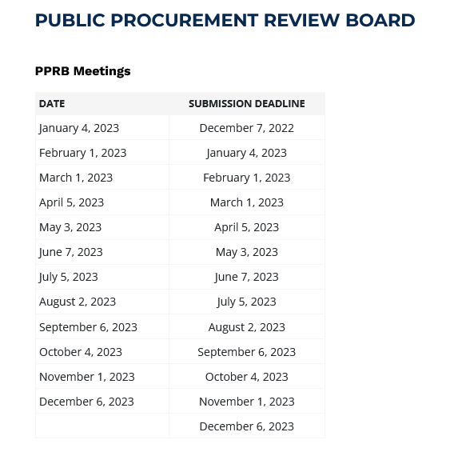
PPRB Agenda Item Deadline
P-1 requests must be submitted to OPTFM by the published deadline. Check the PPRB website.
Notes:
We get several P-1s too late for the agenda, make sure everyone is aware of this cut off at noon on Thursday 2 weeks prior to the first Wednesday of each month.
No notice of award letter should given to vendors until the final PPRB approval is complete.
Need to have a Agency Rep at meeting or on phone.

Slide 116

STATE OF MISSISSIPPI
OFFICE OF PURCHASING, TRAVEL AND FLEET MANAGEMENT
Procurement and Travel Card Services

Slide 117
Procurement Card Staff
Candice Hay
Procurement Card Administrator
Office of Purchasing, Travel and Fleet Management
601-359-5099
Candice.Hay@dfa.ms.gov
Demetra Hayes
Travel Administrator
Office of Purchasing, Travel and Fleet Management
601-359-3912
Demetra.Hayes@dfa.ms.gov
Yolanda Thurman, Director
Marketing, Travel and Card Programs
Office of Purchasing, Travel and Fleet
Management
601-359-2016
Yolanda.Thurman@dfa.ms.gov
Niki Hobkirk
Contract Analyst
Office of Purchasing, Travel and Fleet
Management
601-359-9373
Niki.Hobkirk@dfa.ms.gov

Slide 118

Key Terms
Procurement Card (P-Card)
Procurement Card Administrator
Program Coordinator (PC)
Merchant Category Codes (MCC Codes)
Managing Account – master billing account
Notes:
The Procurement Card (sometimes referred to as the p-card) offers an
alternative method to purchasing services and/or commodities
2. Procurement Card Administrator- person who is the liaison between the Program Coordinator and the bank.
3.Program Coordinator (PC) is the individual that is responsible for overseeing the use of procurement cards in your “specific” agency.
4. MCC codes (Merchant Category Code) are codes or a number that has been assigned to retail outlets which helps identify types of business.

Slide 119
Laws and Policy
MS Code,1972, Annotated, Section 7-7-23
  The State Fiscal Officer established a general rule to allow state agencies to make certain purchases without first issuing a purchase order
MS Code, 1972, Annotated, Section 31-7-9
  Gives OPTFM the ability to develop regulations to oversee the use of the p-card program
Notes:
MS code 31-7-9
The Office of Purchasing, Travel and Fleet Management may adopt purchasing regulations governing the use of credit cards, procurement cards and purchasing club membership cards to be used by state agencies, governing authorities of counties and municipalities, school districts and the Chickasawhay Natural Gas District. Use of the cards shall be in strict compliance with the regulations promulgated by the office. Any amounts due on the cards shall incur interest charges as set forth in Section 31-7-305 and shall not be considered debt.

Slide 120
Procurement Card Program Purpose
Speed
Ease of use
Used for both Commodities/services
Used for a large number of small purchases
Allow departmental personnel to make small dollar purchases ($5,000 & under)
Notes:
Most of a department’s purchases are under $5,000. Its so much easier and quicker with the card.
Almost everybody nowadays has some type of personal credit card they use and they realize its just so much easier with a card.
The future of purchasing is changing and the paper process is slowly vanishing.

Slide 121
Benefits of the P-card Program
Reduction in issuing small dollar PO’s
Reduces process time spent processing large number of requisitions
Increase in processing efficiency
Increase in purchasing flexibility
The procurement card program provides an easy purchase method which can improve customer service
Suppliers benefit from prompt payment
Fewer duplicated invoices
Notes:
Also important to point out, program coordinators have “real time” access to see exactly what each p-card user is doing
Can see the amount of the purchase, the vendor, time and date, etc.
What are some of your agency’s concerns for using the p-card?

Slide 122
P-Card Guidelines
Serve as a source of information about the State of Mississippi Small Purchase Card Program
Include information such as:
  Useful Contact Information
  Prohibited Purchases
  Maximum Threshold Amount for p-card usage
  Forms for agency p-card program maintenance
  Directions on how to become a part of the p-card program
Can Be found on OPTFM website at: https://www.dfa.ms.gov/sites/default/files/Office%20of%20Purchasing%2C%20Travel%20and%20Fleet%20Home/Resources%20Manuals%20Guidelines/procurementcardguidelinesrevised10-30-2013.pdf
Notes:
I suggest any p-card user to print out and make themselves familiar with the p-card guidelines.
Might want to go to the guidelines and highlight what is inside of it.

Slide 123
Getting Started…..
Define documentation and process for Procurement Card
Designate a Departmental Program Coordinator Card Administrator
Prepare a filing system
Complete ALL necessary set up forms for the agency or governing authority
Email forms to OPTFM
Notes:
This might seem like a lot, but its really not. The forms are pretty self explanatory too. If not I’m always here to help.
Might want to show the forms here.
Also explain if the agency is already on the program, how do they request new cards or close cards.

Slide 124

Program Coordinator Responsibilities
Identify cardholders authorized to purchase on behalf of the agency/department
Approve, copy, and submit completed applications/forms to OPTFM
Responsible for distribution of pertinent information to agency/department staff
Notes:
This person is your agencies p-card contact. They are the person who will get in touch with me. The individual cardholders need to go to this person first.

Slide 125
General Conditions
Agencies/Departments may use the procurement for bona fide needs of the agency/department
Maximum amount of purchases is $5,000 per single transaction
Agencies/departments should have an organized and designated operating procedures and designated personnel to manage the program

Slide 126
Minimum Requirements
While using a p-card, the cardholder must be mindful of the following:
  The prices of products or services are fair and reasonable
  Available budget authority exists to cover expenditures
  No capital equipment
  Purchases comply with purchasing laws
  Items are not on the prohibited list
  State contract items can be purchased with the p-card
  Reconciliation process should be conducted by cardholder and program coordinator
Notes:
Let’s not forget we are purchasing agents and we should always find the best price.

Slide 127
Prohibited Purchases Examples
Fuel
Gifts
Generators
Entertainment
Motorized vehicles
Alcoholic beverages
Items on back order
Items for personal use
Travel related expenses
Televisions (greater than $250)
Reoccurring automatic monthly charges
Radioactive, Explosive, or other Hazardous material
Camera and Camera Equipment (greater than $250)
Contractual Services to an Individual, Sole Proprietor, Partnership or LLC-Partnership
Computer and Computer equipment (greater than $250) (central processing unit, terminal, printer, external hard drive)

Slide 128
Equipment Purchases
All agencies and universities are required to maintain a complete and current inventory list of each property item which costs $1000 or more unless the items purchased fall within the groups listed below.
These items will be required as equipment, regardless of their purchase value.
Weapons
Two-way radio equipment
Lawn Maintenance Equipment
Cellular telephones
Chain Saws
NO EQUIPMENT PURCHASE is allowed on the state p-card

Slide 129
Itemized Receipts/Invoices
Obtain an itemized receipt/invoice for each purchase
If receipts cannot be obtained, complete a Missing Document Affidavit Form can be found on the OPTFM website at: https://www.dfa.ms.gov/sites/default/files/Office%20of%20Purchasing%2C%20Travel%20and%20Fleet%20Home/Marketing%2C%20Travel%2C%20Card%20Program/Links/Procurement%20Card%20Services/Forms/Procurement%20Card%20Forms/umbmissingdocumentaffidavitform.pdf

Slide 130
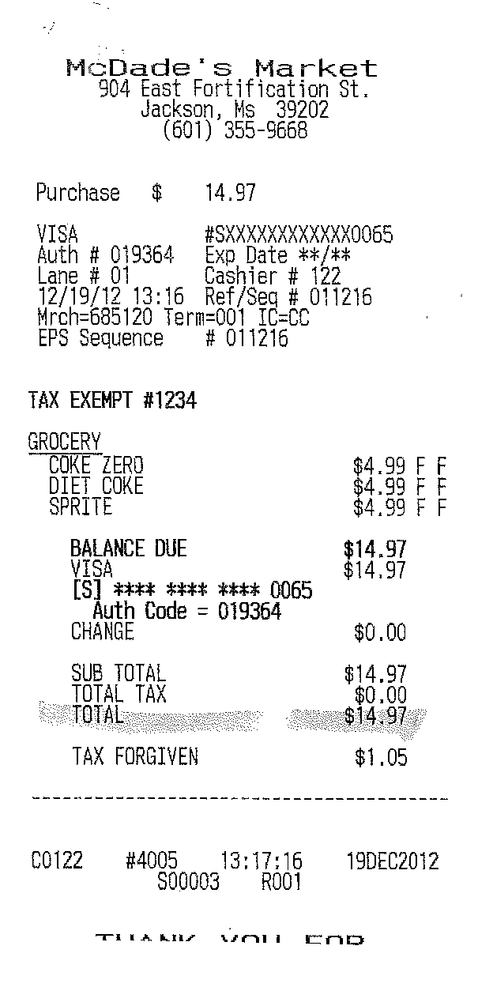
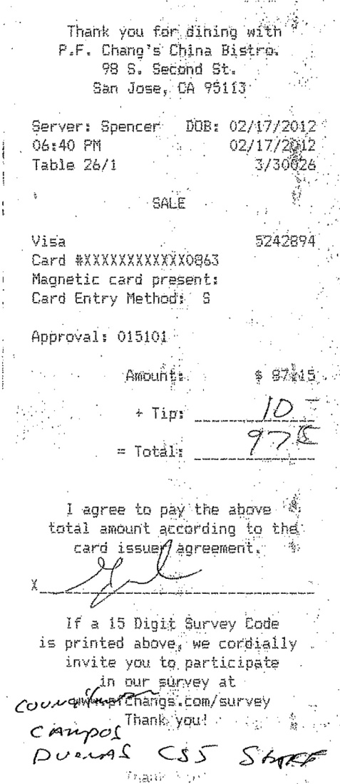
GOOD
BAD
Notes:
Ask the class why one receipt is good and why one receipt is bad.

Slide 131
Food Purchases on P-Card
Determine if the purchase is for a business meeting/event or a bulk food purchase
If business meeting, an agenda is needed
Complete Food Form located on the OPTFM website at: https://www.dfa.ms.gov/sites/default/files/Office%20of%20Purchasing%2C%20Travel%20and%20Fleet%20Home/Marketing%2C%20Travel%2C%20Card%20Program/Links/Procurement%20Card%20Services/Forms/Procurement%20Card%20Forms/umbfoodpurchaseform.pdf
Notes:
Show food form and explain it.

Slide 132
Split Purchases
The maximum amount of a Procurement Card Purchase is $5,000
Split purchases are not allowed and can not be processed with a state p-card
  Split purchases is defined as splitting one purchase totaling more than $5,000 into several to circumvent the $5,000 limit
Purchases over $5,000 must be on a purchase order and requires two written quotes
Notes:
There are a lot of “What if’s” regarding split purchases. If you think you might be splitting a purchase, good chance you are.

Slide 133

TAXES
State of MS sales tax should not be charged to the procurement card
Responsibility of user to inform vendor of tax exempt status
If charged tax, user should obtain a credit
If no credit is obtained, the cardholder must submit payment to the agency for the total tax amount charged during that transaction
Notes:
This is very important. This is one of the great benefits of using the card. Tax can add up if you are not using the card properly.

Slide 134
Surcharges
MS Code section 31-7-9 (1) (d) prohibits a vendor from imposing a surcharge on the P-Card
Surcharge is when the vendor is charging an extra fee just because the form of payment is credit card and not cash
If a surcharge occurs during a transaction, the card user should obtain a credit from the vendor
Notes:
MS Code
(d) In a sale of goods or services, the seller shall not impose a surcharge on a buyer who uses a state-issued credit card, procurement card, travel card, or fuel card. The Department of Finance and Administration shall have exclusive jurisdiction to enforce and adopt rules relating to this paragraph. Any rules adopted under this paragraph shall be consistent with federal laws and regulations governing credit card transactions described by this paragraph. This paragraph does not create a cause of action against an individual for a violation of this paragraph.
Surcharge is when the vendor is charging you an extra fee just because you are using a card and not cash.
******Give P-card activity here.******

Slide 135
When a Mistake is Made
In the event that a true mistake has been made and a credit is not obtainable or an item is not returnable complete the following:
Notify program coordinator of mistake
Type a justification memo with complete details of the situation
Place memo with the monthly statement and receipt of items purchased

Slide 136

Declined Purchases
In the event that the card is declined when attempting to purchase items the following actions should be completed:
Contact your agency’s P-Card Program Coordinator and explain the situation
The PC will notify the P-Card Administrator of the declined purchase
  The P-Card Administrator is to only deal with the PC, not each individual cardholder
The P-Card Administrator will look into the transaction and will either open the card to process the transaction or communicate with the coordinator as to why the transaction can not be completed

Slide 137
Replacement Card
If the bank detects fraudulent activity, the bank will automatically close the card and reissue a replacement card
If the agency wants to issue a replacement card due to fraud detection, a damaged card, name change, and/or etc., the program coordinator should contact the program administrator
Once a replacement card is received or the agency has determined that a replacement card is needed, the program coordinator should complete the following actions:
  Send the PA a closure form for the closed card or card to be closed (if needed)
  Send the PA a setup form for the newly issued replacement card with that cards information
    Only send this in if the replacement card has a new account number
  Shred the old card

Slide 138

Lost/Stolen Cards
Report lost/stolen cards immediately
After calling the bank, report lost/stolen card to your agency’s Program Coordinator

Slide 139

Security Issues
Keep the procurement card in a secure location (e.g. locked file cabinet or office safe)
Require users to sign the office procurement card out and in after use
Do not carry the procurement card on vacations, weekends or holidays
Keep the procurement card separate from personal credit cards.
Always double check receipts against bank statements

Slide 140
Balances on Accounts
Balances should not be carried over to the next month
Balances on the procurement card shall be paid at the receipt of the monthly statement, once statement(s) have been reconciled for accuracy
Per Section 31-7-305, MS Procurement Manual, amounts shall incur an interest rate of 1 ½ %

Slide 141
Liability
The State of Mississippi will not accept any liability or financial responsibility for state employees’ charges that have not been authorized and exceed any specified limits and violate any of the MCC code restrictions pursuant to current card association rules and regulations.

Slide 142
High Level Reconciliation Process
Statements will be available online at the end of each billing cycle
The program coordinator and the individual cardholder should review statement for verification and reconciliation
A copy of the master statement, and original individual statements, logs, etc., related to the program must be maintained at the agency and available upon request for audit purposes
Questions about paying your bill should be directed of the Bureau of Financial Control 601-359-3538
Notes:
Stress that the Bureau of Financial Control handles billing questions.

Slide 143

P-Card Reviews
Pcard Reviews are conducted to ensure that cardholders are utilizing the program correctly
Agencies will receive a notice from the Pcard Administrator notifying the Program Coordinator of which card will be reviewed and the time frame of which all receipts and statements should be submitted
If any inconsistencies are found by the Pcard Administrator, the agency is required to:
  Submit any departmental memos to answer any questions
  Submit a plan on how the errors will be corrected in the future
  Submit proof showing that cardholders have submitted money to the agency for any taxes, surcharges, or unapproved expenses
  Complete additional p-card training
  Send in follow-up transaction data

Slide 144
Rebate
The more the cards are used the higher the rebates
Based on the State’s entire p-card overall spend and the amount of time it takes for agencies to pay their bills, a rebate is awarded to all agencies participating on the state p-card program
Notes:
The state is based on a sliding scale basis. It takes into consideration how fast we pay the bill and how much spend is on the ENTIRE state of MS p-card program, not just your agency. Everyone benefits with the p-card is used. This year the state of MS is on pace to bump up to the next tier on the rebate schedule.
If your having a hard time justifying the p-card program to your supervisor or agency head use this. Explain to him you are already saving money using the card and you get money back on top of that. That rebate money could be used to send your employees to this class or other training classes.

Slide 145
Travel Card Program
The State Travel Card is a travel tool that may replace the traditional purchasing method of purchasing airline tickets, booking hotel rooms, paying for vehicle rental services and more
The savings from reduced paperwork and online processing can provide a direct benefit to the Agency

Slide 146
General Travel Card Information
3 Types of Travel Card Accounts
  Cardless
  Individual Plastic Card
  Department Plastic Card
Obtaining Travel Card Accounts
  All forms are accessible via the OPTFM Website
  The process is parallel to the p-card new account procedure
  Forms should be scanned and emailed to Demetra.Hayes@dfa.ms.gov for approval
Authorized Expenses
  Anything that is travel related (lodging and travel to the designation)
  Registrations to conferences
Notes:
Types of Travel Card Accounts
The Travel Card Program has individual and/or department carded and cardless options available.
Individual Cardholder Account
This type of card allows for approved travel related expenses to be made by the individual who has signed a cardholder agreement for that card. This card is only allowed to be used for authorized expenses for the individual cardholder.
Department Card Account
This type of card allows for approved travel related expenses to be made by one or more individuals who have signed a cardholder agreement for that card. This card is kept locked in a central location where the Program Administrator may check the card out and in as needed. The person who checks out the card is the only one allowed to place expenses on this card.
Cardless Central Travel Account
The cardless travel account is a “ghost card” which allows travel related expenses to be delegated to one person, the Program Coordinator, who is the designated person responsible for making official business travel arrangements for others. Any travel related services, such as travel agency fees, airfare, lodging deposits, etc., which are normally direct billed can now be billed to this account. Registration and conference fees may be paid with the travel card via the telephone or Internet if the hosting organization accepts payment in this manner. This card is not limited to employee expenses only. The expenses of Board members, contract workers, guests of the state, etc. may also be put on this card.
To obtain cards and set up accounts, the Program Coordinator should fill and submit out the required forms on the OPTFM Travel Website at: http://www.dfa.state.ms.us/Purchasing/Travel/Travel.html.
Cardholder Agreement and Request Form –
Cardholder Agreement and Request Form
Program Administrator Designation Form
Cardholder Program Agreement and Application
Forms should be scanned and emailed to laurie.pierce@dfa.ms.gov for approval.

Slide 147
Recap
Keep procurement and travel card(s) in a secure location
Train card users about proper policy and procedure
Use card for speed and money savings
Visit DFA Office of Purchasing and Travel webpage for latest information: https://www.dfa.ms.gov/purchasing-travel-and-fleet-management

Slide 148

P-Card Activity

Slide 149
Review Questions
Page -106-

Slide 150

Bureau of Fleet Management
Ramona Jones, Director
Alicia Adams, Contract Analyst
Woolfolk Building
Suite 701A
501 North West Street
Jackson, MS 39201
601.359.3409

Slide 151
Purchasing State-Owned Vehicles:
Approval
No Department or Agency of the State of Mississippi may purchase any motor vehicle, regardless of funds used, without first obtaining approval from the BFM!!!!
No requests shall be approved if the agency has not properly maintained vehicle data in MAGIC
Inadequacies or discrepancies must be corrected prior to approval

Slide 152
Purchasing State-Owned Vehicles:
Justification
Agencies must submit with request the lowest cost vehicle possible to carry out its intended use
Requests shall be in writing from agency head, certifying it’s the lowest cost option available
The requesting agency should ensure that the intended use and justification of need is as specific and detailed as possible the first time it is submitted

Slide 153
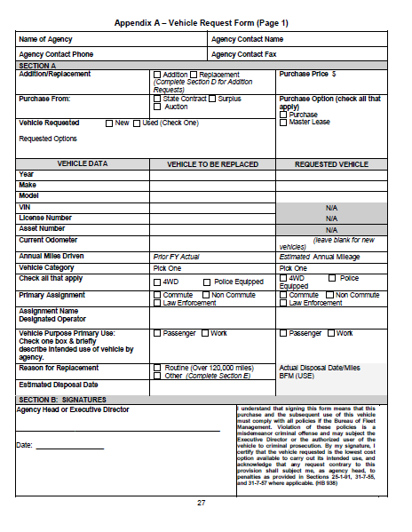
Vehicle Request Form

Slide 154
Purchasing State-Owned Vehicles:
Vehicle Replacement
When “vehicle replacement” is the justification for a new purchase, the vehicle being replaced must be disposed of within 60 days of delivery of the new vehicle
Agencies should identify the vehicle to be replaced with the information required by Section 3.101.03 of the Fleet Manual

Slide 155

Purchasing State-Owned Vehicles:
Vehicle Purchase Records
The department or agency shall maintain proper purchase documentation which provides the intended use of the vehicle and the basis for choosing the vehicle.

Slide 156
Purchasing State-Owned Vehicles:
Title Process
Vehicle Titles should be titled as:
  State of Mississippi/Department of Finance and Administration – Agency Number
    See Appendix H
  Title application shall reflect the requesting agency’s current address as the mailing address on the title with the titles being retained on file at the Agency.
  DFA does not retain copies of titles. For questions regarding titles, contact MS DOR.

Slide 157

Purchasing State-Owned Vehicles:
Marking of State-Owned Vehicles
State Vehicles should have :
  Permanent Decal
  Or Painted on both sides of the vehicle in letters at least three inches in height and on the rear in letters no less than one-half inches in height, Stating the name of the Agency
    Must be in color that contrasts with the vehicle
      Refer to Section 25-1-87 of the MS Code
      NO GHOST MARKINGS – Including law enforcement vehicles

Slide 158
Vehicle Use Policy:
Operating a State-Owned Vehicle
Authorized users include:
  State employees
  State contract workers
  Elected and/or appointed officials
  Independent contractors (where approved on a case by case basis)
  Section 5.201.04 Fleet Manual
Authorized users must have:
  A valid driver’s license (Mississippi residents must have a Mississippi Driver’s License)
  Acceptable driving record (see UA – 1 Form)
  Authorized by their agency to operate a state-owned vehicle

Slide 159
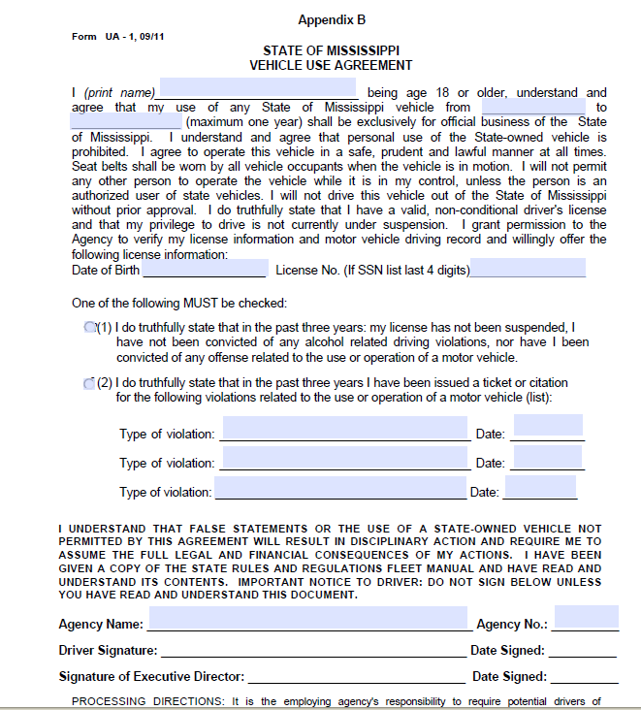
Vehicle Use Agreement

Slide 160

State-Owned Vehicles:
Logs
A daily log of all trips must be recorded for each state-owned vehicle. (See Appendix G for Sample Daily Trip Log.)
Each daily trip log shall contain:
  the operator of the vehicle,
  date of vehicle use,
  beginning and ending odometer reading,
  total miles traveled,
  purpose of each trip,
  and the business locations visited each day

Slide 161
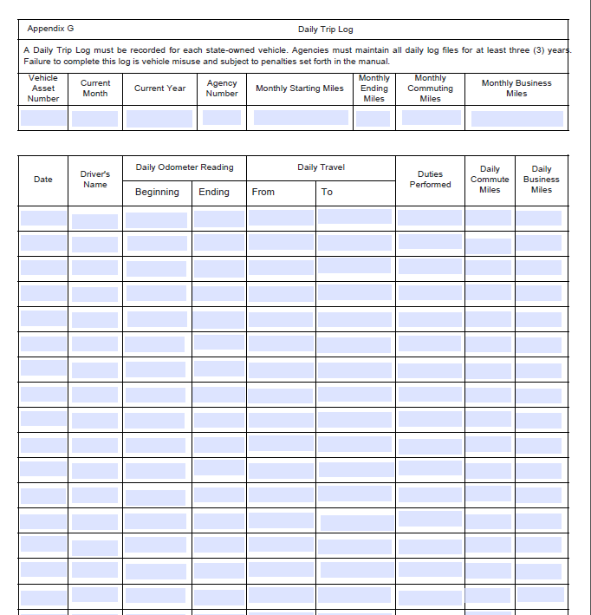
Daily Trip Log

Slide 162
Vehicle Use Policy:
Misuse or Inappropriate Activities
Inappropriate activities or misuse include, but are not limited to:
Using the vehicle for personal use outside of the employees’ scope of employment
Failure to maintain accurate daily trip log (Appendix G)
Use of alcohol in state-owned vehicles
Use of drugs in state-owned vehicles
Use of tobacco products in state-owned vehicles

Slide 163
Vehicle Use Policy:
Misuse or Inappropriate Activities
Inappropriate activities or misuse include, but are not limited to continued:
Improper vehicle assignment
Failure to report changes in driving status;
Falsification of documents
Failure to comply with vehicle safety laws (ex: speeding and /or reckless driving)
Failure to take proper care of the vehicle
Failure to comply with any policy or procedure otherwise set forth herein
Violation of vehicle replacement policy

Slide 164

State-Owned Vehicles:
Unauthorized Usage
Sightseeing or trips for pleasure unless the trip is part of the official agenda for a business conference
Transporting family members, dependents or friends to school, daycare, medical appointments, social events or other personal activities
Conducting other personal business outside the authorized user’s scope of employment

Slide 165
Vehicle Use Policy:
Vehicle Classification
State Vehicles Assignments are classified as:
  Law Enforcement : a state-owned vehicle assigned to a sworn law enforcement officer as defined in section 45-6-3 of the code, or a law enforcement trainee as defined in section 45-6-3 (e) of the code, to be driven in the daily performance of the duties of a sworn law enforcement officer or trainee if use of the vehicle is essential for the employee to carry out their job duties. Agencies must supply a copy of the official certification from the Mississippi Board on Law Enforcement Officer Standards and Training (BLEOST)
  Commute: a state-owned vehicle assigned to be driven from an employee’s official duty station or temporary place of work to an employees residence as needed
  Non- Commute: a state-owned vehicle assigned to be driven to and from an employees official duty station to any temporary place of work and returned to the official duty station on a daily basis. This vehicle must not be driven to and from the employee’s residence

Slide 166

State Vehicle Safety Operation Policy
Impaired Driving
Distractions
Fines
Seat Belts

Slide 167
State Vehicle Safety Operation Policies : Reporting Accidents
Call an ambulance if anyone is injured
Immediately notify the city police, sheriff’s office or highway patrol
Do not move either vehicle until an officer of the law advises you to do so
The Proof of Insurance number that should be entered on the police report is 11-46-15

Slide 168
State Vehicle Safety Operation Policies : Reporting Accidents
Do not make any statement of guilt to any party
Notify your immediate supervisor as soon as possible
Complete a State of Mississippi Liability Claim Report Form, available online
Submit the form, along with police report and any other applicable information to TORT

Slide 169
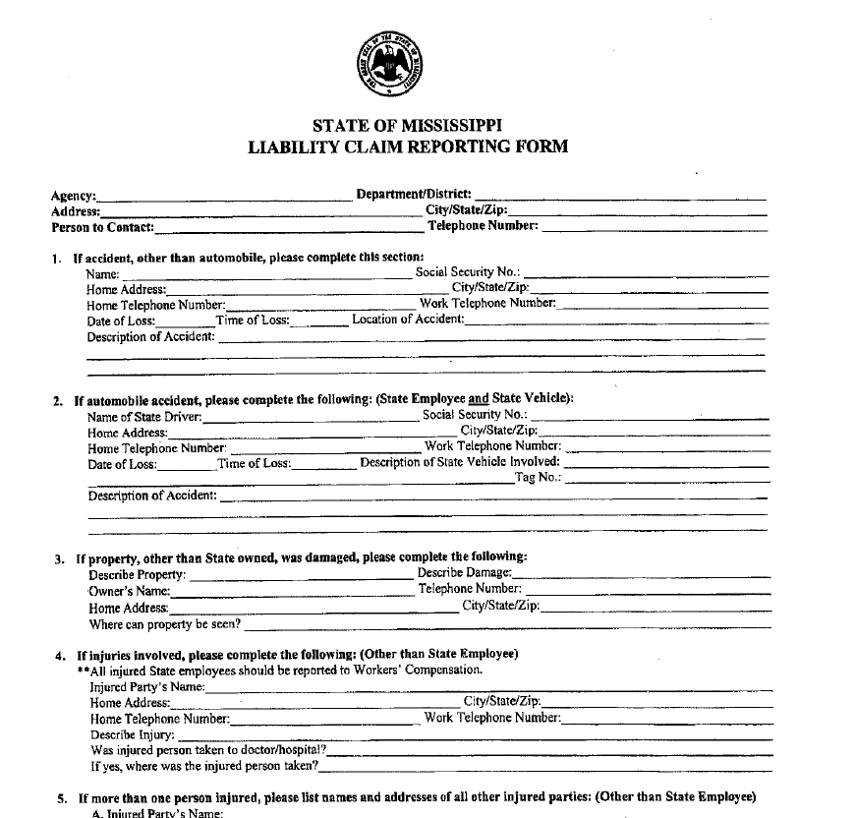
Liability Claim Reporting Form

Slide 170

Maintenance and Care of Vehicles
All agencies are urged to establish a written policy which shall describe the planned maintenance program for its fleet
All maintenance and repairs performed on state-owned vehicles must be documented in MAGIC and retained for the life of the
vehicle

Slide 171

Maintenance and Care of Vehicles:
Fuel Purchases
Gasoline purchases shall be obtained using the state-approved fuel access card from vendor facilities that accept the state-approved Fuel Access Card
Compare FuelMan pricing weekly on the OPTFM website
Only regular unleaded gasoline or diesel from self-service pumps should be used. No higher-octane gas is to be purchased

Slide 172

Maintenance and Care of Vehicles :
Alternative Fuels
Each agency is encouraged to purchase alternative fuel vehicles and use alternative fuels when it is determined that it would be cost effective and would not cause harm to the state-owned vehicle
Purchase of alternative fuels are 100% reimbursable, where pre-approved by the operator’s agency

Slide 173
Vehicle Replacement and Disposition: Replacement Criteria
Vehicle | Years | Miles
Sedans and Wagons | 7 | 150,000
Light Trucks and Sports Utility Vehicles (8,600 GVWR or below) | 7 | 150,000
Passenger Vans | 7 | 150,000
Cargo Vans | 7 | 150,000

Slide 174
Vehicle Replacement and Disposition: Methods
State-owned vehicles which become surplus to the needs of a state agency may be disposed of in any of the following ways:
  Sold
  Traded
  Transferred

Slide 175
Vehicle Replacement and Disposition: State-Owned Vehicle Disposal Specification
The specifications or instructions to prospective buyers should provide a listing of all items being offered and such listing shall provide:
  Make/Model
  Year of Manufacture
  Mileage
  Location (Where the vehicle may be inspected)
  Date and time when vehicle may be inspected
  Address of location to which the bids shall be delivered
  Time and date set for the bid opening
  Name of person to be contacted if additional information is necessary

Slide 176
Fleet Management Certification Program
The Bureau of Fleet Management will be implementing a Fleet Manager Certification Program to ensure that Agency Fleet Coordinators have the necessary knowledge to complete Fleet Management tasks in MAGIC
All agencies are required to have a Certified Fleet Manager in order to procure vehicles
The Fleet Manager Certification Program will consist of a lecture, demo, review, and exam. The Fleet Manager will be required to attend the entire program and pass the exam in order to become a Certified Fleet Manager

Slide 177

Review??
What are examples of “justification” for a vehicle? ?
What is DFA ??
What do I want for dinner??
Why am I taking this class again??

Slide 178

?? Questions ??
See page 117 in the CMPA Manual

Slide 179

Determining Invitation for Bids, Request for Proposals, and Writing Bid Specification Requirements

Slide 180
Unit Objectives
Define key terms
Differentiate between the reverse auction, bidding, and proposal processes
Identify the steps in the bid process and the proposal process
Understand when each process is appropriate
Explain the purpose for specifications
Identify key considerations for developing specifications
Discuss procedures for developing specifications
Explain key restrictions for specifications

Slide 181
Key Terms
Brand Name Specification
Brand Name or Equal Specification
Qualified Products List
Specification
Reverse Auction
Invitation for Bid
Request for Proposals
Notes:
Brand Name Specification – a specification limited to one or more items by manufacturers' names or catalog numbers.
Brand Name or Equal Specification – a specification which uses two or more manufacturer's names or catalog numbers to describe the standard of quality, performance, and other characteristics needed to meet Mississippi requirements and which provides for the submission of equivalent products. The use of Brand Name or Equal Specifications that contain less than two manufacturer’s names or catalog numbers may be cause for rejection of the purchase request by the Office of Purchasing, Travel and Fleet Management.
Qualified Products List – an approved list of supplies, services, or construction items described by model or catalog numbers, which, prior to competitive solicitation, the State has determined will meet the applicable specification requirements.
Specification – any description of the physical, functional, or performance characteristics or of the nature of a supply, service, or construction item. A specification includes, as appropriate, requirements for inspecting, testing, or preparing a supply, service, or construction item for delivery.
Invitation for Bids – all documents, whether attached or incorporated by reference, utilized for soliciting bids.
Request for Proposals – all documents, whether attached or incorporated by reference, utilized for soliciting proposals.

Slide 182

1st things 1st
Upper level Management buy-in
End – User input
$ funds

Slide 183
Reverse Auction General Overview
The Process
  Determination of the need
  Development of bid specifications
  Advertisement placed in local paper and with MPTAP (MS Apex Accelerator)
  Responses are received and reviewed to determine responsiveness; quotes received are used to develop starting price (if they conform to market research)
  Responsive bidders invited to auction event
  Auction is held
  Lowest and best responsive, responsible bidder is awarded
  Other offerors are notified of award
  Contract developed and signatures obtained
  Purchase ordered issued and contract is managed
Notes:
Advertise in local paper and with MDA-MS Procurement Technical Assistance Program (MPTAP (MS Apex Accelerator)
Must run for two consecutive weeks
Cannot open bids sooner than the 8th working day after second advertisement
Determination of Need
End users express a need for purchasing to help them complete their job or make it easier
Check state contracts and agency contracts
Look to see if other departments can share inventory
Quotes
Once all options have been exhausted then proceed with Bid

Slide 184
IFB General Overview
The Process
  Determination of the need
  Determination that RA will not work for this procurement (Exemption from RA granted by PPRB or in the case of a term contract, reverse auction shall not be the primary method)
  Development of bid specifications
  Advertisement placed in local paper and with MPTAP (MS Apex Accelerator)
  Bids are received (with time and date stamp)
  Bids are opened at specified time as advertised
  Results tabulated
  Lowest and best responsive, responsible bidder is awarded
  Other offerors are notified of award
  Award is approved by PPRB
  Contract developed and signatures obtained
  Purchase ordered issued and contract is managed
Notes:
Advertise in local paper and with MDA-MS Procurement Technical Assistance Program (MPTAP (MS Apex Accelerator)
Must run for two consecutive weeks
Cannot open bids sooner than the 8th working day after second advertisement
Determination of Need
End users express a need for purchasing to help them complete their job or make it easier
Check state contracts and agency contracts
Look to see if other departments can share inventory
Quotes
Once all options have been exhausted then proceed with Bid

Slide 185
Why Bid Specifications?
Specifications serve as a basis for obtaining a supply, service, or construction item adequate and suitable for the State's needs in a cost-effective manner, taking into account, to the extent practicable, the costs of ownership and operation as well as initial acquisition costs
Specifications permit maximum practicable competition consistent with this purpose
Specifications shall be drafted with the objective of clearly describing the State's requirements

Slide 186
Specification Sources
Collect as much information as possible from end user as to the function/performance of the requested product
Get product info from industry (brochures, catalogs, specs)
Look for standards and test information from professional societies where available
Call similar agencies in other States to see if specifications already exist
Call on subject matter experts in the purchasing field
NIGP Database of Specs
Notes:
Specification Sources
There are many available sources that can be of assistance to you when you are developing your specifications. Here are suggestions for gathering specification information:
Collect as much information as possible from the end user as to the function and performance of the requested product. Use their expertise and knowledge.
Collect product information from the industry (brochures, catalogs, specs, etc.). Many manufacturers list their catalogs and product specifications on the Internet.
Look for standards and test information from professional societies where available.
Look for specification information from other government entities. Check to see if standard specifications already exist. Use the Internet and e-mail for research. Many states have standard specifications listed on the Internet.
Call on other “experts” in the purchasing community for help.
NIGP: The National Institute of Governmental Purchasing maintains a library of over 10,000 specifications developed by federal, state, and local government purchasing entities in the U.S., and Federal, Provincial, and local entities in Canada.

Slide 187
Why Use Specifications
To maximize competition
To let vendors know what you want while not restricting bidding as well as encouraging open competition
They serve as public records
They are necessary to evaluate bids to determine if the bids are responsive
Notes:
Specifications are written so as to not restrict bidding but to encourage open competition. The goal is to invite maximum reasonable competition. The degree to which specifications are open and unrestrictive directly affects the type and extent of the competition desired.
Specifications are public records; they serve to keep the purchasing open by allowing the public to see exactly what is being purchased. Specifications are used during the evaluation of bids to determine whether or not bids are responsive. Some of the difficulty in preparing specifications stems from the fact that the State can seldom dictate the exact characteristics of the products it wants. The requirements of an agency are usually not sufficient to justify a special or name brand product. Consequently, specifications are developed around a manufacturer’s product specifications. If the specification did not have to satisfy state statutes requiring competitive bidding, the task would be much easier. The immense variety of items purchased by the State further complicates specification writing. Products are improved, new products are introduced, and the needs of the public change. Consequently, the function of preparing and updating specifications must be an ongoing one.

Slide 188
Shall, May, Should, or Will
Use “shall” to denote the imperative
Use “may” or “should” to express non-mandatory provisions
Use “will” to express future requirements or when certain conditions are met
Notes:
Shall, May, Should, or Will?
Use “shall” to express a requirement binding on the contractor or the purchaser.
Use “may” or “should” to express nonmandatory provisions.
Use “will” to express future requirements or when certain conditions are met.

Slide 189
Formulation and Restriction
Specifications for term contracts when issued for the first time will be sent to selected competitive vendors for their review and comment prior to the request for formal bid
It is not the intent to either write or approve any specifications that are restrictive and preclude competitive bidding
It is not the intent to write or allow to be written specifications that are so open and nonspecific as to invite participation by vendors offering less than quality products

Slide 190
Formulation and Restriction
Welcome and invite vendor participation, but do not tolerate vendor dictations
In some cases, specifications will invite bids on a single product or service or major repair part
Notes:
*To conform to and be compatible with items of equipment or furnishings presently in use. When such cases arise, no consideration will be given to an alternate bid.

Slide 191
Authority to Prepare Brand Name Specification
Since use of a brand name specification is restrictive, it may be used only when the Chief Procurement Officer makes a determination that only the identified brand name item or items will satisfy the State's needs
Agencies shall seek to identify sources from which the designated brand name item or items can be obtained and shall solicit such sources to achieve whatever degree of competition is practicable
Notes:
Authority to Prepare Brand Name Specification
Since use of a brand name specification is restrictive, it may be used only when the Chief Procurement Officer makes a determination that only the identified brand name item or items will satisfy the State's needs.
The Agency Procurement Officer shall seek to identify sources from which the designated brand name item or items can be obtained and shall solicit such sources to achieve whatever degree of competition is practicable. If only one source can supply the requirement, the procurement shall be made under Section 3.109, Sole-Source Procurement.

Slide 192
The Right Way
When using brand name or equal, seek to designate as many different brands as are practicable as “or equal”
Be clear that use of brand name or equal is for the purpose of describing the standard or quality, performance, and characteristics desired and is not to limit or restrict competition
List two or more brand names and model numbers and “or equal”, then list the salient features common to all of the identified, acceptable products
Notes:
Use of Brand Name or Equal
Procurement officers may use brand name or equal specifications when they are deemed appropriate to meet the needs of the agency. Brand name or equal specifications may be prepared if it is determined:
No specification for a common or general use item or qualified products list is available;
Time does not permit the preparation of another form of specification, not including a brand name specification;
The nature of the product or the nature of the State's requirements makes use of a brand name or equal specification suitable for the procurement; or
Use of a brand name or equal specification is in the State's best interest.
Brand name or equal specifications shall seek to designate as many different brands as are practicable as "or equal" references and shall further state that substantially equivalent products to those designated will be considered for award. Unless it is determined that the essential characteristics of the brand names included in the specifications are commonly known in the industry or trade, brand name or equal specifications shall include a description of the particular design, functional, or performance characteristics which are required. It must be understood also that where a brand name or equal specification is used in a solicitation, the solicitation shall contain explanatory language that the use of a brand name is for the purpose of describing the standard of quality, performance, and characteristics desired and is not intended to limit or restrict competition.

Slide 193
Specifications Prepared by Architects and Engineers
The requirements regarding the purposes and non-restrictiveness of specifications shall apply to all specifications, including, but not limited to, those prepared by architects, engineers, designers, and draftsmen for public contracts

Slide 194
Ready to Bid?
Where to start…..
Procurement manual is your best friend!
OPTFM Team is a phone call or email away!
OPTFM Web-site
CMPA/CPPO resources

Slide 195
Invitation for Bid Content
Invitation for Bid Content SHALL include the following items:
  (1) Instructions and information to bidders concerning the bid submission requirements, including the time and date set for receipt of bids, the address of the office to which bids are to be delivered, the maximum time for bid acceptance by the State, and any other special information.
  (2) The purchase description, evaluation factors, delivery or performance schedule, and such inspection and acceptance requirements as are not included in the purchase description.
  (3) The contract terms and conditions, including warranty and bonding or other security requirements, as applicable.
The failure to include the items listed above will be cause for rejection
Notes:
Discuss the following information:
Normally the Invitation for Bids Packet will be divided into the following sections:
(1) General Conditions
This section is sometimes referred to as the “boilerplate”. This section includes instructions and information which should be considered by the bidders. This information is standard for all bids and may include how to complete and submit the bid forms, how errors will be handled, how to obtain clarification of the specifications, etc.
(2) Instructions and Special Conditions
This section includes instructions and information which is pertinent and unique to the particular Invitation for Bids. This may include special delivery requirements, bonding, installation, etc. This section should include information concerning the method used to evaluate and award the contract (i.e., all or none, line item, life-cycle-cost, etc.)
(3) Specifications
This section should clearly describe the minimum requirements and any testing requirements.
(4) Bid Form
A bid form should be provided so that all bidders are submitting pricing in a similar format. Instructions on the proper completion of the bid form should be included if needed.
(5) Execution Page
The packet should include a page for the bidder to complete showing bidder information such as name, contract administrator, address, phone, e-mail, fax, etc. This should also include a space for the bidder to provide a signature indicating the bidder’s acceptance of the terms and conditions and commitment to honoring the prices bid.

Slide 196
Public Notice and Opening
Public Notice
  Public notice of Invitation for Bids when anticipated expenditure is more than $75,000, shall be made in compliance with Section 31-7-13(c), Mississippi Code of 1972, Annotated.
Bid Opening
  Bids shall be opened publicly in the presence of one or more witnesses at the time and place designated in the Invitation for Bids. The name of each bidder shall be recorded. The amount of each bid and such other relevant information as may be specified by regulation may be recorded; the record and each bid shall be open to public inspection as provided in Section 1.108, Public Access to Procurement Information.

Slide 197
Correction or Withdrawal
Public Notice Correction or withdrawal of inadvertently erroneous bids before or after award, or cancellation of awards or contracts based on such bid mistakes shall be permitted in accordance with regulations
After bid opening, no changes in bid prices or other provisions of bids prejudicial to the interest of the State or fair competition shall be permitted
Except as provided by regulation, all decisions to permit the correction or withdrawal of bids, or to cancel awards or contracts based on bid mistakes shall be supported in writing

Slide 198
Bid Acceptance & Evaluation
Bids shall be unconditionally accepted without alteration or correction, except as authorized by regulations
Bids shall be evaluated based on the requirements set forth in the Invitation for Bids
Those criteria that will affect the bid price and be considered in evaluation for award shall be objectively measurable
The Invitation for Bids shall set forth the evaluation criteria to be used
No criteria may be used in evaluation that are not set forth in the Invitation for Bids

Slide 199
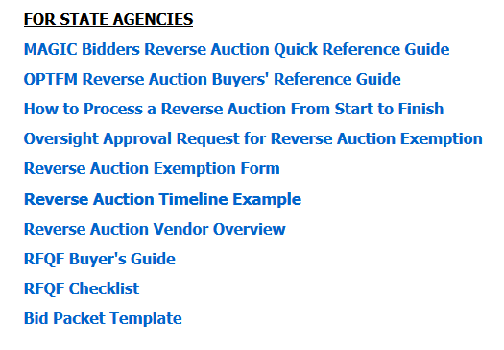
How are Reverse Auctions Different?
Generally speaking, the process is very similar
Invitations for Bids contain mostly the same information, with the addition of details about how bidders will be selected to participate in the auction, the request for quotes, and other details about the auction
OPTFM has all necessary information to conduct an auction on its website including a Bid Packet Template and a Timeline Example

Slide 200
Responsive vs. Responsible
Responsive Bidder – a person who has submitted a bid which conforms in all material respects to the Invitation for Bids
Responsible Bidder or – a person who has the capability in all respects to perform fully the contract requirements and the integrity and reliability which will assure good faith performance

Slide 201
Award
The contract shall be awarded with reasonable promptness by written notice to the lowest responsible bidder whose bid meets the requirements and criteria set forth in the Invitation for Bids

Slide 202
Request for Proposals
Use when determined in writing that the use of competitive sealed bidding is either not practicable or not advantageous to the State, a contract may be entered into by competitive sealed proposals
1st Prior approval must be obtained from the PPRB
Refer to Procurement Manual for specifics regarding advertising requirements, evaluation techniques, and award procedures.
Many new requirements from HB 1109! (Sections 31-7-401 – 31-7-423 of the MS Code)

Slide 203
“Practicable” Distinguished from “Advantageous”
The term “practicable” denotes what may be accomplished or put into practical application
“Advantageous” denotes a judgmental assessment of what is in the State’s best interest
Competitive sealed bidding may be practicable; that is, reasonably possible but not necessarily advantageous; that is, in the State’s best interest

Slide 204
General RFP Information
Discussions may be conducted with responsible offerors who are reasonably susceptible of being selected for award
Offerors shall be accorded fair and equal treatment with respect to any opportunity for discussion and revision of proposals
Award shall be made to the responsible offeror whose proposal is determined in writing to be the most advantageous to the State
No other factors or criteria (other than those identified in the proposal) shall be used in the evaluation
Public Records Act

Slide 205
Difference between IFB & RFP
Invitation for Bid (IFB)
Request for Proposals (RFP)
IFB may be used to procure high-cost items with easily definable characteristics
IFB may be used when “what” and “how” is known
Any state agency can issue an IFB
Remember reverse auction is the primary method of receiving bids
RFP may be used when the award will be based on more than price alone
RFP may be used when “what” is known but not “how” or “how” may vary from one vendor to another
Only Certified Purchasing Offices can issue a RFP without prior approval from PPRB

Slide 206
Debriefings
In accordance with Chapter 3, Section 3.107.18 of the Manual, the Agency Procurement Officer is authorized to provide debriefings that furnish the basis of the source selection decision and contract award. Debriefings may only be conducted when utilizing the competitive sealed proposal process as authorized in Chapter 3, Section 3.107.

Slide 207

Activity
Break into groups to complete “Right item specification activity”

Slide 208
Review Questions
Page -129-

