Slide 1
Contracts / PO Process for CMPA Training

Slide 2
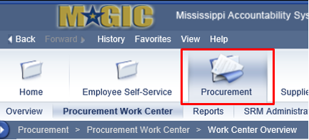
Basic Navigation
Select the Procurement tab and then click on Procurement Work Center.
To create an Contract, click on the Contract link.
To search for an existing Contract, click on the Contract icon.
Notes:
There are two ways to create an RFx. One is via Shopping Cart and the other is to create the RFx directly.

Slide 3
Contract Types
The following are Contract Types used in MAGIC:
Contract Types | Description
CNTR | General Purchasing
SOLC | CNTR/Oversight Appr
EMEC | Emergency Contract
LSAG | Legal Services
SWCT | Statewide Contract
EPLC | Express Products List
BRCT | BRICKS Construction
BRLE | BRICKS Lease
MDOT | MS Dept. of Transportation Construction
OREQ | Oversight Request
Notes:
Contract types are used to identify various contracts. If the incorrect contract type is selected, the contract must be deleted and started again with the correct type. Contract types cannot be modified after the selection has been made.
We will explore each one of these contract types in detail on the next slides.

Slide 4
Contract Types
Selecting the Contract type is very important.
The type of Contract cannot be changed once created.
The selected Contract type determines the Smart Number assigned and the information that must be entered to create the Contract.
Notes:
Note: The only documents that contain SMART numbers are the RFx and Contract. The RFx SMART Number is only applicable to the RFx. If a contract is created as a follow-on from the RFx, the contract will have its own unique SMART number. All other documents (i.e. Invoices, PO’s) will have a unique system generated number.

Slide 5
Contract Process Flow
1
2
Create Contract
(Manually)
Create Contract
(Shopping Cart)
3
Create Contract
(from RFx)
Release Contract for Approval via Workflow
Contract Released Available as Source of Supply
No
Workflow Contract Approval
(UWL)
Oversight Approval Required?
Edit Contract
Reject
Approve
Yes
Approve
Oversight Contract Approval
(UWL)
Reject
Notes:
This is a high level process flow for contracts
There are 3 possible starting points for the contract creation process
Create a contract manually without reference to an existing document
Create a contract with reference to a shopping cart (will not detail in this course)
Create a contract from an accepted RFx
Contracts are managed in the MAGIC portal via Supplier Relationship Management (SRM).
A contract shell can be created when line items are entered directly, or imported from a Shopping Cart or RFx.
Upon completion the contract is sent to the appropriate oversight agencies for approvals (OPTFM, ITS, AG,MSPB and OPSCR).
The Contract and related attachments are also available in Records Management. Records management acts as an electronic “file cabinet” for all of the documents generated within MAGIC.

Slide 6
Contract Approval Overview
Workflow uses the organizational structure to determine who approves which requests.
Request
Approve/ Reject
Workflow

Slide 7
Contract Approval Workflow
Workflow is triggered when the Release button is selected.
The number of approvals is based on factors such as Contract Type, Target Amount, and Product Category.
The Approval path is shown under the Approval tab.
An Ad-hoc Approver can be added prior to submitting the document for approval.
Once all approvals have been secured, the contract status will show “Released”.
Notes:
Only people with an approval role within the agency can be added as an adhoc approver.

Slide 8
Approval Tab
The Approval tab provides the approval path and status in workflow
Notes to the approver can be added in the Header Approval Note
Notes:
Process Step, Current Status, Processor, Received & Processed On, Forwarded By, and Work Item ID
Status:
In process – Buyer is creating contract
Recall – creator of the contract is making edits prior to contract approval
Revision – contract has been rejected and creator is revising contract
Open (No Decision Made) – contract has been released for approval but approver has not made a decision yet
Rejected – approver has rejected contract
Approved – approver has approved contract
Automatic System Approval – no approver required, system approved

Slide 9
Approval Types
There are different types of approvals:
Agency Buyer Manager approval
Oversight approval
Board (Offline) Approval

Slide 10
Agency Buyer Manager Approval
The Agency Buyer Manager Approval is the first in the sequence of approval steps.
Various Approvals apply depending upon approval threshold and the contract amount.
If the Buyer Manager creates the contract, this level of approval does not apply.

Slide 11
Oversight Approval
Oversight approvers include OPSCR, OPTFM, ITS, SPB, and AG.
In some cases, there could be multiple levels of approval.
If additional approval is needed besides Oversight Approval, manually add an Ad-Hoc Approver.
Notes:
Example of mulitple levels of approval: Legal contracts may require approval from both the AG’s office and State Personnel Board’s Legal Division
Note: Oversight entity can be added as an Ad-Hoc approver, if necessary.

Slide 12
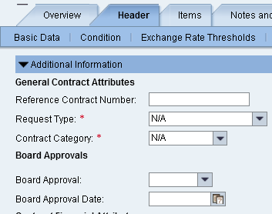
Offline Approvals
Agencies can obtain Offline or Board Approval and record it on the contract.
Agency/Board Approvals are manually set to ‘Approved’ with the Approval Date.
Notes:
Offline approvals are approvals obtained outside of MAGIC through emails or signatures on legal contract documents. These approvals are not electronically routed through the system. They are usually wet signatures obtained from an agency board or oversight board. Once the offline approvals are received, Buyers can update the Agency/Board Approval field on the Contract Header>Additional Information tab to record the approval decision (approve or reject) along with the date the approval was obtained.

Slide 13
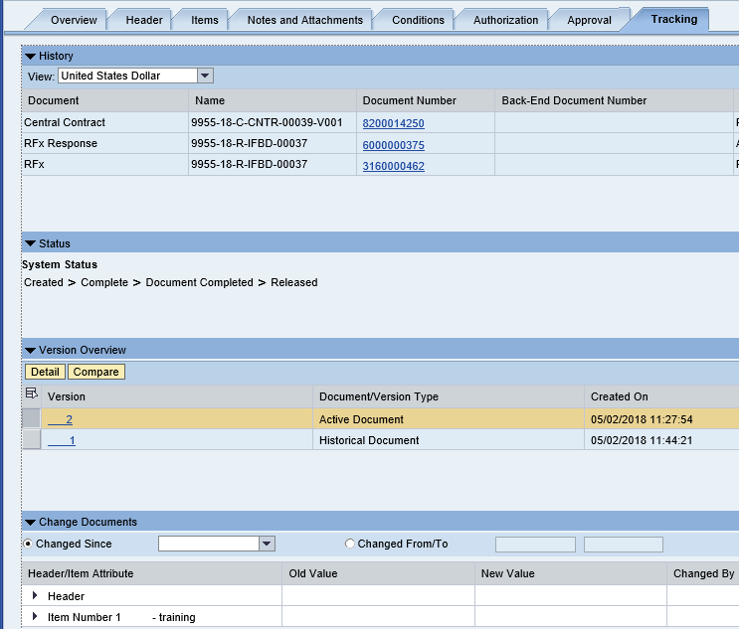
Tracking Tab
The Tracking tab contains the following:
History
Status
Version Overview
Change Documents
Notes:
History - provides links to any associated documents
Status - provides the historical flow of system status on the Contract
Version Overview - provides for comparison between two versions
Compare Versions - You can only compare two versions of a document at a time using the Compare button. (Note: You must hold the Shift key to select multiple versions.)
Change Documents Details - displayed by expanding the various sections to view changes.

Slide 14
Contract Alerts
Certain events can trigger alerts:
The contract is about to expire.
The release quantity is approaching the Target Quantity for a contract.
The Release Value is approaching the Target Value (at both Header and Item level) for a contract.
NOTE: Alerts go to all users of the Purchase Group regardless of the function.

Slide 15
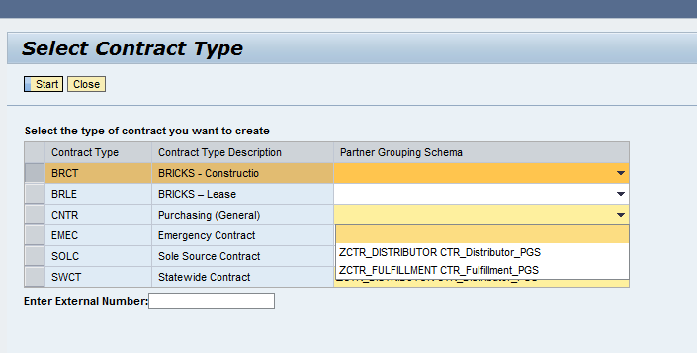
Distributor/Fulfillment Contract
When creating a contract with Distributors or Fulfillment Vendors, the Partner Grouping Schema must be identified at the point the Contract Type is selected.
Notes:
Once the Contract Type or Partner Grouping Schema is selected, it cannot be changed.
Distributors or Fulfillment vendors can be added to the contract. Both Partner Grouping Schema types cannot be included on a single contract.

Slide 16
Distributor/Fulfillment Contract
Distributors and Fulfillment Vendors are added to the contract under the Header Partner functions
Notes:
Multiple Distributors or Fulfillment vendors can only be added to the contract one at a time.
Once a vendor is added at the Header, it applies to all lines of the contract. If, however, a Distributor or Fulfillment vendor does not apply to a specific contract line, it must be deleted from Partners at the line item level.

Slide 17
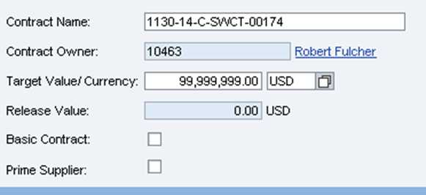
Distributor/Fulfillment Contracts
If the vendor on the contract can also fulfill the orders, the Prime Supplier Flag must be checked.
Notes:
If Prime Supplier is checked, the prime vendor will be available for selection in the dropdown when creating Shopping Cart and POs which reference the contract.
This field is located on the Overview Tab of the Contract.

Slide 18
CONTRACT SPEND
PO’s referencing service contract lines
Display effect on release value
Reducing line item amount
Cancelling PO’s
Explain PO Close processing
Direct Invoices
Display effect on release value

Slide 19
Contract Items on POs
When creating the PO with a contract line item, you can select Contract from the Add Item list.
The search options related to Contract:
Contract name or number
Supplier
Product
Product Category
Search results displays a list of all contracts valid for the search criteria
Purchase Orders should be created for all items with a contract, even if the items do not require a PO. This will allow for posting of the final invoice payment after the contract has expired.
Notes:
If a PO is not created for a contract item, you will have to use a special request process through the Office of Fiscal Management to pay the invoice from an expired contract.
If account distribution is selected to make payments on contracts (via the Finance Dept.) without a PO, and the contract expires, Finance can not generate a payment after the expiration date.
If contract is expired but invoice is prior to expiration date then they are fine. But if invoice date is after contract day then can’t pay without the waiver process.. On direct entry it’s looking at the invoice date.

Slide 20
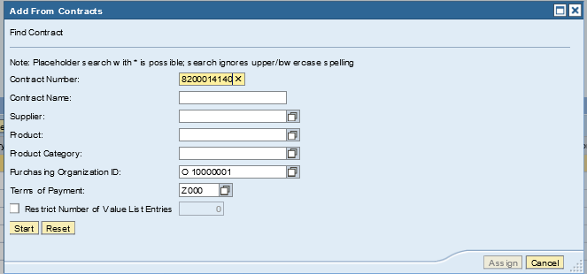
Contract Items on POs
Notes:
Use the Add from contract option in the Add Items menu
Key your contract number into the Contract number field and click start to being the search

Slide 21
Contract Items on POs
Notes:
Click the twisty to view the line items from the contract

Slide 22
Contract Items on POs
Notes:
Click assign to assign the item to your purchase order
You will have to perform these functions multiple times in order to add multiple lines from a contract. The system will only add one at a time.

Slide 23
DEMO
Demonstration of the
Contract Creation and PO Creation Process

Slide 24
Questions

Slide 25
Support Information
Go to the MMRS section of the DFA website for the latest Customer Support information.

