Slide 1


Office of Personal Service Contract Review
Mississippi Department of Finance and Administration

Slide 2
What is OPSCR? The Office of Personal Service Contract Review is an office at the Mississippi Department of Finance and Administration. OPSCR serves as staff to the PPRB for oversight of procurement and contracts for personal and professional services. OPSCR also consults with agencies regarding the procurement process and compliance with the PPRB OPSCR Rules and Regulations.

Slide 3
Who Works at OPSCR? Teselyn Funches, Director Teselyn.Funches@dfa.ms.gov (601) 359 -5114 Lance Fulcher, Deputy Director OSSS April Burns, Deputy Director OSSS Shannon Smith, Contract Analyst OSSS Lance.Fulcher@dfa.ms.gov April.Burns@dfa.ms.gov Shannon.Smith@dfa.ms.gov (601) 359-5286 (601) 359-5198 (601) 359-3451 OPSCR@dfa.ms.gov OSSS@dfa.ms.gov
Kimberly Burse, Contract Analyst Kimberly.Burse@dfa.ms.gov (601) 359-5023 | Jonathan Dillard, Contract Analyst Jonathan.Dillard@dfa.ms.gov (601) 359-6580
Angela Cooper, Contract Analyst Angela.Cooper@dfa.ms.gov (601) 359-5203 | Chelsea Stewart, Contract Analyst Chelsea.Stewart@dfa.ms.gov (601) 359-9312
Trina Kelly, Contract Analyst Trina.Kelly@dfa.ms.gov (601) 359-2724 | Shantina Christmas, Administrative Assistant Shantina.Christmas@dfa.ms.gov (601) 359-3422

Slide 4
What is a Service Contract? A contract in which the Contractor furnishes labor, time, or effort not usually involving the delivery of a specific end product other than that which is incidental to the required performance.

Slide 5
Contract Approval Types
Board Approval
Contracts requiring Board approval.
Must be submitted on or before the first Wednesday of the month to be approved the following month.
Incomplete submission packets may result in the item being pushed to the following month.
Staff Approval
Contracts which can be approved by OPSCR staff.
Up to 30-day approval timeline.
Board items will be processed first.

Slide 6
Personal & Professional Services Procurement 101

Slide 7
Mississippi Procurement Organization
Public Procurement Review Board
Information Technology Services Board
Mississippi
Department of
Finance and Administration
(DFA)
Mississippi
Department of Information Technology
Services (ITS)
OPSCR:
Personal and
Professional Services
OPTFM:
Purchasing, Travel,
Fleet Management
BOB:
Buildings, Construction
RPM:
Real Property
Information Technology Systems, Commodities,
and Services

Slide 8
Purpose of the PPRB The Public Procurement Review Board is charged with promulgating rules and regulations governing the solicitation and selection of contractual personnel, including personal and professional service contracts.

Slide 9
The PPRB’s role is to ensure compliance with procurement laws and regulations and to maintain
COMPETITION
FAIRNESS
TRANSPARENCY
in the solicitation and award of contracts.

Slide 10





Who are the Members of the PPRB?
Norman McLeod
Rita Wray
Norman Katool,
Vice Chair
Billy Morehead
David Russell,
Chair
Liz Welch, Executive Director of DFA, Ex Officio & Non-Voting Member
3 Appointees by the Governor
2 Appointees by the Lieutenant Governor

Slide 11
PPRB Threshold for Services Personal and professional services contracts involving expenditures of funds in excess of $75,000.00 must be approved by the PPRB, unless otherwise exempt. Miss. Code Ann. § 27-104-7(2)(g) The total expenditures shall not be artificially divided and agencies shall not underestimate the extent of services required in order to avoid PPRB purview. Contracts for $75,000.00 or less will not route to OPSCR for review and approval unless the agency has multiple contracts with the same vendor and the cumulative value of those contracts exceeds $75,000.00.

Slide 12
Exemptions (Miss. Code § 27-104-7) IT Non-IT Commodities Accountant* Auditor * Architect * Attorney* Engineer * Anatomical Pathologist * Utility Rate Experts * Actuaries * MDOT VAB (limited) PERS (relating to managing trust funds) Agency with ONLY non-state service employees IHL Entertainers at the Mississippi State Fairgrounds DFA (aircraft, Mental Health Accessibility) DPS (specialized forensic lab equipment) *These professionals must be performing duties for which they are licensed or certified.
PPRB Purview Over Service Contracts
Inclusions
Personal Services:
Consulting
Policy Analysis
PR
Marketing
Public Affairs
Legislative Advocacy (lobbyist)
Temporary Staffing
Janitorial Services
Linen/Laundry
Educational Testing
Waste Management
Transportation
Microfilming
Security
Advertising
Insurance
Food Services
Professional Services:
Nurses
Psychologists
Physicians
Psychiatrists
Dieticians
Lab Services
Medical Personnel
Pharmacists
Pilots
Therapist
“any other contract that
the board (leadership) deems appropriate for oversight”

Slide 13
When does the PPRB meet? The PPRB meets on the 1st Wednesday of every month at 9:00 a.m. Special meetings are sometimes called for hearings or overflow contracts (not for late contracts). Meetings are currently being conducted virtually. A link to the meeting is available on DFA’s website. Agency representatives are asked to be available for OPSCR to contact during the meeting if the Board has questions about your contract.

Slide 14
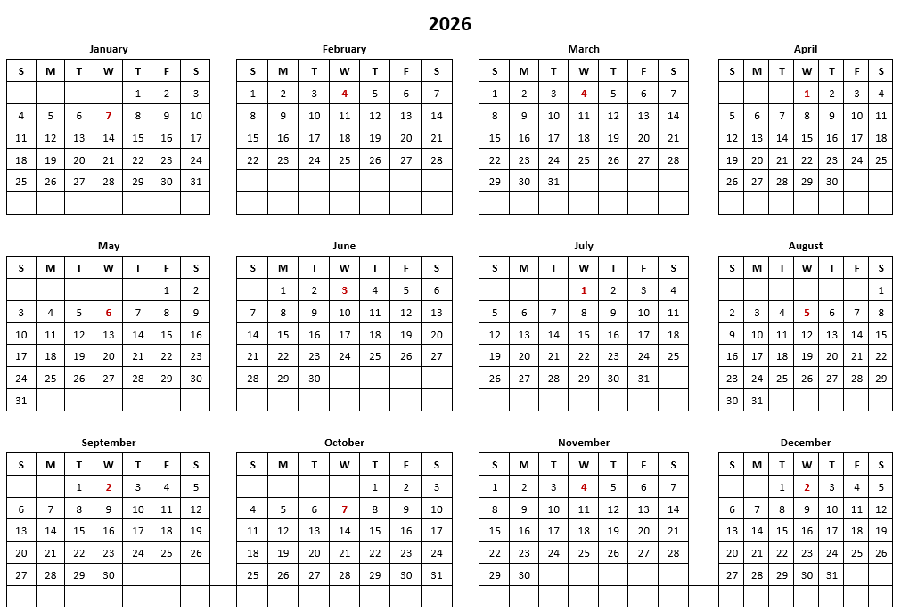
What is the Deadline to Submit Contracts for PPRB Approval? Approximately 30 days prior to the next Board Meeting

Slide 15
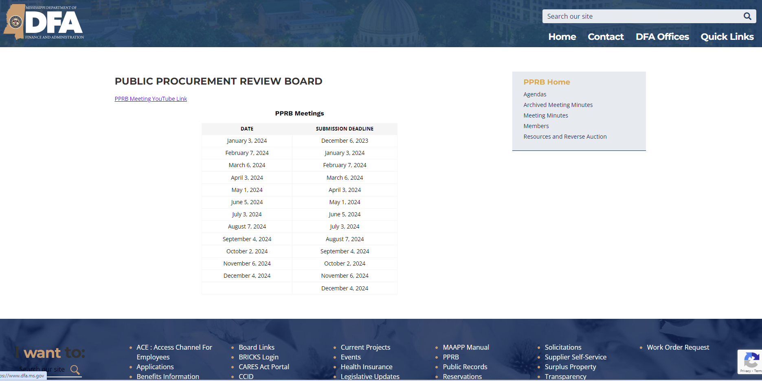
Where can I get more information about the PPRB? The Meeting Dates, Agendas, and Minutes are posted on the DFA website: www.dfa.ms.gov
You may also receive regular communication about PPRB meetings
and other information about oversight of service contracts from OPSCR@dfa.ms.gov.

Slide 16
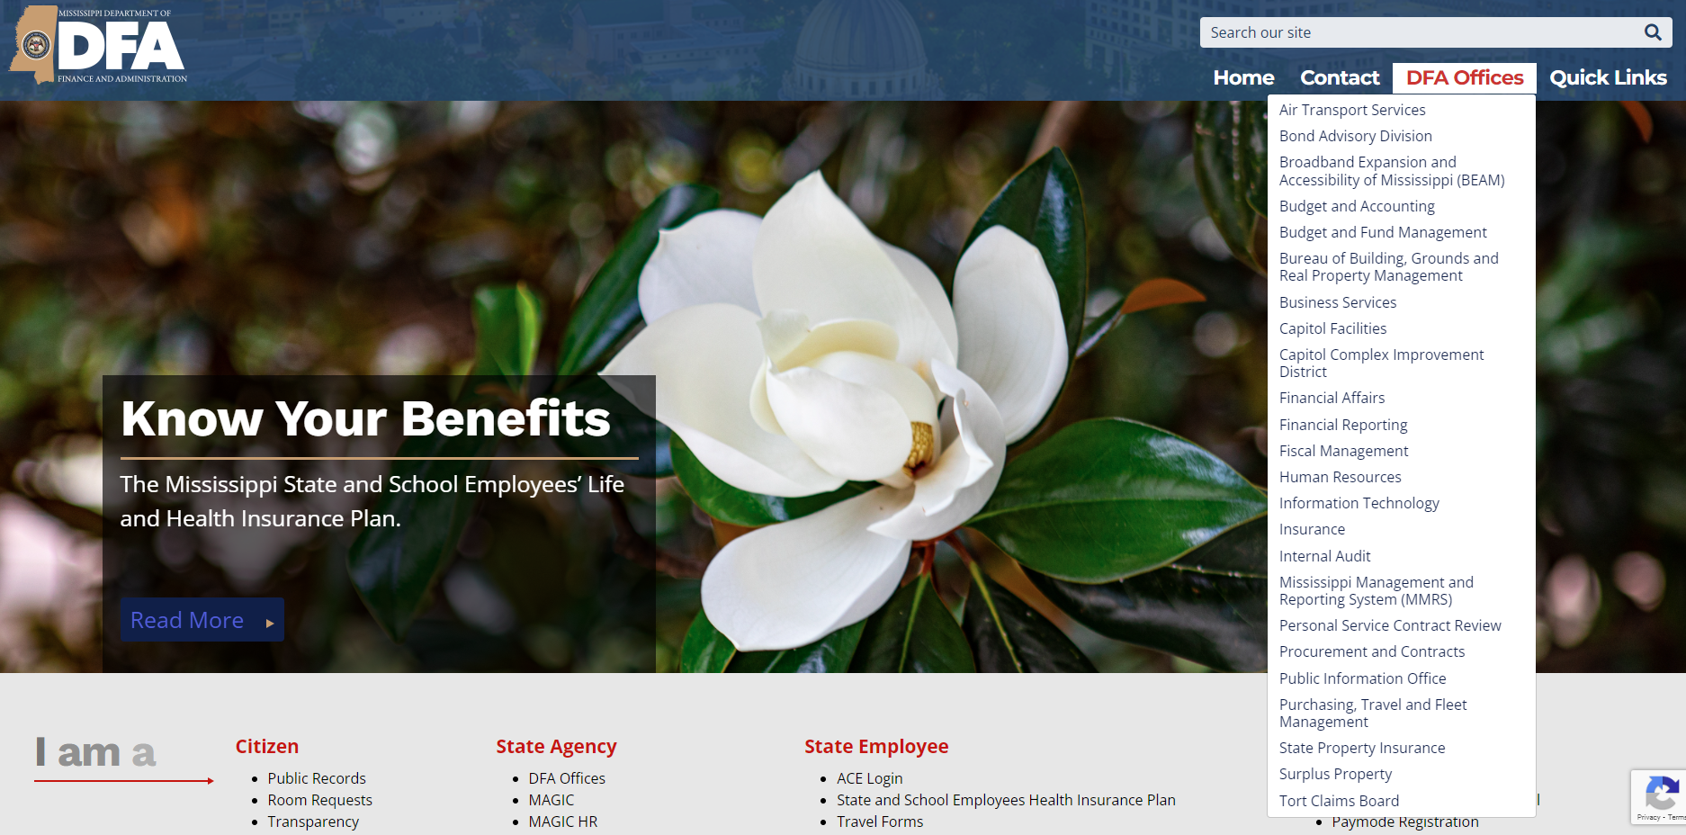

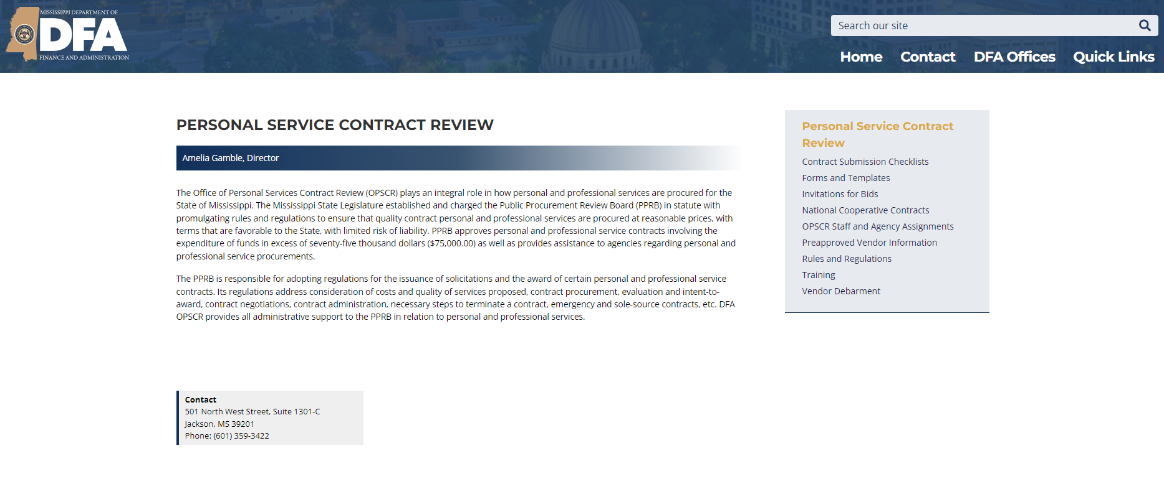
What Governs Procurement of Services? The PPRB OPSCR Rules and Regulations (R&R) govern solicitation of personal and professional services. The R&R can be found on the DFA website: www.dfa.ms.gov.
Mississippi Code § 27-104-7
PPRB threshold, purview, exemptions
§ 31-7-401 et seq.
RFP and RFQ solicitations
§ 25-9-120
PSCRB to PPRB
effective January 1, 2018

Slide 17
Procurement Cycle for Services
Need Identified
Implementation and Contract Administration
Determine Purview
Board Approval and Contract Execution
Procurement
Method Chosen
Evaluation and Contract Award
Prepare Solicitation with SMEs
Issue Solicitation and Receive Responses

Slide 18
How Can My Agency Procure a Needed Service?
1. Invitations for Bids 2. Requests for Proposals* 3. Requests for Qualifications* 4. Requests for Applications 5. Small Purchases 6. Sole Source Procurement | 7. Emergency Procurement 8. Exigent Circumstances 9. PVLs/Cooperatives 10. Statutory Exemptions 11. Government-to-Government 12. No Cost Contracts
*RFP and RFQ require prior approval from PPRB.

Slide 19
Invitation for Bids R&R Chapter 5

Slide 20
Competitive Sealed Bidding is the Statutorily Preferred Method of Procuring Services in Mississippi Miss. Code § 31-7-403(1) Bids are Evaluated To Determine if the Vendor: (1) is Responsive to the Invitation for Bids (2) Is Responsible to Provide the Service (3)Bid the Lowest Price

Slide 21
Content of IFB the IFB shall include: Instructions & Information regarding Bid Submission Requirements: Time/Date set to receive Bids Address to Deliver Bids A Bid Form Latest Time Bids will be Accepted (maximum time for bid acceptance) Manner of Bid Submission (including relevant forms) The Description of Services or Scope of Work, Minimum Qualifications and Supporting Documents, and other Acceptance Requirements The Contract Terms & Conditions PPRB OPSCR Rules & Regulations Section 5.1

Slide 22
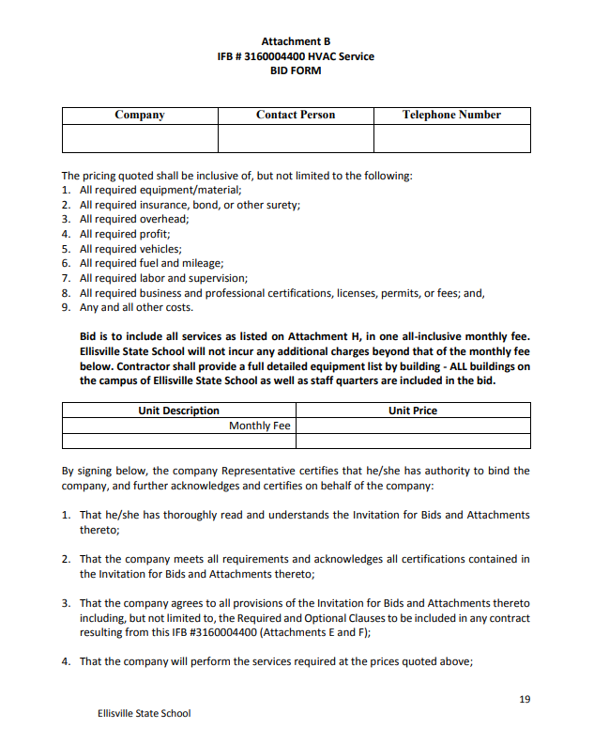
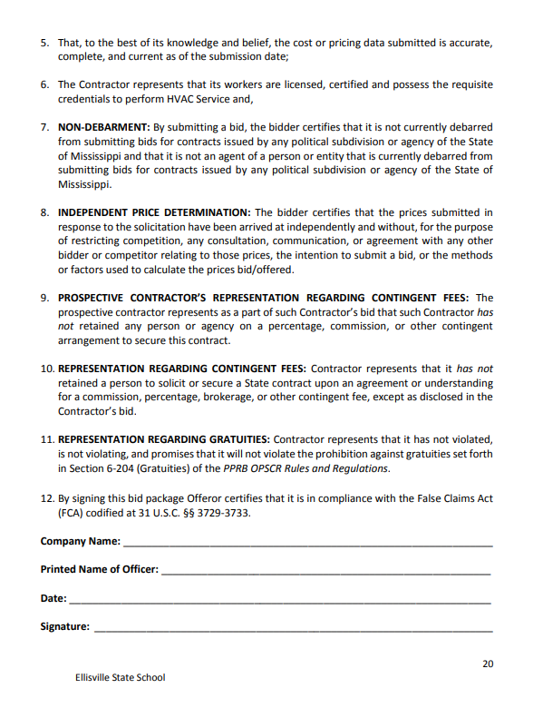

Bid Form R&R Section 5.1.3 Bid forms are required to be provided by the agency and all bidders must submit the bid price using the required form.

Slide 23
Converting an RFP/RFQ into an IFB The Scope of Work should be very detailed and specific. Work with Agency SMEs to know exactly what you need. Spell out precisely what you want and how you want it done. Anything that is not specified in the IFB will not be required of the contractor.

Slide 24
Key Phases of an IFB Procurement
PUBLIC NOTICE
Procurement Portal
Agency Website
Newspaper, published twice
BID OPENING
Location, Record, Attendance Log
MINIMUM REQUIRE-MENTS
Responsive & Responsible
BID EVALUATION
Calculate Lowest Bidder
AWARD
Notice of Intent to Award sent to Bidders, Agency Website, Procurement Portal

Slide 25
Publication R&R Section 5.2 Furnished to a minimum of 3 Bidders Required Publication: Newspaper (1x per week for 2 consecutive weeks) – Legal Notice Section, County of Agency Agency Website Procurement Portal Content of Newspaper Advertisement: Agency Name Personal or Professional Services Sought Due Date for Responses Name & Contact Information of Procurement Officer Means of Obtaining the Solicitation RFx Number Time for Publication: 30 Calendar Days Prior to Bid Submission Deadline Unless Chief Procurement Officer determines a shorter time is necessary – 14 day minimum

Slide 26
Amendments to the IFB R&R Section 5.3
Bidders must acknowledge receipt in writing
Distribution: all prospective bidders
procurement portal
agency website
“within a reasonable time” to be considered (14 calendar days)
Q&A documents must be treated as an amendment
Pre-Bid Conference (optional): explain procurement requirements
14+ days after IFB issued
must be recorded
transcript and Q&A become amendments

Slide 27
Bid Opening R&R Section 5.4
Bids shall be date stamped upon receipt
Remain unopened until time set for bid opening
Opened privately
one or more witnesses (Agency officials)
names of witnesses recorded
Time & Date in IFB
Name of Bidder & Price recorded

Slide 28
Bid Evaluation
Responsive
Responsible
Lowest Price
Does the bid meet the technical requirements of the IFB?
Page Numbers, Signed Certification, Correct Number of References, etc.
Is the Bidder capable and qualified to perform the work?
Minimum Requirements,
Experience, Reference Checks, Equipment, etc.
Of the Bidders deemed Responsive and Responsible, who bid the lowest price?
Cannot use evaluation criteria which is not contained in the IFB.
Be consistent!!! Consult with agency legal!!!
Can you defend your decisions?

Slide 29
Reasons to Reject Bids or Cancel Solicitation R&R Section 5.7
Non-responsible
Non-responsive
Agency determined the proposed price was unreasonable
Lack of competitiveness
Collusion
Reasonably available competition not received
Error in specifications
Cancellation or changes in the intended project
Limitation or lack of available funds
Vendors whose bids are rejected shall be promptly notified
in writing of the rejection and the reasons therefor.

Slide 30
Award Lowest Responsive and Responsible Bidder
Notice of Intent to Award
Provided to the public regarding intention of agency
to award the contract to the successful bidder.
Published at the time the successful
bidder is notified.
Distributed to all bidders, agency website,
and the procurement portal.
Ranks all bidders and their prices from lowest to highest and recommends successful bidder for contract award.
States reasons why successful bidder was selected.
Public Posting of Agency Procurement File
Notice of Contract Award
Provided to the public regarding the agency’s
final award of the contract.
Published following PPRB approval
and contract execution.
Distributed on agency website and
procurement portal
Contains an analysis of why the contract was awarded, renewed, or amended; a summary of the award including the nature, amount, and duration of the contract, name of the bidder, and statement that the contract is available for public inspection.

Slide 31
Debriefing and Reconsideration
Vendor receipt of the Notice of Intent to Award and posting of the Agency Procurement File triggers the Debriefing and Reconsideration periods.
Email Delivery Receipt & Read Receipt
Vendors must be debriefed prior to the contract being presented to PPRB for approval.
Vendors have 3 business days to file a Request for Reconsideration of the Intent to Award. Reconsideration is limited to what is in the procurement file, the terms of the solicitation, and violations of OPSCR’s rules and regulations.
Requests for Reconsideration must be resolved for Board approval.

Slide 32
Requests for Applications and Contract Workers R&R Chapter 7

Slide 33
Request for Applications An RFA can only be used to procure WIN contract workers. The Agency establishes: Rate of Pay Minimum Qualifications Scope of Work

Slide 34
Publication Time: 14 calendar days Where: Procurement Portal Newspaper or Recruiting Website or Both Agency Website Sent Directly to At Least 3 Potential Applicants (recommended) Content: Name of Agency & Means of Contacting Procurement Official Minimum Qualifications for the Position Period of Performance Rate of Pay Deadline to Submit Applications Manner to Submit Applications

Slide 35
Evaluation Classify all applications as responsive and responsible. (Do they meet your minimum requirements?) It’s recommended that all acceptable applications be evaluated by the same person or committee. Interviews may be conducted and applicants shall be evaluated on predetermined criteria.

Slide 36
Award Notification of Intent to Award shall be given to applicants, posted on the Agency’s website, and posted on the procurement portal. Notice of Contract Award shall be made available to the public following approval by the PPRB and any other required entities and final execution. Notice shall include an analysis of why the contract was awarded, renewed, or amended. Applicants do not have an automatic right to a Debriefing or Reconsideration.

Slide 37
Contract Worker The Agency must make a written determination that a worker is a contract worker and not an independent contractor.
Behavioral Control
Does the Agency treat the person as an employee (set schedule, heavily supervise, uses agency supplies, etc.)?
Instructions given to worker
Training provided to worker
Financial Control
Reimbursement of business expenses
How the worker is paid
Extent of worker’s investment
Can the worker realize a profit or loss
Extent to which the worker makes services available in the marketplace
Contract Worker
Does the Agency render very little control over the day-to-day activities of the person (only concerned about the end product)?
Relationship of the Parties
Written contract
Employee-like benefits
Permanency of relationship
Extent to which worker’s work is a key aspect of business
Independent Contractor

Slide 38
Small Purchases R&R Chapter 13

Slide 39
$75,000.00 and Under PPRB Approval NOT Required
$50,000.01 to $75,000.00
“Insofar as it is Practical”
3 Written Quotes
Award to Lowest
Responsive & Responsible Quote
Keep Records
$50,000.00 and Under
Agency Standard
Operating Procedure
“Adequate and
Reasonable Competition”
Keep Records

Slide 40
Sole-Source Procurement R&R Chapter 9

Slide 41
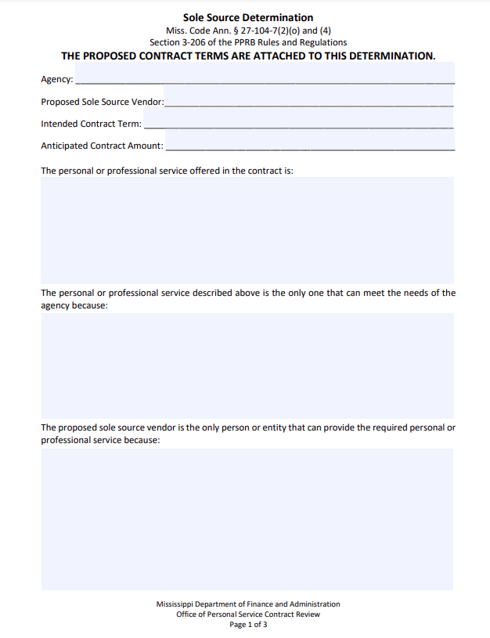
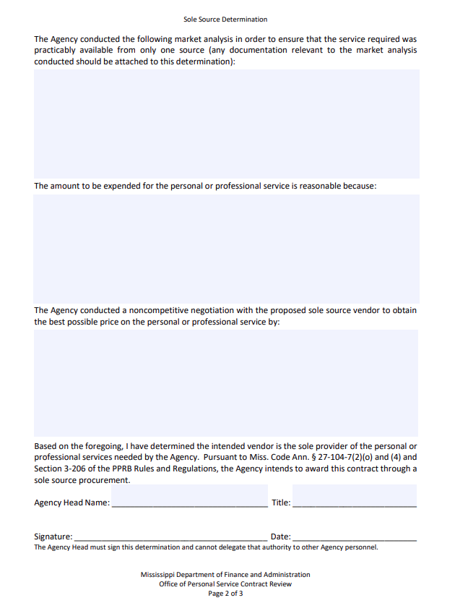
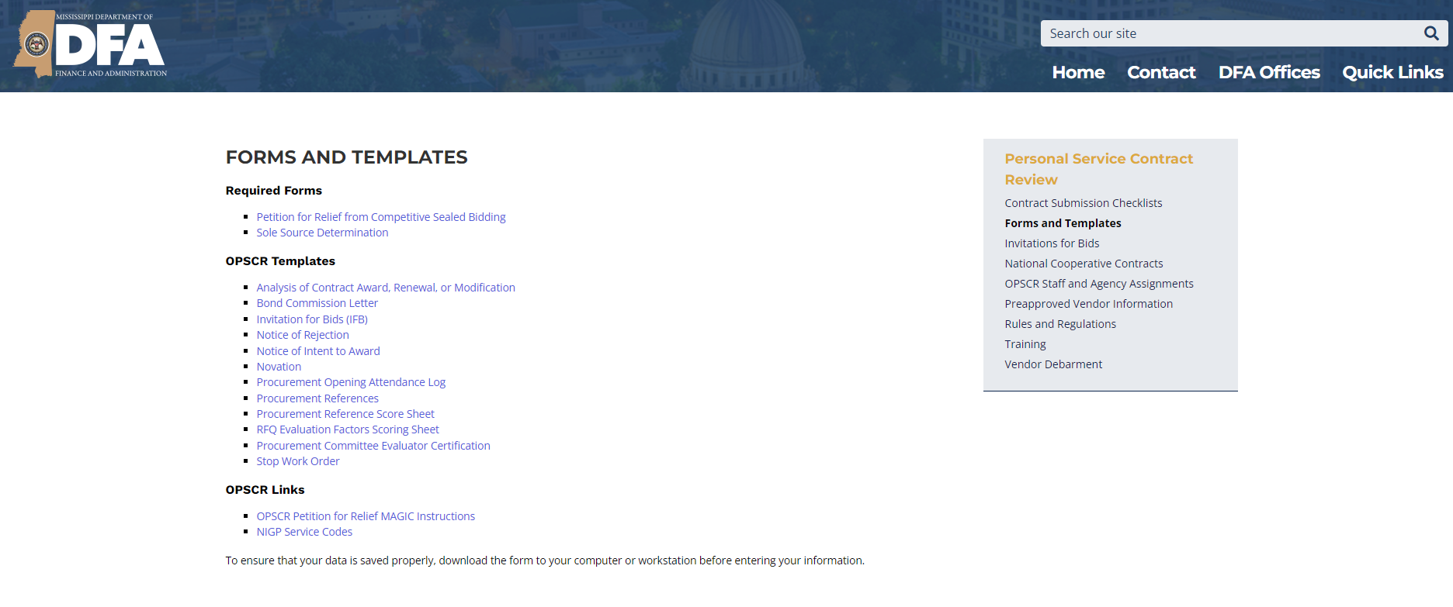
Sole-Source Procurement Sole source procurement is not permissible unless a service is available from only a single vendor. Only getting one response on a prior solicitation does not make the provider a sole source! The Agency Head must make a written determination as to whether a procurement shall be made as a sole source.

Slide 42
Two Types of Sole Source
1. Court Order mandating Agency use a particular source or provider
Agency Head determination must include Court Order
Publication is not required
2. Service only available from a single provider
Publication:
Procurement Portal and Agency Website for 21 calendar days
Contents: Contract Ts & Cs
Agency Head Determination
Instructions for Filing Objection
Vendors have 21 calendar days minimum to file Objection
Must be approved by PPRB if greater than $75,000.

Slide 43
Emergency and Exigent Circumstances Procurement R&R Chapter 10

Slide 44

Required Elements of Agency Head Determination R&R Section 10.1
Detailed Circumstances of Emergency
Scope of
Emergency Procurement
Events Leading up to Situation
Scope of Services Necessary
to Meet the Emergency
Negative Impact if Competitive Procurement Required
Time Necessary to Meet the
Emergency, No More than 1 Year
Basis for Selection of Particular Contractor
Made with such Competition as is Practical under the Circumstances
Signed by Agency Head

Slide 45
Review and Approval Emergency Contracts do not require PPRB approval. Upload executed contract and the Agency Head determination to MAGIC. OPSCR will do a post-approval audit for compliance with R&R Section 10.1.5. OPSCR reports Emergency Contracts: PPRB (monthly) House and Senate (quarterly)

Slide 46
Exigent Circumstances
Exigent Circumstances are a pressing need which cannot be met by undertaking any other method of procurement.
Required Elements of Agency Head Determination:
Exigent circumstances exist
Explanation of circumstances
Why a competitive procurement cannot be done
How the Agency maximized competition or a detailed explanation for why competition is unobtainable
Incumbent vendors must agree to extend all terms and conditions in the existing contract, including price.
Contracts require PPRB approval prior to execution. OPSCR only advises on procedural compliance. The Agency is responsible for advocating approval of the contract to PPRB.

Slide 47
Cooperative Procurements R&R Chapter 8

Slide 48
PPRB establishes the PVL Miss. Code § 27-104-7(2)(i)
Current Services
Security
Janitorial
Nursing Temporary Staffing
Lawn & Landscaping
Background Screening
Remediation & Emergency
OPSCR runs IFBs for various commonly
used services, and PPRB approves the
PVL IFBs and prices. Agencies can enter their own contracts
with the PVL vendors for the services and at the bid price without PPRB approval. Use of the PVL is optional.

Slide 49
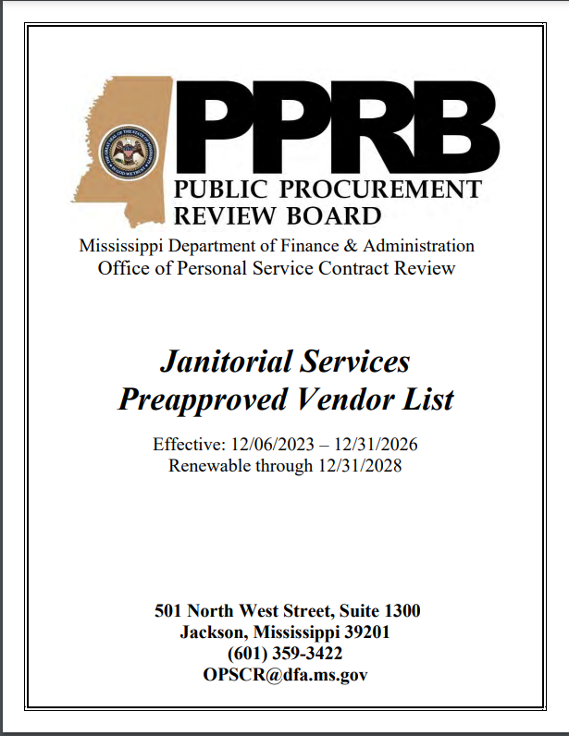
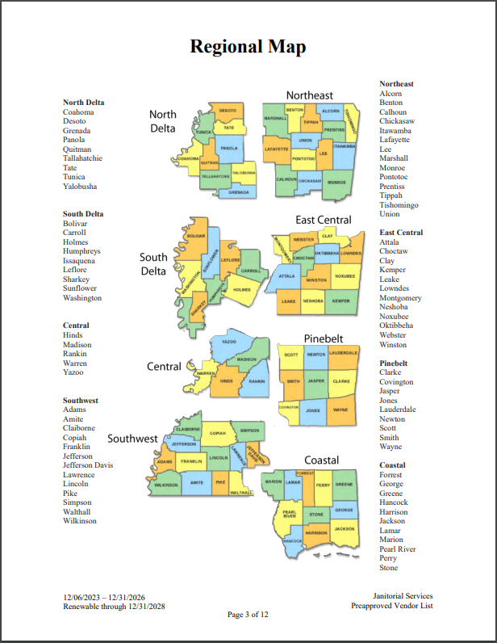
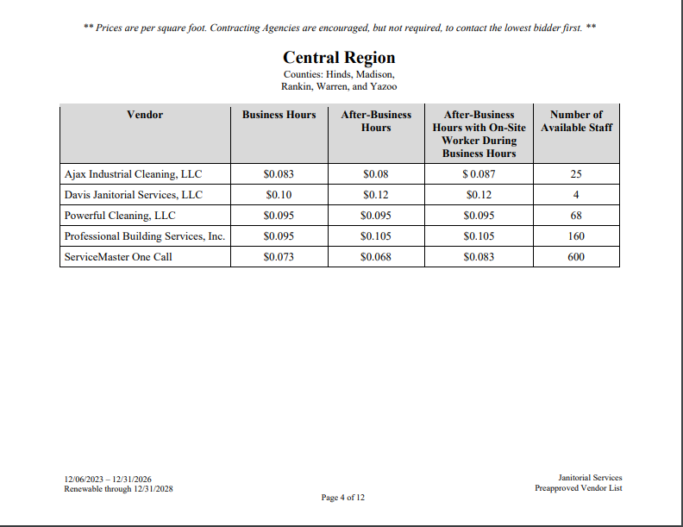
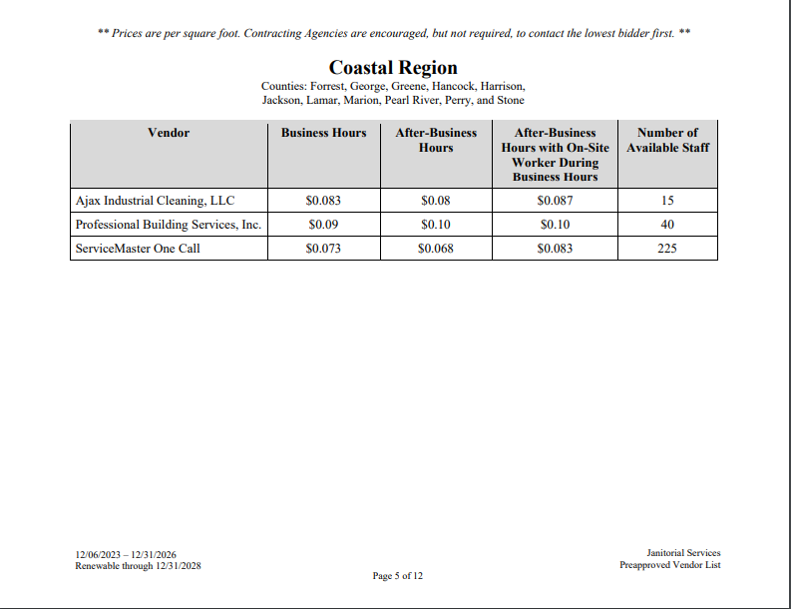
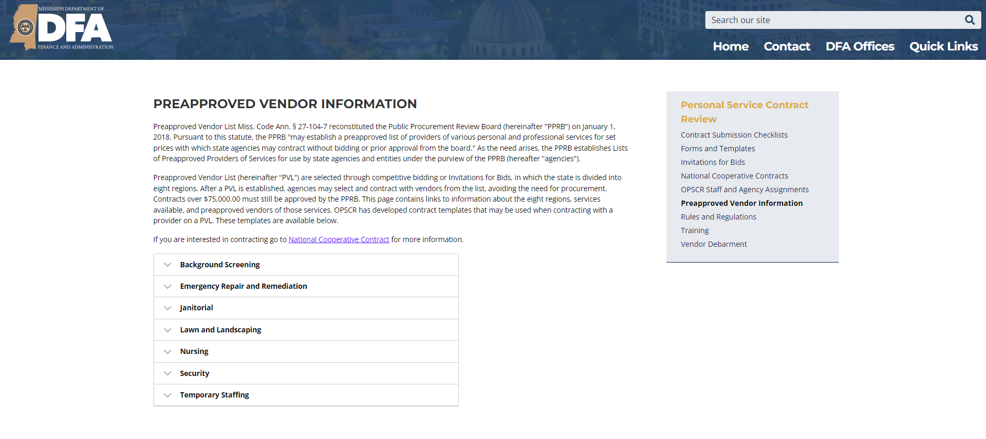
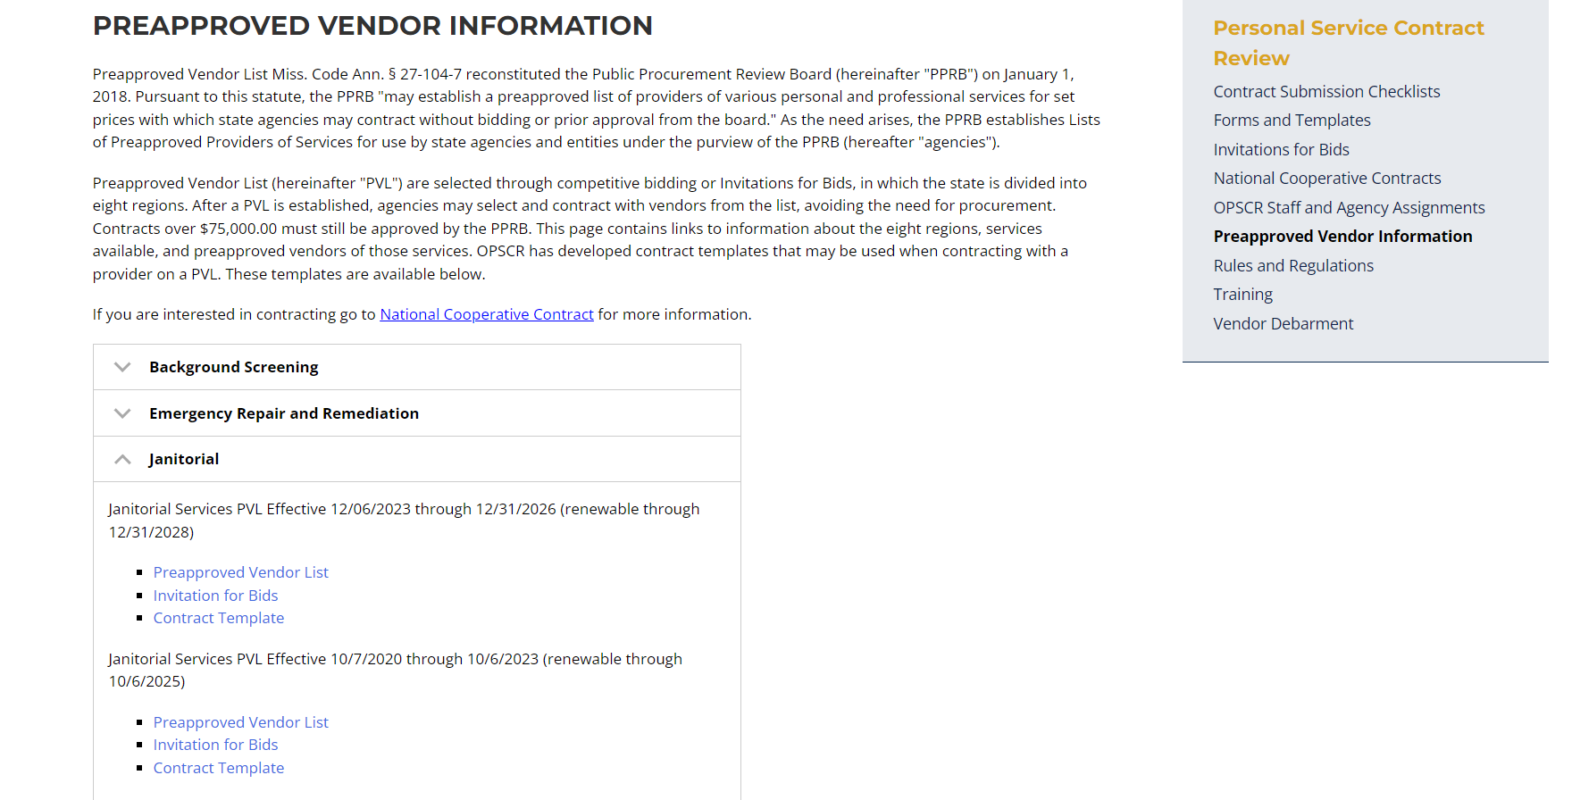
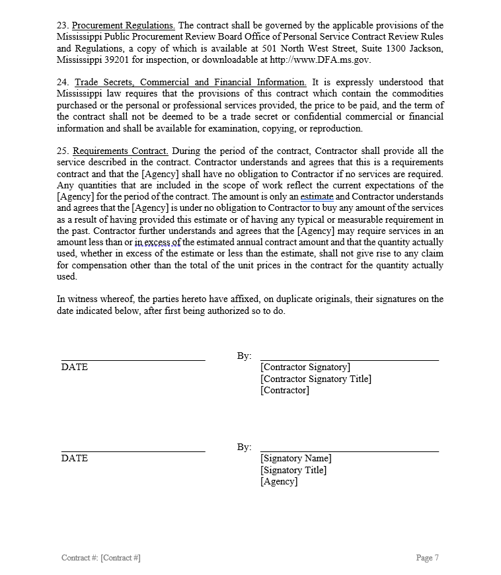
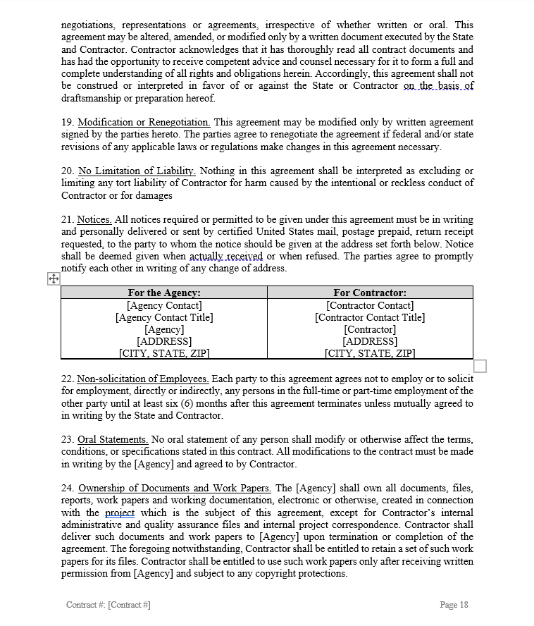
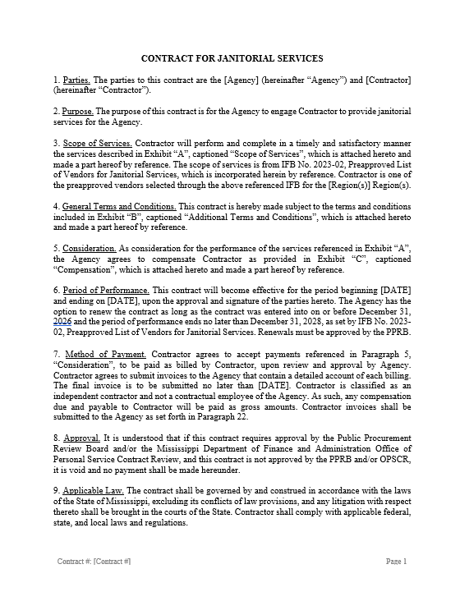
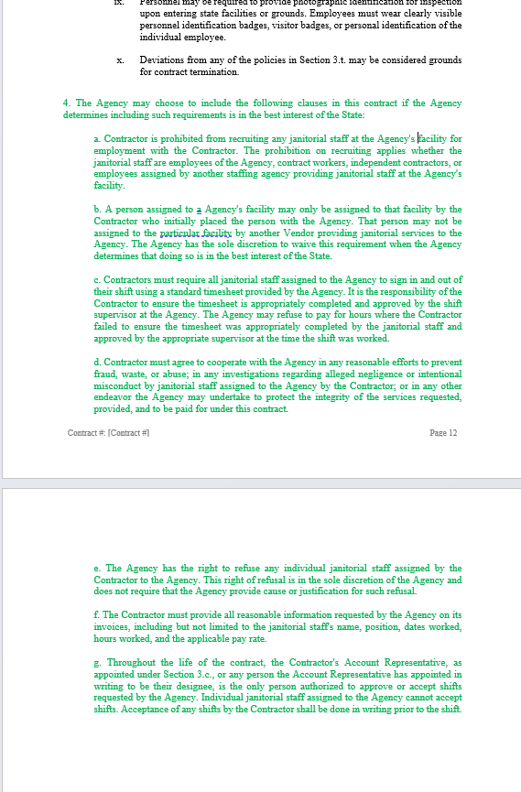
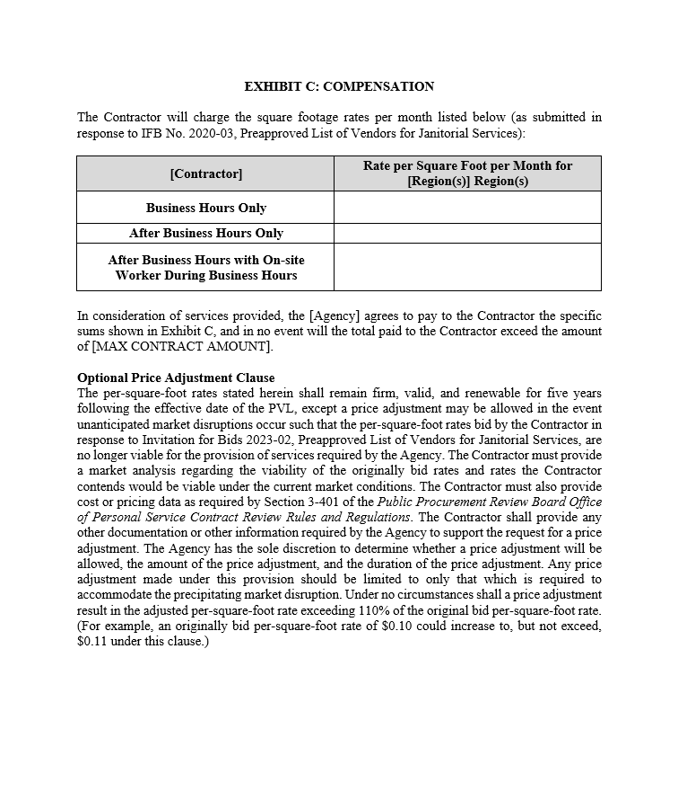
Janitorial Services PVL (eff. 12/6/23 – 12/31/26)
Contract Template (exp. 12/31/26; renewable through 12/31/28

Slide 50
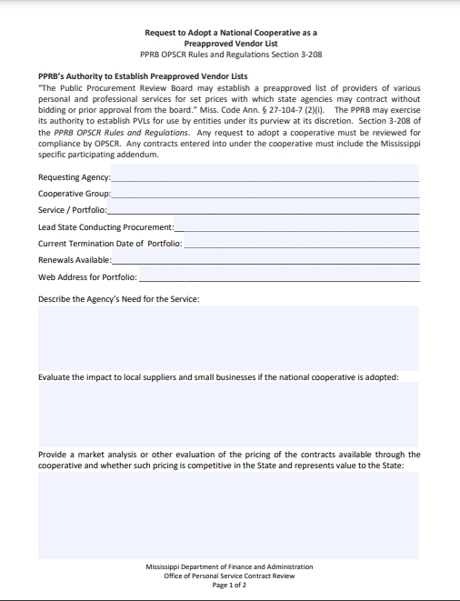
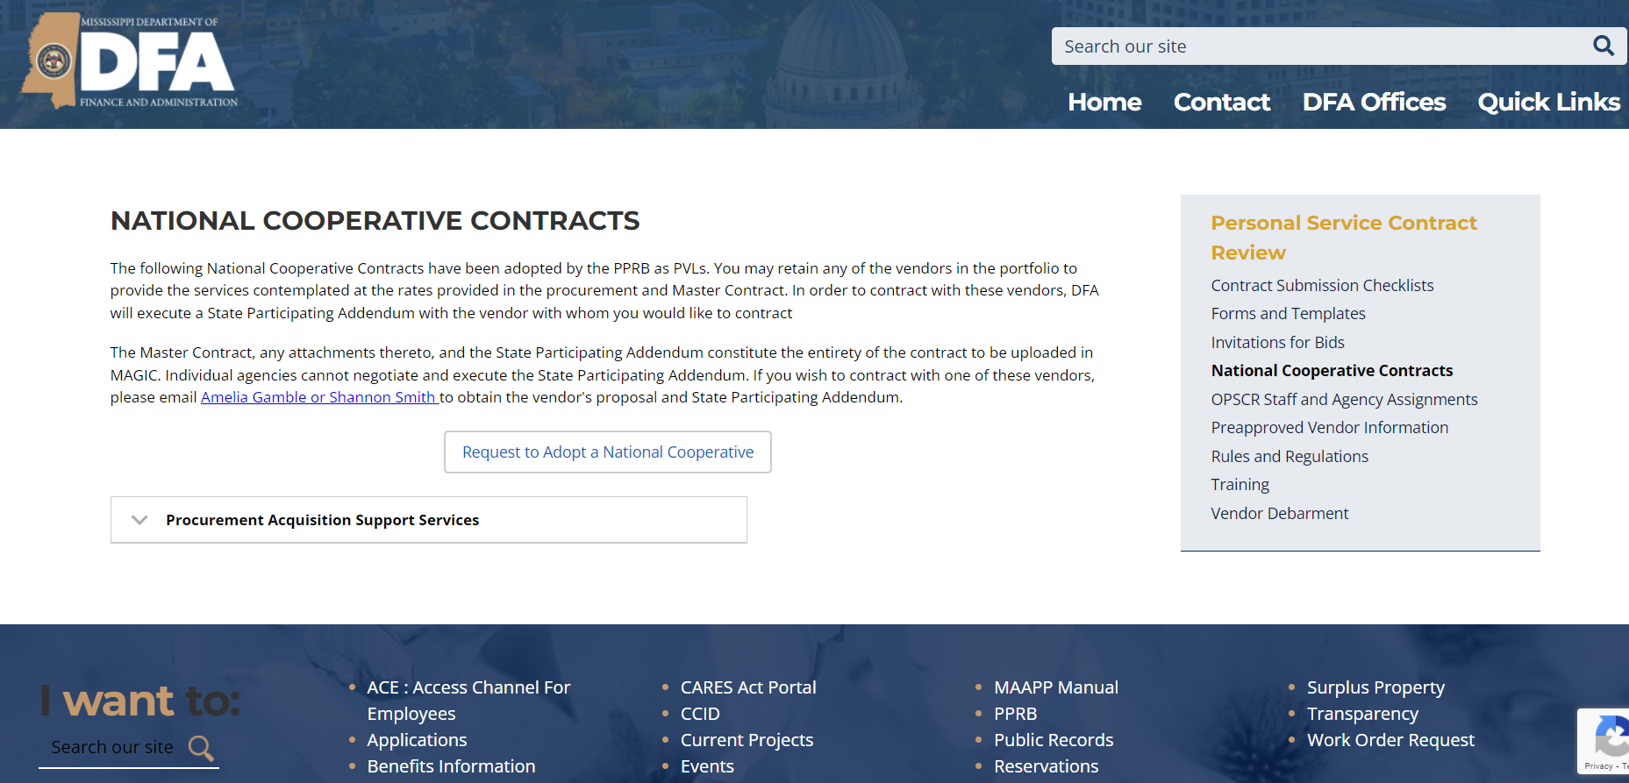
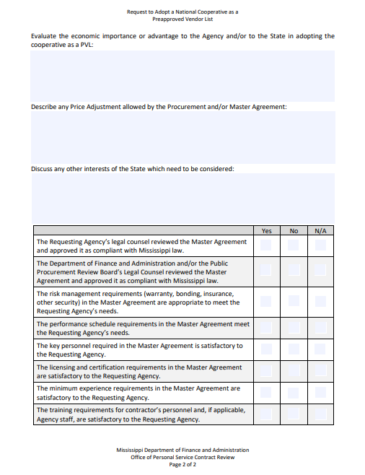
National Cooperatives

Slide 51
In-State Cooperatives
When an Agency under PPRB’s purview runs a solicitation in compliance with procurement laws and regulations, a different Agency may “piggyback” off that solicitation.
Can use all or part of the soliciting agency’s scope of services but no additional services can be added
Piggybacking Agency can ONLY contract with winning vendors. If the soliciting Agency awarded to more the one vendor, the piggybacking Agency can award to less vendors but not more. Highest scoring vendors (or lowest price if an IFB was used) MUST be awarded.
Piggybacking Agency can use same or lower pricing. If there is any change in scope, the piggybacking Agency must be able to demonstrate that the price per service was available in original procurement.
Contract requires PPRB approval

Slide 52
Other Methods to Procure Services R&R Chapters 11 & 12

Slide 53
Statutory Exemptions
Government to government
No Cost
Professional Exemptions Miss. Code § 27-104-7
Agency-Specific Exemptions
Upload to MAGIC
Contract with PPRB Agency - PPRB approval not required
Contract with non-PPRB State entity – Fair Market Value Determination
No expenditure of State funds
Not under PPRB purview

Slide 54
Requests for Proposals and Qualifications R&R Chapter 6 Miss. Code § 31-7-400, et seq.

Slide 55
Why use an RFP/RFQ instead of an IFB?
Lowest Price
An IFB is evaluated on price alone,
while an RFP/RFQ allows
evaluation factors in addition to price.
Cost
Technical
Management
After the submission deadline, RFP/RFQ allows:
Offerors to
change their Responses
Best and Final Offer
Agencies to engage in discussions
with offerors

Slide 56
Deciding between an RFP and an RFQ
Requests for Proposals
Can the service be performed
differently depending on
which vendor is selected?
Would the agency benefit
from receiving various ideas
and approaches?
Does the agency have an end goal in mind but want different proposals as to how a vendor would achieve it?
Requests for Qualifications
Is the offeror’s personnel
and experience the most
important factor to consider?
Does the agency set the price?
A unique or creative approach
to the work is not needed.
The most highly qualified
offeror is needed.
Agencies have discretion to choose solicitation type.

Slide 57
Petition for Relief R&R Section 6.3
An agency seeking to use an RFP or RFQ must obtain approval from the PPRB
by filing a Petition for Relief from the requirement to use Competitive Sealed Bidding.
Requirements
Submit using the form on DFA website
Explain why using an IFB is not practicable or advantageous
Include agency plan for alternative procurement
Include categories of evaluation factors
Signed by the Agency Head or Designee
Timing
Submit Petition by regular submission deadline for PPRB approval
The RFP/RFQ cannot be released until Petition has been approved
PPRB can revoke approval at any time
Determination should be reviewed for applicability from time-to-time
PPRB’s approval expires after one year

Slide 58
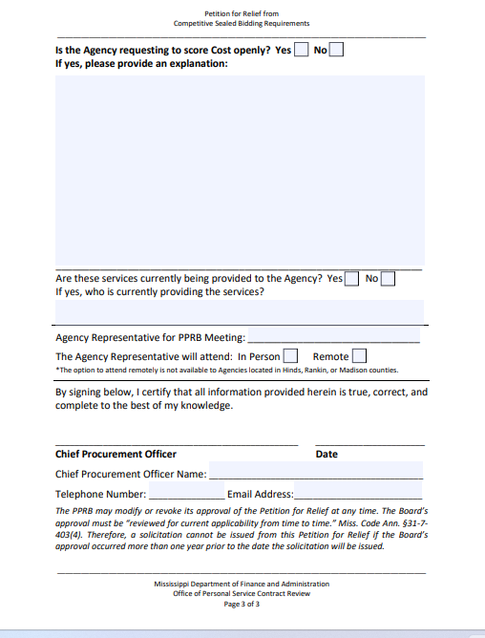
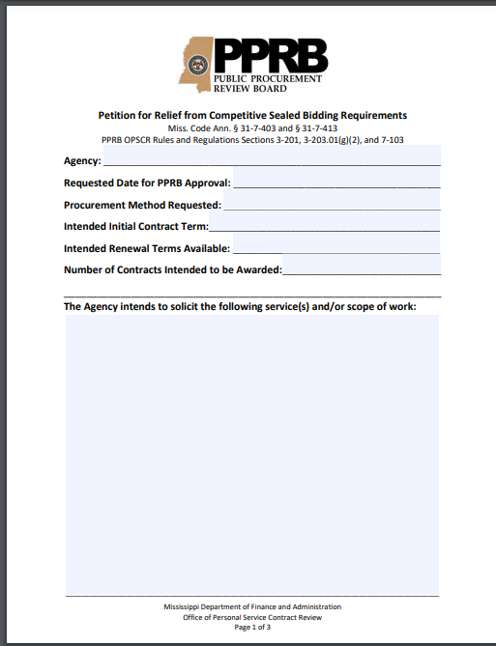
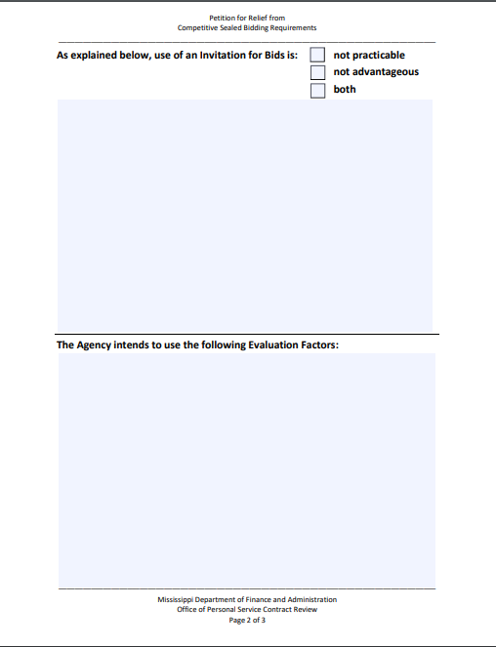
The Petition for Relief form can be obtained on the DFA website: www.dfa.ms.gov

Slide 59
Advantageous, Practicable, & Other Factors
Need for flexibility
Use of comparative judgment (relative ability of offerors) may result in more beneficial contracts
Need to weigh artistic and aesthetic value such that price is a secondary factor
Not a fixed price contract
Discussions needed to be conducted with offerors
Need to offer opportunity to revise proposals
Price is not primary consideration in determining award
Quality, Availability, Capability overriding in relation to price
Priority should be given to maintenance and service as compared to initial installation
The marketplace will respond better to an RFP or RFQ
Practicable
Other Factors to Consider
Advantageous
Procurement of services which can be solicited using an IFB cannot be combined with solicitations for services using an RFP or RFQ.

Slide 60
Evaluation Factors in Petition for Relief
The evaluation factors for the RFP/RFQ must be approved by PPRB with the Petition for Relief.
Cost:
The Petition for Relief must show that Price is at least 35% of the available points,
and whether any other factors will be considered in the evaluation of Cost.
Technical & Management:
The points allocated to each category must be approved with the Petition for
Relief. Points allocated to subfactors are not required, unless any category has as
many or more points allocated to it than Price. In that case, the agency must
demonstrate that no subfactor will be allocated as many or more points than Price.

Slide 61
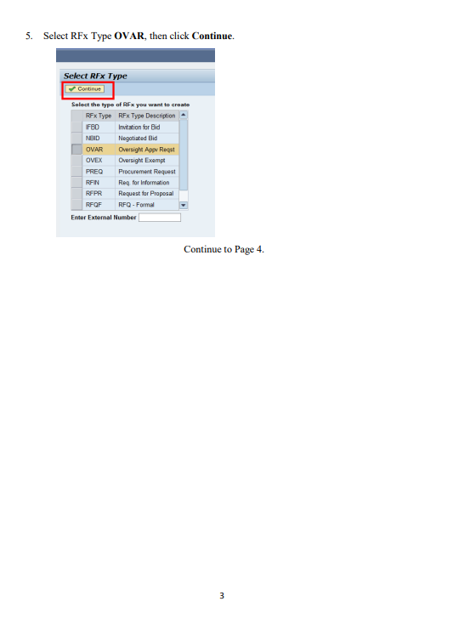
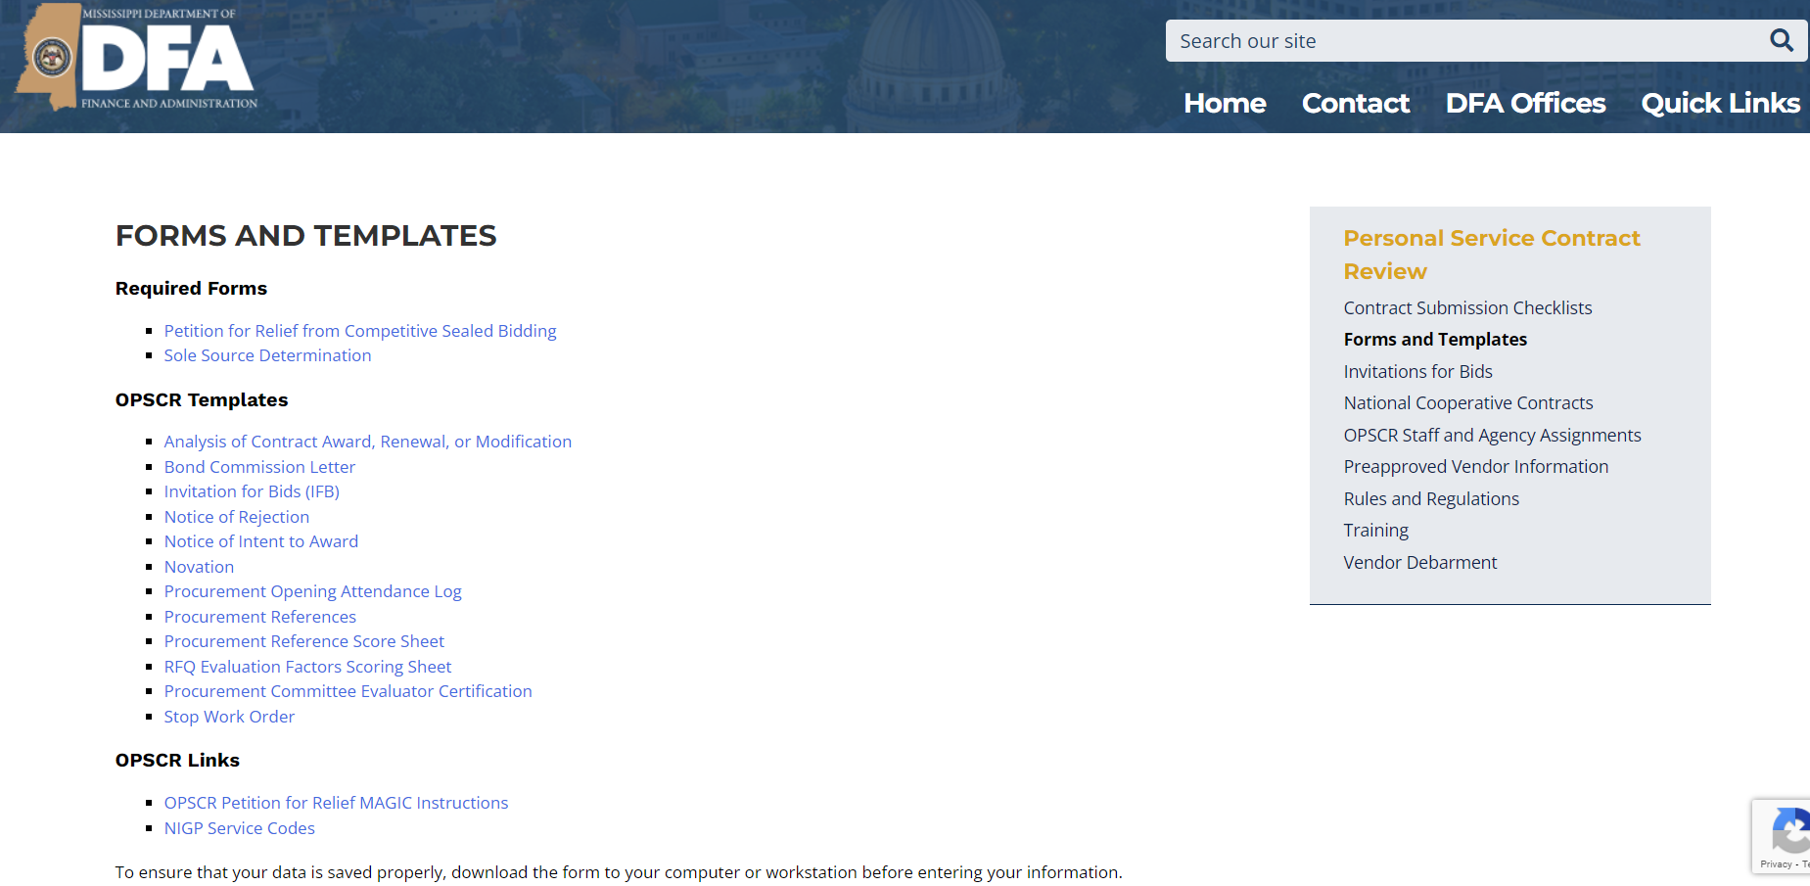
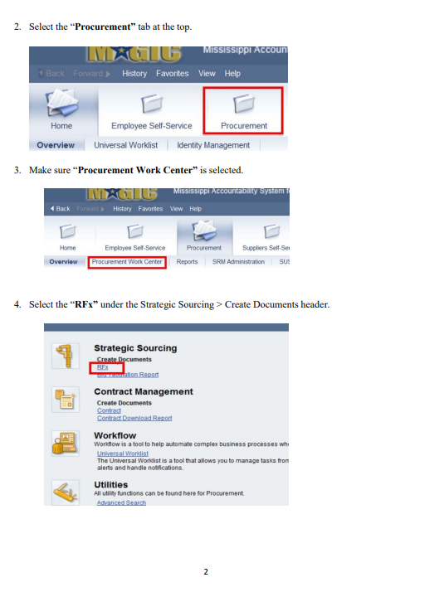
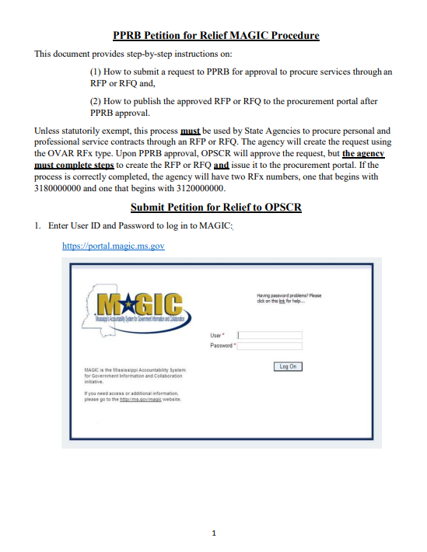
MAGIC Procedures for Issuing a Petition for Relief (OVAR: Oversight Approval Request)
Agencies Must: (1) Publish the Petition for Relief, and
(2) Publish the RFP/RFQ by creating a follow-on RFP/RFQ from a PPRB approved OVAR Do you need Technical Help → mash@dfa.ms.gov

Slide 62
Required Content for an RFP/RFQ A statement that discussions may be conducted with Offerors who submit Proposals or Qualifications determined to be reasonably susceptible of being selected for award, but that Proposals or Qualifications may be accepted without such discussions Instructions and information concerning proposal submission requirements Type of services required and description of work involved Minimum qualifications Contract Ts & Cs A statement that the offeror’s price was submitted and arrived at independently

Slide 63
Required Content for an RFP/RFQ The order of importance of the evaluation criteria, either by the order listed, weight, or some other manner A requirement that the Offeror list all their principals A statement that the RFP or RFQ, its amendments, the Offeror’s Proposal or Qualification and the Best and Final Offer shall constitute the contract Offerors must acknowledge amendments in writing A statement that the solicitation may be canceled at any time by the Agency and that the Agency can reject any proposal when in their best interest

Slide 64
Required Content for an RFP/RFQ Notice of opportunity to request reconsideration to the terms of the solicitation A requirement that the Offeror submitted an unredacted version of their proposal as well as a version redacted for confidential commercial or financial information and/or trade secrets and notice that the redacted version will be furnished by the Agency in response to public record requests Notice of Exclusion if redactions are made in bad faith

Slide 65
Developing Evaluation Factors Like an IFB, an agency can prepare minimum qualifications and evaluate whether the Offeror is Responsive and Responsible. Responsive and Responsible Offerors are evaluated on the following: Technical Factors (optional) Management Factors (optional) Cost Factors (Price, as a subfactor, is mandatory) An agency has discretion as to what to evaluate in each category.

Slide 66
Scoring Evaluation Factors
Blind Scoring is no longer required by
Miss. Code Ann. Sec. 31-7-417

Slide 67
Technical Factors Proposed Methodology Does the Offeror demonstrate a clear understanding of the scope of work and related objectives? Did the Offeror provide complete responses to the RFP/RFQ requirements? Has past performance of proposed methodology been documented? Does Offeror use innovative technology and techniques?

Slide 68
Cost Factors There may be cost factors in addition to price: Is the price and its component charges adequately explained? If required, are suitable bonds, warranties, or guarantees provided? Has the Offeror included quality control and assurance programs? Does the Offeror have sufficient financial resources?
Price (dollar amount only) is a subfactor and must:
be given at least 35% of the points
be the highest weighted factor
be scored objectively

Slide 69
Management Factors Does the proposed scheduling timeline meet the needs of the agency? Does Offeror document a record of reliability, timely performance, on-time and on-budget implementation, and compliance with contractual requirements? Is there a project management plan? Does the Offeror document industry or program experience? Does the Offeror have a record of poor business ethics? To what extent does the Offeror rely on in-house resources vs. contracted resources? Is there documentation of experience in performing similar work by employees and subcontractors? Does the Offeror demonstrate cultural sensitivity in hiring and training staff?

Slide 70
Assigning Evaluation Points
Example 1
25 Technical
30 Management
45 Cost
Individual Cost Factors:
35 Price
10 Financial Stability
Example 2
40 Technical
25 Management
35 Cost (Price Only)
Example 3 35 Technical 35 Management 30 Cost
Individual Technical Factors:
10 Understanding of SOW
10 Innovative Technology
and Techniques
10 Plan to Deliver Contract
Requirement A
10 Plan to Deliver Contract
Requirement B
On its face, this point allocation is not compliant with the statutory requirements. The number of points allocated to Cost does not meet the 35% requirement for Price, an individual factor under Cost. Price must be at least 35% and the highest weighted individual factor.

Slide 71

Double Check Publication
Advertisement
Same
requirements
as an IFB
Publication
Newspaper Agency Website Transparency

Slide 72
Letters of Intent
Pre-Proposal or Qualification Conference
Amendments
Not required under the R&R.
May assist in planning facilitation of procurement.
Cannot be due less than 14 days after public notice
Must give Offerors a reasonable amount of time to incorporate Answers into their proposals or qualifications.
The Q&A must be treated as an amendment.
Amendments must be identified and Offerors required to acknowledge.
Send to all prospective Offerors; post on procurement portal and agency website.
Reasonable time to allow Offerors to incorporate into response.
Not required under the R&R.
Must be recorded, and recording must be put in writing. The writing must be treated as an amendment.
Q&A
Period

Slide 73
Evaluation Committee Members shall have the relevant experience necessary to evaluate the proposal or qualification. Members’ names and job titles are disclosed publicly after contract award, including resumes of any members who are not State employees. Must sign declaration that he or she has no conflict of interest before evaluating. The committee may use advisors to provide opinions on the proposals and qualifications. Advisors are subject to the same rules and restrictions as committee members.

Slide 74
Award Responsive and Responsible Offeror with the Highest Evaluated Response The same Notice of Intent to Award and Notice of Contract Award requirements apply to RFPs/RFQs as those which apply to IFBs. Statutory Requirement: Notice of Intent to Award must be posted 48 hours prior to contract award.

Slide 75
Debriefing and Requests for Reconsideration
Vendor receipt of the Notice of Intent to Award and posting of the Agency Procurement File triggers the Debriefing and Reconsideration periods.
Email Delivery Receipt & Read Receipt
Vendors must be debriefed prior to the contract being presented to PPRB for approval.
Vendors have 3 business days to file a Request for Reconsideration of the Intent to Award. Reconsideration is limited to what is in the procurement file, the terms of the solicitation, and violations of OPSCR’s rules and regulations.
Requests for Reconsideration must be resolved for Board approval.

Slide 76
Common Problems
Time Management
Advertisement, Q&A, Amendments, Site Visits, Conferences, Evaluation, Presentations, BAFO, Award, Debriefing, Protest, Regulatory Board
Advertising
Transparency, Website, Content of Advertisement, Amendments, Due Date
Agency Procurement File

Slide 77



Planning Your RFP/RFQ Timeline
When does your current contract expire or when do you need the work to start? Schedule your operational start date and work backwards.
Do you need an Implementation Period? How long?
What is the date of the last PPRB Meeting where your Contract can be approved in order to meet your timeline? What date do you have to submit the contract to OPSCR?
Schedule Debriefing and Reconsideration (3) Periods. When can you send Notice of Intent to Award (48 hrs)?
Double Check Scoring, Executive Review of Award
How much time will you need to Evaluate Bids?
R&R/Technical/Cost/Management
Submission Deadline
Q&A
Vendor Preparation Time/Agency Preparation Time
Will you hold a pre-submission conference?
How much time will vendors need to prepare?
What date will you issue the RFP/RFQ?
When do you need to provide public notice?
When does the newspaper need ad copy?
How long will it take you to prepare the
RFP/RFQ? Who will need to review
the RFP/RFQ at your agency?
When do you need the Board to approve the
Petition for Relief? When must you submit it?

Slide 78
Debriefing and Reconsideration

Slide 79
Vendor Debriefing: The Who, What, Where, When, and Why R&R Section 5.6.2 & 6.9.2
W
H
O
Unsuccessful Vendor
Agency Procurement Official
If Vendor Brings An Attorney
Successful Vendor
Agency Personnel with Knowledge
Agency AG

Slide 80
Significant weaknesses in debriefed vendors offer, if any
Price of winning vendor and debriefed vendor
WHAT
Ranking of all vendors
Summary of the rationale for the award
Reasonable responses to relevant questions re: procedures & regulations followed
NOT a point-by -point comparison of debriefed vendor’s offer with other offers
Debriefings must be conducted before PPRB approval
List of vendors and dates of debriefings in Agency Procurement File

Slide 81
In Person
Telephonic
WHERE
Video Conference
Any Method Acceptable to the Agency

Slide 82
WHEN
Agency Notify Vendors of Right to Debriefing
Award Letters to Vendors
Procedure & Deadlines
Vendors Must Request Debriefing
Agency sets deadline and method for when requests for debriefing must be received
Agency Must Conduct Debriefing
While OPSCR is reviewing the procurement (in Agency Head’s discretion)
Prior to Presentation to PPRB for Approval

Slide 83
W
Strengthen Business Relationships
H
Improve the Procurement Process
Y
Prevent Requests for Reconsideration

Slide 84
Reconsideration: R&R Sections 5.2.4, 5.6.3, 6.5.4, & 6.9.3
3 Business Days after Solicitation Issued
Two Times Vendors Can make a request
3 Business Days after Notice of Intent to Award

Slide 85
What is Reconsideration:
An opportunity for vendors who are aggrieved by the solicitation or contract award to seek a remedy from the Agency
Procurement Preparation, Facilitation, and Contract Award
Statutory Compliance
Regulatory Compliance
Compliance with Terms of Solicitation
Competition Fairness Transparency

Slide 86
Notify Vendors of Reconsideration Rights and Procedure in the Solicitation and Notice of Intent to Award
Vendors must file request in writing within 3 business days of Solicitation or Notice of Intent to Award being issued
Complete Agency Procurement File must be posted on Agency website to trigger 3-day period
Vendors submit to Chief Procurement Officer of Agency and Director of OPSCR
Reconsideration stays the solicitation or contract award until resolved
Requests for Reconsideration must be resolved before submission of the contract to OPSCR
Request and Agency decision given to each vendor and posted on the procurement portal and the Agency’s website
Agency must reasonably respond to each allegation in writing

Slide 87
Agency Procurement File Appendix D
All documents required to be posted on Agency website as part of the Agency Procurement File are listed in Appendix D and sorted by solicitation type.
Complete posting triggers period for reconsideration. If it is determined that part of the Agency Procurement File is missing, you must post the missing documents to be in compliance and trigger the 3 business day period.
Because vendor submissions are now required to be posted, solicitations now require notice to vendors that they must produce both a redacted and unredacted version of their submissions or that by not providing a redacted version their unredacted submission will be posted as submitted.

Slide 88
Contract Submission Packets

Slide 89
OPSCR Contract Submission Packet
All Procurement Documents
Any Documents Demonstrating Compliance with R&R
Unexecuted Contract with PPRB required Clauses
Solicitation
Bid Opening / Registration of Bids/Proposals
All Vendor Responses
Publication/Advertising (Newspaper, Website, Transparency)
Documentation of Vendor Conferences
Amendments/Q&A
Reference Score Sheets
Evaluation Team and Score Sheets
Notice of Intent to Award
All Correspondence with Vendors
Certificates of Insurance Evaluator Conflict of Interest Certifications
Reconsideration Requests/Decisions
Checklists
Incomplete packets delay review and may result in having to be pushed to the next PPRB meeting.

Slide 90
OPSCR Training
Email: OPSCR@dfa.ms.gov for information
Visit DFA OPSCR website for future class dates

