Slide 1
Fleet Manager
Certification Program
Ramona Jones, Director
Bureau of Fleet Management

Slide 2
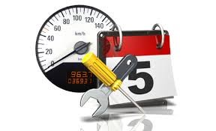
Objectives
Overview of BFM Policies and Procedures
New Vehicle Setup
Reporting and Data Monitoring
Maintaining Vehicle Data

Slide 3

Overview
  Staff
  Mission
  Purchasing state-owned Vehicles
  Vehicle Use Policy
  Safety Operation Policy
  Maintenance and Care of Vehicles
  Vehicle Replacement and Disposition
  Process Flow Chart

Slide 4


Bureau of Fleet Management
Woolfolk Building
501 North West St - 701A
Jackson, MS 39201
Alicia Adams
Contract Analyst
601-359-3647
Fax: 601-359-3910
Alicia.Adams@dfa.ms.gov
Ramona Jones
Bureau Director
601-359-9335
Fax: 601-359-3910
Ramona.Jones@dfa.ms.gov

Slide 5

Mission
The mission of the Bureau of Fleet Management (BFM) is to provide a consistent, efficient, and cost effective Fleet Management program for all vehicles owned and operated by the State of Mississippi.

Slide 6

Purchasing State-Owned Vehicles:
Purchase Decision
The decision to purchase a vehicle should be carefully considered.
BFM will not approve any request to purchase a vehicle if it is not the best use
of public funds.

Slide 7
Purchasing State-Owned Vehicles:
Approval
No Department or Agency of the State of Mississippi may purchase any
motor vehicle, regardless of funds used, without first obtaining approval
from BFM.
No requests shall be approved if the agency has not properly maintained
vehicle data in MAGIC (2017 Regular Legislative Session, HB 938).
Inadequacies or discrepancies must be corrected prior to approval
  Accurate Asset and Equipment Record Statuses
  Fuel, Maintenance, and Repair Data of Vehicles
  Accurate Vehicle Mileage Readings
  Assignment Type of Vehicles and Driver Assignments
  County Field on the Asset Record

Slide 8
Purchasing State-Owned Vehicles:
Justification
Agency requests must propose the lowest cost vehicle to carry out its intended use
Requests shall be in writing from agency head, certifying it is the lowest cost option available
The requesting agency should ensure that the intended use and justification of need is as specific and detailed as possible before it is submitted

Slide 9
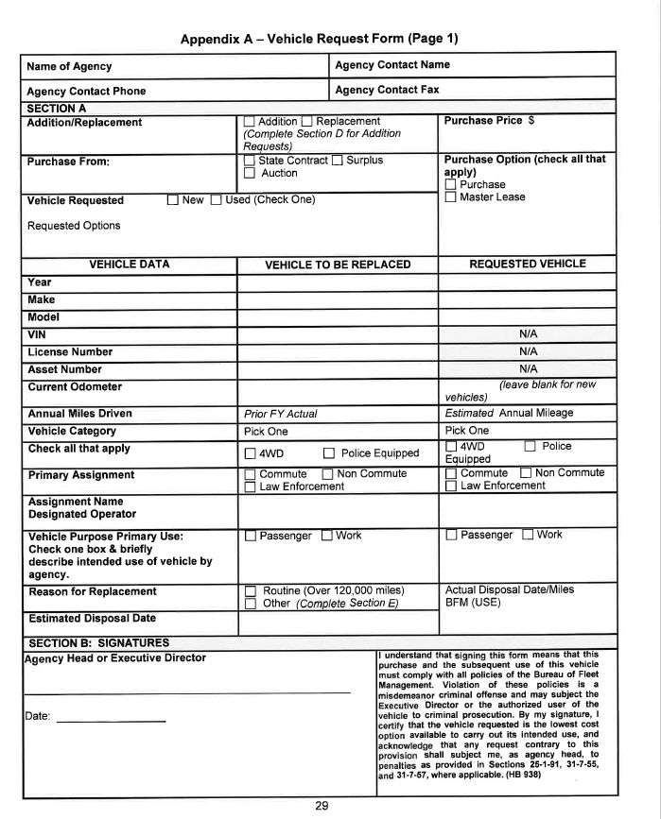
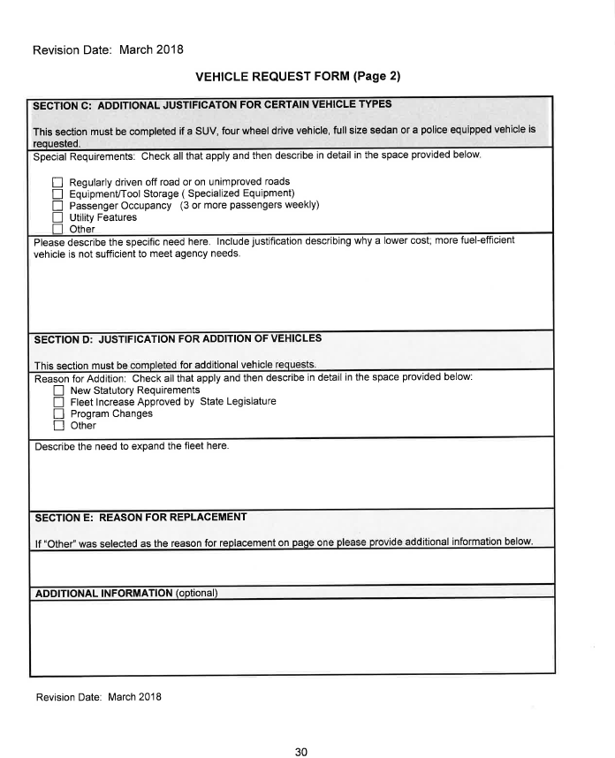
Vehicle Request Form

Slide 10

Purchasing State-Owned Vehicles:
Vehicle Replacement
When “Vehicle Replacement” is the justification for a new purchase,
the vehicle being replaced must be disposed within 60 days of delivery
of the new vehicle.
Agencies should identify the vehicle to be replaced with the
information required by Section 3.101.03 of the Fleet Manual.

Slide 11

Purchasing State-Owned Vehicles:
Vehicle Purchase Records
The department or agency shall maintain proper
purchasing documentation which provides the
intended use of the vehicle and the basis for
choosing the vehicle.

Slide 12

Purchasing State-Owned Vehicles:
Title Process
Vehicles should be titled as:
  State of Mississippi/Department of Finance
  and Administration – Agency Number
    See Appendix H of the Fleet Manual
    The Title Application shall reflect the requesting agency’s
    current address as the mailing address on the title. The title should be kept on file at the agency.

Slide 13
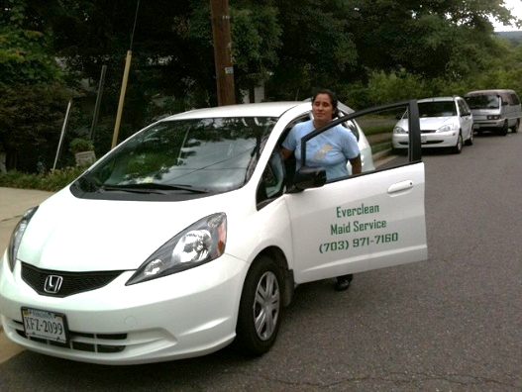
Purchasing State-Owned Vehicles:
Marking of State-Owned Vehicles
State Vehicles should have:
  Permanent Decal
  or
  Agency name painted on the vehicle
  On both sides in letters at least three (3) inches in height, and on the rear in letters not less than 1.50 inches in height.
  Must be in a color that contrasts with
  the vehicle.
      Refer to Section 25-1-87 of the
      MS Code.

Slide 14
Vehicle Use Policy:
Vehicle Classification
State Vehicle Assignments are classified as:
Law Enforcement: A state-owned vehicle assigned to a sworn law enforcement officer as defined in section 45-6-3 of the code, or a law enforcement trainee as defined in section 45-6-3 (e) of the code, to be driven in the daily performance of the duties of a sworn law enforcement officer or trainee if use of the vehicle is essential for the employee to carry out their job duties. Agencies must supply a copy of the official certification from the Mississippi Board on Law Enforcement Officer Standards and Training (BLEOST).
Commute: A state-owned vehicle assigned to be driven from an employee’s official duty station or temporary place of work to an employee’s residence as needed. This assignment type requires a driver assignment.
Non-Commute: A state-owned vehicle assigned to be driven to and from an employee’s official duty station to any temporary place of work and returned to the official duty station on a daily basis. This vehicle must not be driven to and from the employee’s residence.

Slide 15

Driver Assignments
  All vehicles with an assignment type of ‘Commute’ are required to have a valid driver’s assignment.
  Agency driver assignments must be entered into MAGIC and approved by BFM.
  Commute Driver Assignments require submission of Commuter Authorization Form, Commuter Mileage Calculator form and the last three (3) months trips log to BFM for approval of commute driving assignment. If this is a new assignment, submit an estimated mileage total.
  Driver assignments are valid for a period of one year.

Slide 16
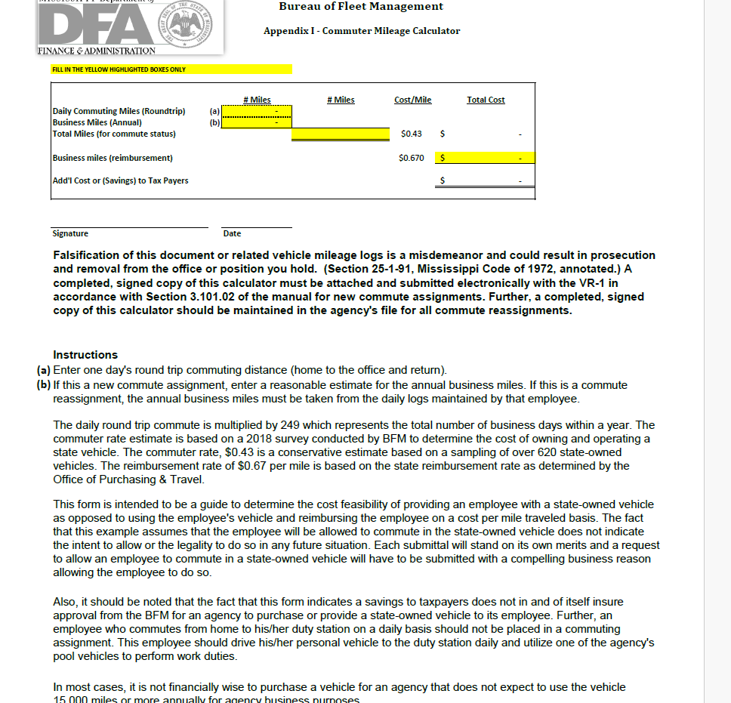
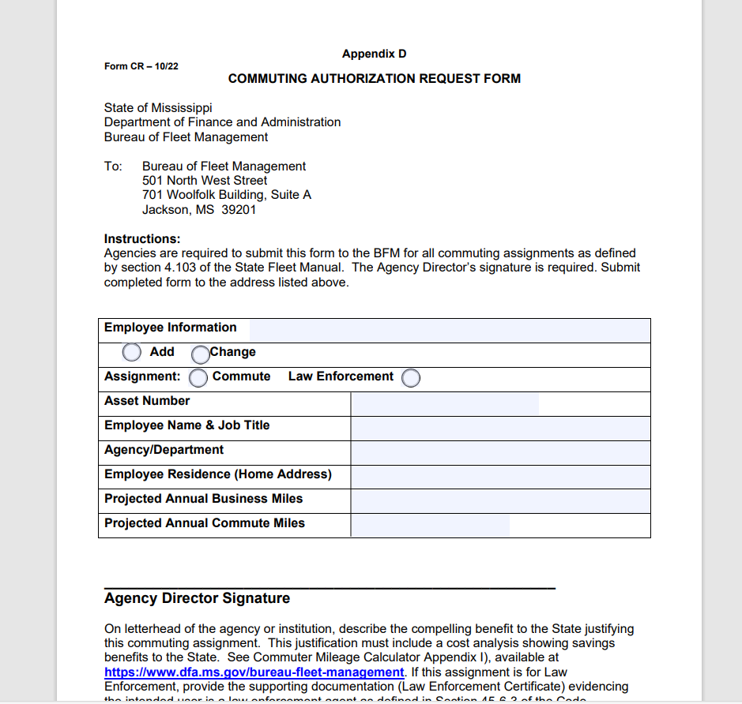
Commuter Mileage Calculator and Commuter Authorization Form

Slide 17
Vehicle Use Policy:
Operating a State-Owned Vehicle
Authorized users include:
  State employees
  State contract workers
  Elected and/or appointed officials
  Independent contractors (where approved on a case by case basis according to Section 5.201.04 of the Fleet Manual)
Authorized users must:
  Have a valid Mississippi Driver’s License
  Have an acceptable driving record (see UA – 1 Form)
  Be authorized by their agency to operate a state-owned vehicle

Slide 18

Vehicle Use Policy:
Misuse or Inappropriate Activities
  Inappropriate activities or misuse include, but are not limited to:
  Improper vehicle assignment
  Failure to report changes in driving status
  Falsification of documents
  Failure to comply with vehicle safety laws (ex: speeding and/or reckless driving)
  Failure to take proper care of the vehicle
  Failure to comply with any policy or procedure
  otherwise set forth herein
  Violation of vehicle replacement policy

Slide 19

Vehicle Use Policy:
Misuse or Inappropriate Activities (cont.)
Inappropriate activities or misuse include, but are not limited to:
  Using the vehicle for personal use outside of the employee’s scope of employment
  Failure to maintain accurate Daily Trip Log (Appendix G)
  Use of alcohol in state-owned vehicles
  Use of drugs in state-owned vehicles
  Use of tobacco products in state-owned vehicles

Slide 20
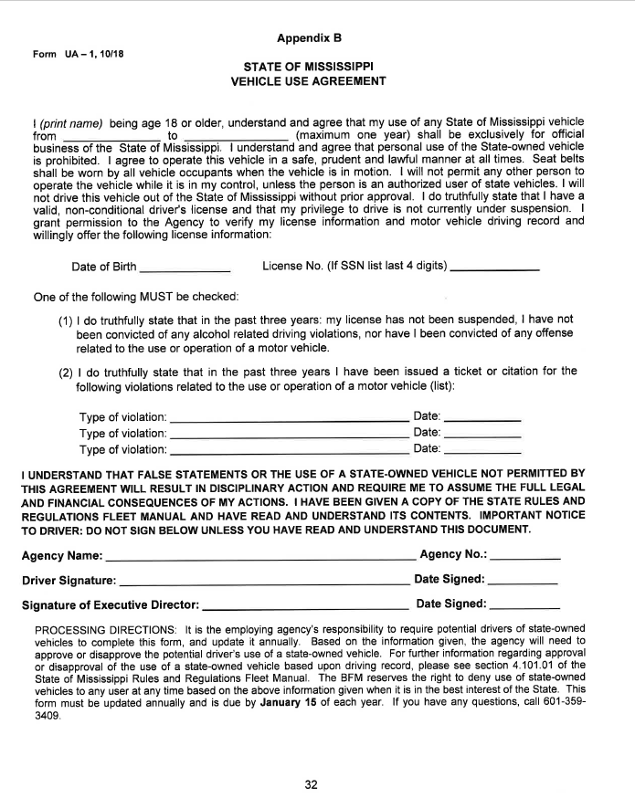
Vehicle Use Agreement

Slide 21

State-Owned Vehicles:
Logs
A daily log of all trips must be recorded for each state-owned vehicle. (See Appendix G for Sample Daily Trip Log)
Each Daily Trip Log shall contain:
  the operator of the vehicle
  date of vehicle use
  beginning and ending odometer reading
  total miles traveled
  purpose of each trip
  the business locations visited each day
Agencies with law enforcement drivers should contact BFM for guidance on compliance with this section.

Slide 22
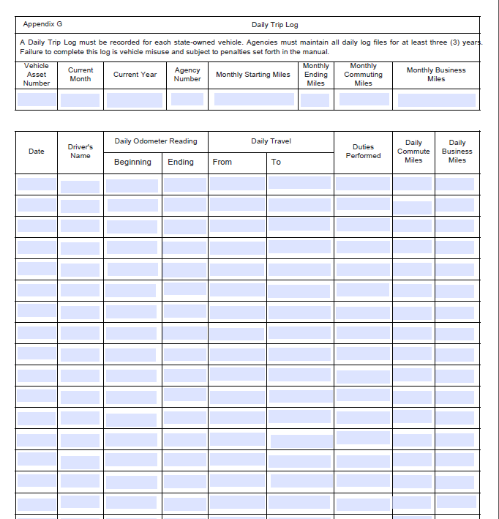
Daily Trip Log

Slide 23

State-Owned Vehicles:
Unauthorized Usage
Sightseeing or trips for pleasure unless the trip is part of the official agenda for a business conference.
Transporting family members, dependents or friends to school, daycare, medical appointments, social events or other personal activities.
Conducting other personal business outside the authorized user’s scope of employment.

Slide 24

State Vehicle Safety Operation Policy
Impaired Driving
Distractions
Seat Belts
Fines

Slide 25
State Vehicle Safety Operation Policies: Reporting Accidents
Call an ambulance if anyone is injured.
Immediately notify the City Police, Sheriff’s Office, or Highway Patrol.
Do not move either vehicle until an officer of the law advises you to do so.
The Proof of Insurance number that should be entered on the police report is 11-46-15.

Slide 26

State Vehicle Safety Operation Policies: Reporting Accidents
Do not make any statement of guilt to any party.
Notify your immediate supervisor as soon as possible.
Complete a State of Mississippi Liability Claim Report Form (available online).
Submit the form, along with the police report, and any other applicable information to TORT.

Slide 27
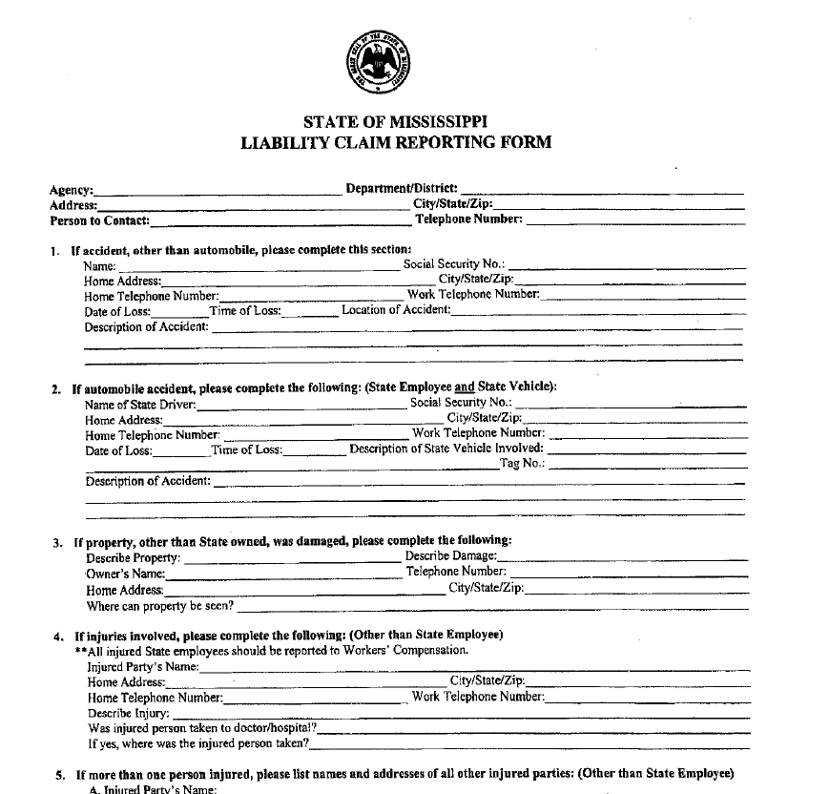
Liability Claim Reporting Form

Slide 28

Maintenance and Care of Vehicles
All agencies are urged to establish a written policy which shall describe the planned
maintenance program for its fleet.
All maintenance and repairs performed on state-owned vehicles must be documented
in MAGIC and retained for the life of the vehicle.

Slide 29
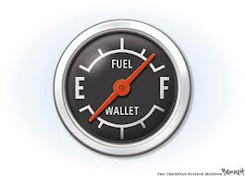
Maintenance and Care of Vehicles:
Fuel Purchases
Gasoline purchases shall be obtained using the state-approved fuel access card
From vendor facilities that accept the state-approved Fuel Access Card.
Compare FuelMan pricing weekly on the OPTFM website.
Only regular, unleaded gasoline or diesel from self-service pumps should be
used. No higher-octane gas is to be purchased.

Slide 30
Vehicle Replacement and Disposition: Replacement Criteria
Vehicle | Years | Miles
Sedans and Wagons | 7 | 150,000
Light Trucks and Sports Utility Vehicles (8,600 GVWR or below) | 7 | 150,000
Passenger Vans | 7 | 150,000
Cargo Vans | 7 | 150,000

Slide 31

Vehicle Replacement and Disposition: Methods
State-Owned vehicles which become surplus to the needs of a state agency
may be disposed in any of the following ways:
  Sold
  Transferred

Slide 32

Vehicle Replacement and Disposition:
State-Owned Vehicle Disposal Specification
The specifications or instructions to prospective buyers should provide a listing of all items being offered and such listing shall provide:
  Make/Model
  Year of Manufacture
  Mileage
  Location (Where the vehicle may be inspected)
  Date and time when vehicle may be inspected
  Address of location to which the bids shall be delivered
  Time and date set for the bid opening
  Name of person to be contacted if additional information is necessary

Slide 33

Process Flow Chart
PO Creation
Goods Receipt
Invoice
Update Asset Master
Update Equipment Record
Create Measuring Points
Create Driver’s Assignment (if necessary)
Create Initial Odometer Posting
Disposal
Notes:
(Old chart info)
Po creation:
Low cost justification letter
Fleet Data Up-To-Date
VR-1 Form
Bfm approval:
DFA/BFM must approve all state agency vehicle purchases
Goods receipt:
All vehicles should delivered within 120 days of PO receipt
Invoice:
Vehicles must be paid on an invoice referencing a PO.

Slide 34

New Vehicle Setup
  Unit Objectives:
  Asset and Equipment Lifecycle
  Asset Record Completion
  Update Equipment Master
  Create Measuring Points
  Initial Odometer Reading
  Create Driver Assignments

Slide 35
Asset and Equipment Lifecycle
Create Asset Master
Manually Update Equipment (vehicle)
VinTelligence Updates Equipment (vehicle)
Enter Initial Measurement Documents
Establish Driver Assignment (if needed)
Responsibility
Asset Management
(Property Officer)
Fleet Management
(Fleet Coordinator)
Interface
Notes:
Set up steps for new vehicles
Create asset master:
Done by Asset Management
Adds county and unique inventory number
Manually update equipment (vehicle) master:
Transaction code IE02
Done by Fleet Management
Add measuring points
Enter classification
Install at functional location
VinTelligence interface:
Updates equipment VIN information
Enter initial measurement document:
Transaction code IK11
Done by Fleet Management
Create to initial preventive maintenance plans
Driver assignment:
Done by Fleet Coordinators and Central Fleet Administration
Create request if necessary
Note: The color designations above are consistent throughout the course to indicate the responsibility.

Slide 36

Asset Record Completion
The Property Officer will complete the Inventory Number, Serial Number, and County fields
The Inventory Number and Serial Number will then replicate to the Equipment Record
The Equipment Record is now ready for the Fleet Coordinator to complete.
Notes:
New vehicle setup job aid is available for agencies to complete asset and update equipment records.

Slide 37
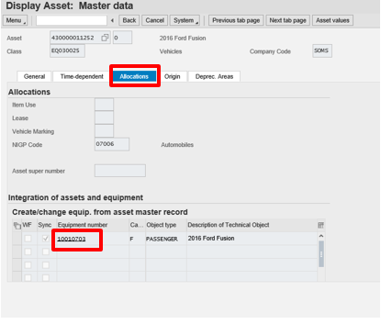
Asset Record Completion
Notes:
Each asset assigned to vehicle asset class has a corresponding equipment record. The equipment number is found on the allocations tab of asset record

Slide 38
Update Equipment Master
After Asset completion, the Fleet Coordinator will update the Equipment Master in order to:
Allow FuelMan to post Cost and Odometer Readings
Synchronize the Asset and Equipment Record statuses
Capture Driver Assignment Types
Initiate VinTelligence to standardize descriptive information about the vehicle
Enter Location
Notes:
(Example)
Data updated through VinTelligence –
- Make
- Model
- Number of doors
- Number of Cylinders

Slide 39
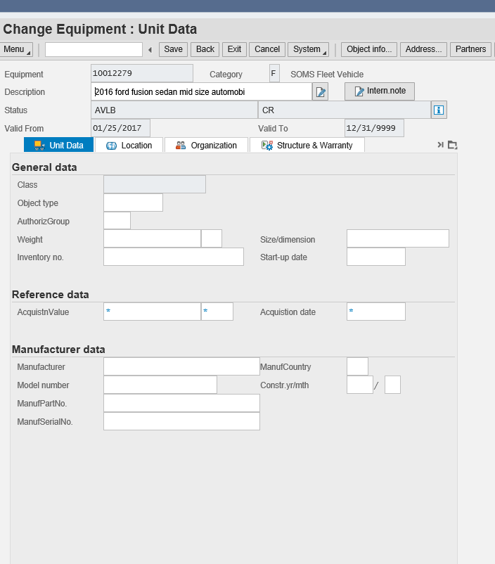
Update Equipment Master:
Equipment Record Update
Transaction IE02 is used to update the Equipment Record by filling in the mandatory fields.
The main purpose of the Equipment Record is for maintenance statistics for reporting.
Notes:
When you enter the equipment record the header data displays equipment number, description and initial status AVLB. This description is replicated the asset record.

Slide 40
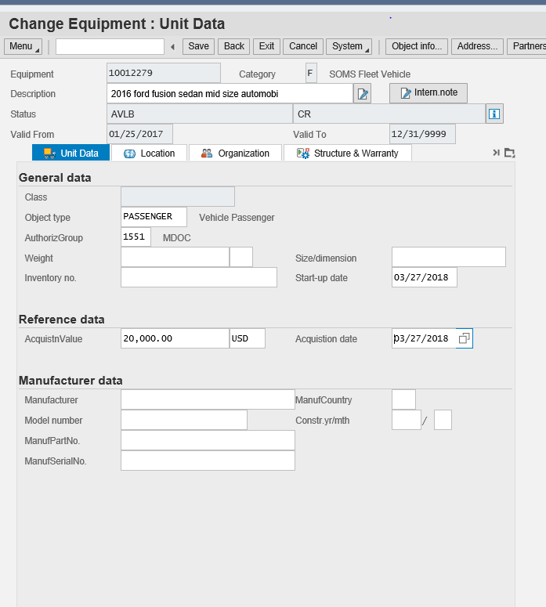
Update Equipment Master:
Unit Data Tab
Enter the following required fields on the Unit Data tab:
Object Type
AuthorizGroup
Acquisition Value/Currency
Acquisition Date
Notes:
Object Type-passenger, truck, motorcycle or unknown. By selecting object type and class the vehicle specific tabs appear on the equipment record (vehicle technology and vehicle id/measurements.)
Authorization Group-applies system security to only allow edit rights to employees in an agency
Acquisition Value-total cost of the vehicle minus options
Currency-United States Dollar (USD)
Acquisition Date-the date the vehicle was received by the agency

Slide 41
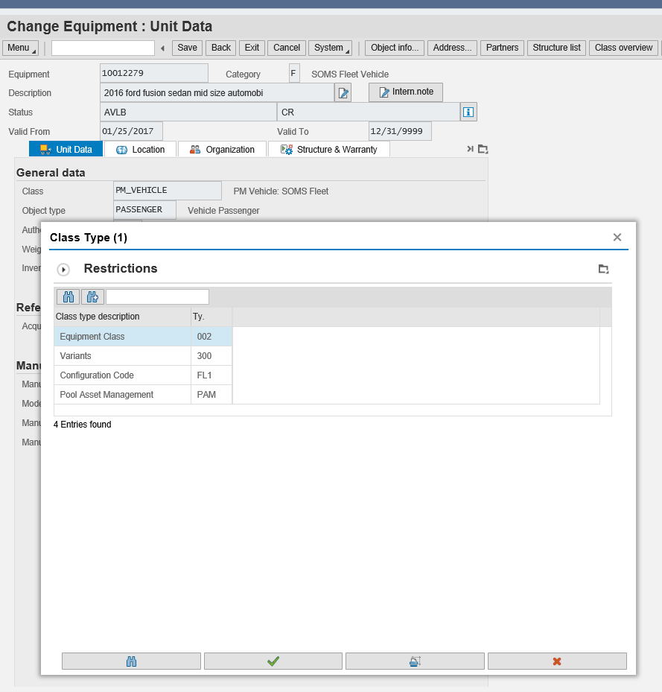
Update Equipment Master:
Class Overview
Select the Class overview button and select ‘Equipment Class 002’
Select the green check mark
Notes:
By selecting PM_Vehicle class vehicle specific attributes are applied to the record

Slide 42
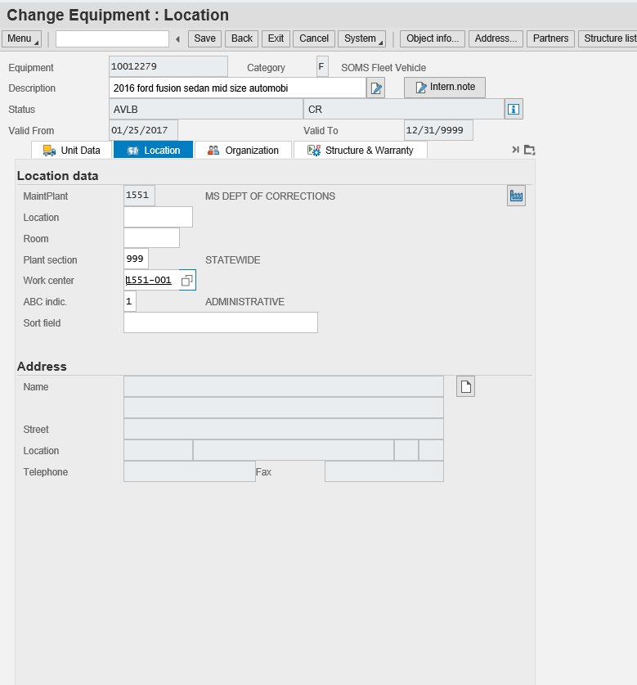
Update Equipment Master:
Location Tab
MaintPlant (Required)
Plant Section (Required)
Work Center (Required)
ABC Indic. (Required)
Notes:
MaintPlant-populates from the asset and references the agency number
Plant Section-District or division within an agency. Agencies that do not have districts use 999 for statewide
Work Center-location where maintenance and repairs are done. Must be populated for FuelMan interface. For agencies that do not have a physical shop, default work centers have been created for each agency.
ABC Indicator-Defines how the vehicle is used

Slide 43
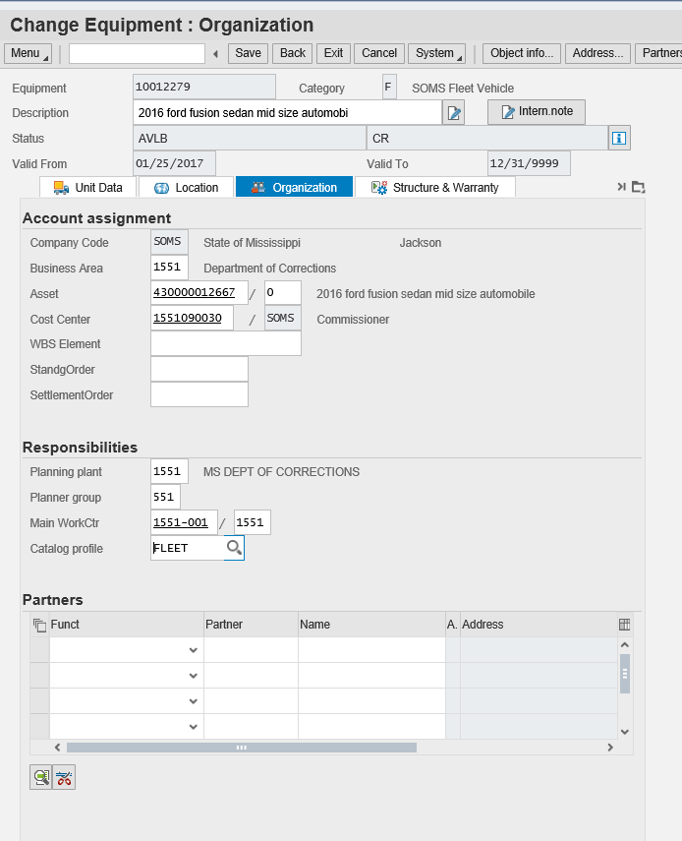
Update Equipment Master:
Organization Tab
Planner Group (Required)
Main WorkCtr (Required)
Catalog Profile (Required)
Notes:
Organization tab displays a link to the asset record
Planner Group-authorization object can be used to define security at a sub agency level. 3 digit code that is related to the SPAHRS agency number
MainWorkCtr-Center-location where maintenance and repairs are done. For agencies that do not have a physical shop, default work centers have been created for each agency.
Catalog Profile-Will always be FLEET

Slide 44
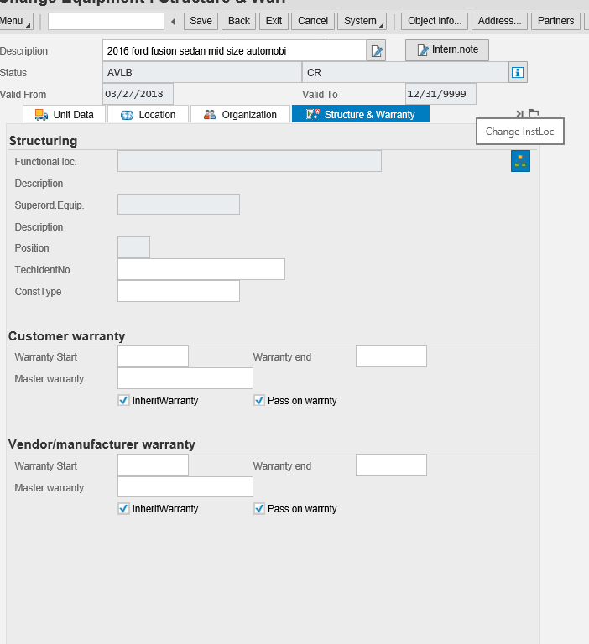
Update Equipment Master:
Structure and Warranty Tab
Functional Location is used to identify the vehicle’s agency, district, and assignment type
Example: 1551-999-FL
(Dept. Corrections- Statewide- Law Enforcement)

Slide 45
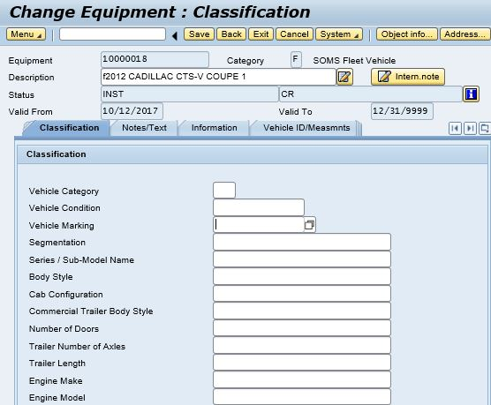
Update Equipment Master:
ClassificationTab
Enter marked/unmarked in Vehicle Marking Field (Required)

Slide 46
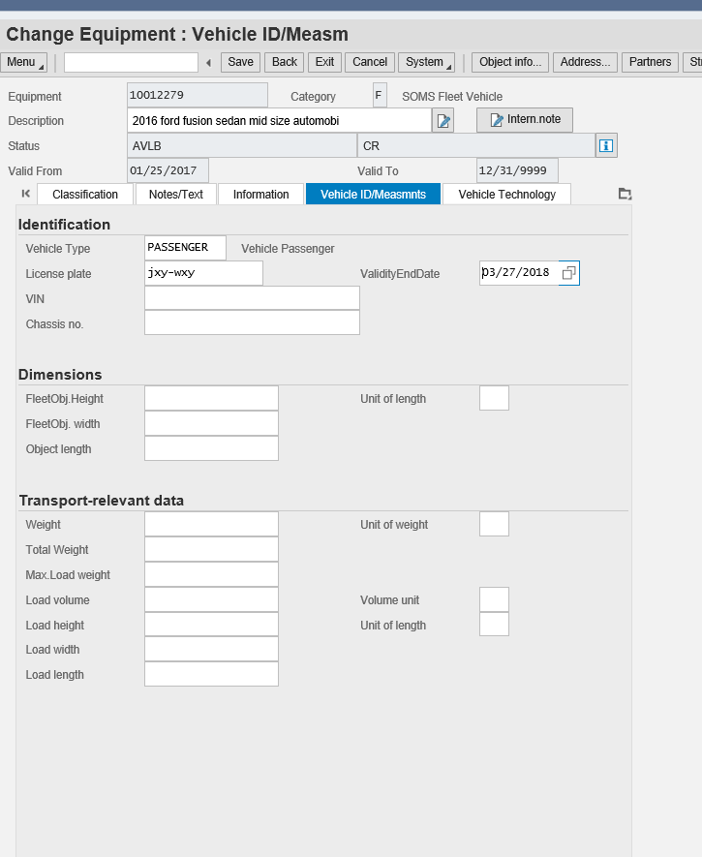
Update Equipment Master:
Vehicle ID/Measurements Tab
License Plate Number
Validity End Date
VIN (VIN can be copied from serial number on Unit Data tab)
Once the VIN is entered and Equipment Record is saved,
VinTelligence interface retrieves and populates descriptive information onto the Equipment Record
Notes:
Make new screen shot capturing vin number.
After VIN is entered and equipment record is saved, VinTelligence

Slide 47
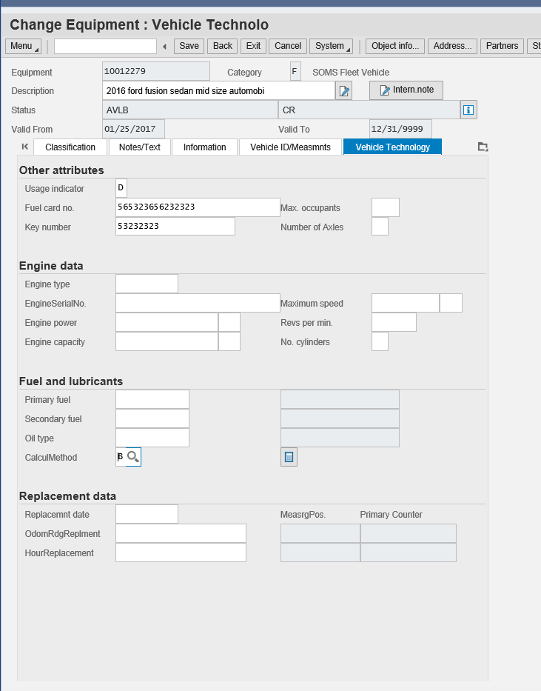
Update Equipment Master:
Vehicle Technology Tab
Enter the Usage Indicator (Required)
Enter Fuel Card no. (FuelMan Card)
Enter “B” in the CalcuMethod (Required)

Slide 48

Exercise 1
Update Equipment Master & Install a Functional Location – IE02
Scenario Objective: A vehicle has been acquired and received. Asset Management has set up the Asset Master, which has generated the Equipment (vehicle) Master shell. Update the Equipment (vehicle) Master with the appropriate fleet information.

Slide 49
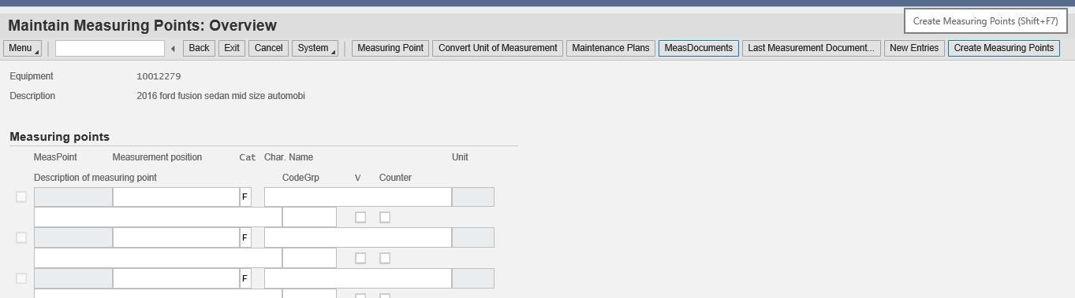
Create Measuring Points
Three measuring points are created for each vehicle record in order to track:
Fuel Consumption Fuel Cost Odometer Readings
1
2
3
(PM_Fuel) (PM_FuelCost) (PM_Miles)
Notes:
Measuring points are statistical buckets that are created for each vehicle. Measurement documents are posted to the measuring points. Generate the measuring points by clicking the create measuring points button.
Measurement documents cannot be deleted. If a mistake has been make, you will need to reverse the measurement document.

Slide 50
Exercise 2
Create measuring points – IE02
Scenario Objective: The new vehicle must have measuring points assigned. By assigning measuring points to the vehicle, odometer readings, fuel costs and fuel consumption can be recorded. Assign the three measuring points PM_MILES, PM_FUELCOST, and PM_FUEL to the Equipment (vehicle) Master.

Slide 51
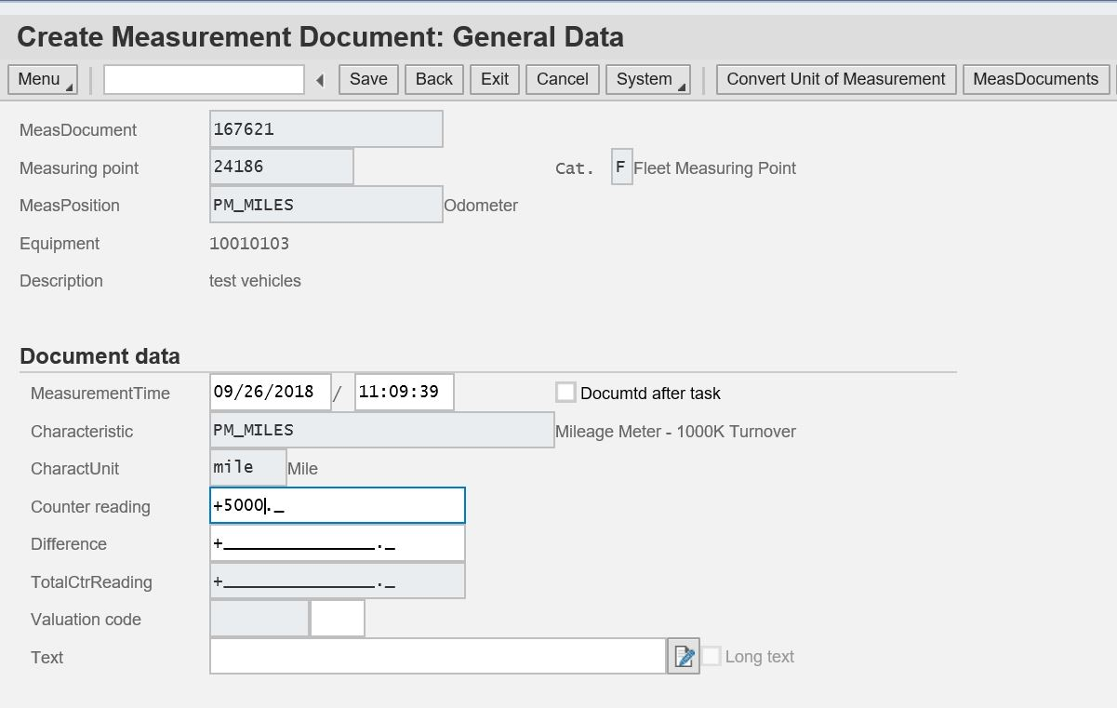
Initial Odometer Reading (IK11)
Every new vehicle must have an initial odometer reading. This is the starting point to calculate miles driven. It is important to have an accurate starting point to calculate cost per mile.
The initial odometer reading must be set to Total CntrReadg Set Externally (this makes the counter reading the starting point for the vehicle’s mileage count).
Notes:
The initial odometer reading must be set Total CntrReadg set externally. This makes the counter reading a starting point for the vehicle. IK11

Slide 52
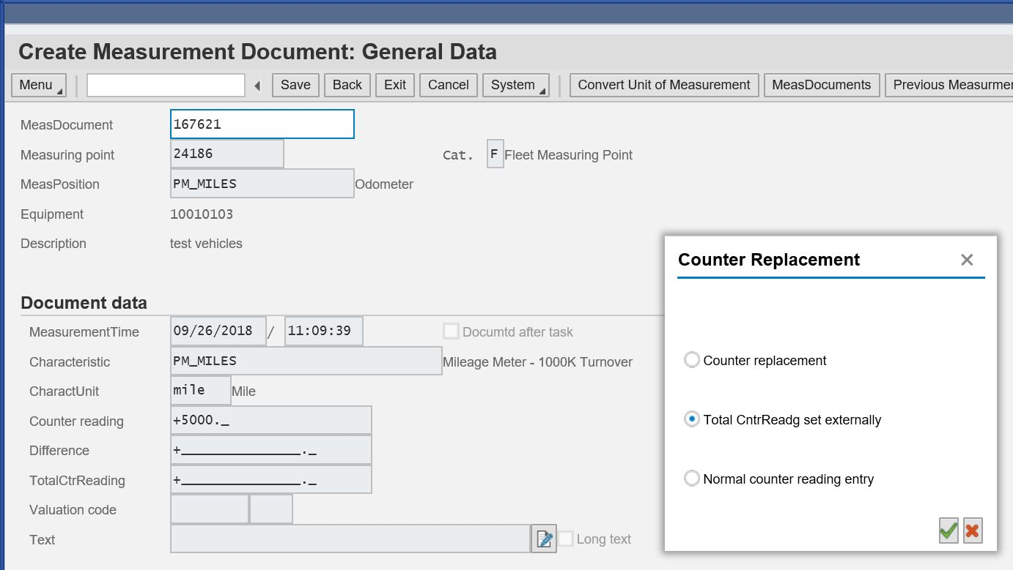
Initial Odometer Reading (IK11)

Slide 53
Exercise 3
Create Initial Odometer Reading – IK11
Scenario Objective: The initial odometer reading must
be documented for the new vehicle. Enter an initial
odometer reading of 5000 miles for the equipment
(vehicle) and the date is 2 months before today’s date.

Slide 54
Driver Assignments
Request for Assignment
ZPMFME_DAV_INIT
Agency Approval ZPMFME_DAV_REQ
OPTFM Approval ZPMFME_DAV_APPR
Notes:
Driver assignment enhancement:
History of driver assignments on equipment (vehicle) master
Last 5 assignments
Design follows current system for driver assignments
Read-only view in equipment (vehicle) master
Not used for pool vehicles with assignment “non-commute”
Checks for date overlap
Uses ALV list edits for review
Uses custom transaction codes:
ZPMFME_DAV_INIT
ZPMFME_DAV_REQ-must have fleet coordinator role
ZPMFME_DAV_APPR

Slide 55
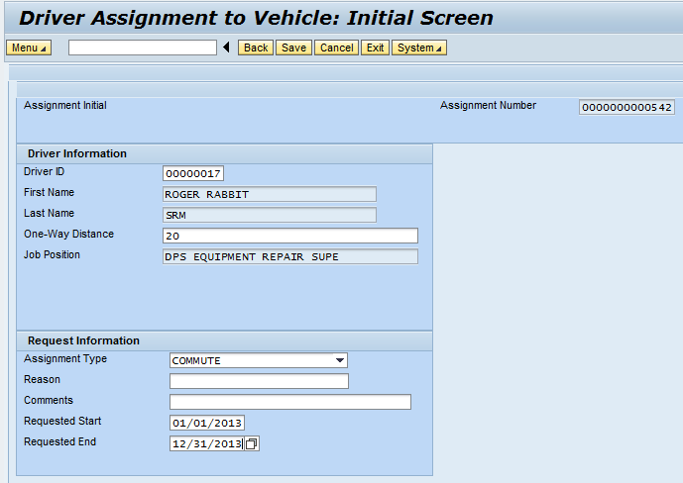
Initial Request for Assignment
Required fields
Driver ID
One-Way Distance
Assignment Type
Requested Start
Requested End
Notes:
Generated by proposed driver or supervisor
Initial request for driver assignment:
Is for vehicle assignment types commute and law enforcement
Has status INITIAL
Driver ID:
Uses HCM mini master
Defaults first and last name
One-way distance:
Is used to check for personal use
Assignment type:
Identifies commute or law enforcement
Requested start / end:
Is required
Is for maximum of one year

Slide 56
Exercise 4.1
Create Driver Assignment Request – ZPMFME_DAV_INIT
Scenario Objective: A new driver assignment is required for
the newly acquired vehicle. Create the Initial Driver
Assignment Request.

Slide 57
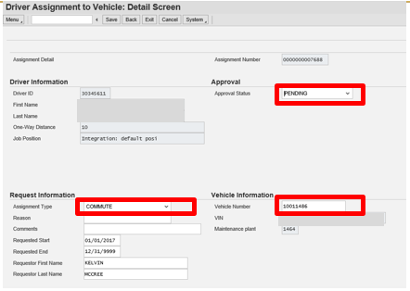
Agency Driver Assignment Approval

Slide 58
Exercise 4.2
Perform Agency Driver Assignment Approval – ZPMFME_DAV_REQ
Scenario Objective: The Driver Assignment must be approved
by the agency. Review the Driver Assignment Request, assign
equipment (vehicle) and change the status of the request to
indicate agency approval.

Slide 59
Reporting and Data Monitoring
Unit Objectives:
  Perform Self Audit
  Asset/Fleet Report
  Active Equipment Records list (IE36)
  Vehicle and Equipment Status Report
  Analytics (BI/BW) Report
Notes:
Add audit sheet and as we go through the reports refer back to fields audit sheet

Slide 60

Perform Self Audit
The following reports are used to complete internal audits:
  Fleet/Asset Report
  Display Vehicle List (IE36)
  Vehicle Mismatch Report
  Annual Integrity Audit
    Executive Directors of agencies that are operating vehicles must submit to the Bureau of Fleet Management a yearly Data Integrity Audit that certifies the accuracy of the data in MAGIC. BFM will provide each agency with a Fleet Data Audit on an annual basis that must be verified and certified by the Executive Director of the agency. These audits will be completed in March of each year, beginning in 2019.
Agency Fleet Coordinators should perform self audits to ensure data is adequate and free of discrepancies

Slide 61
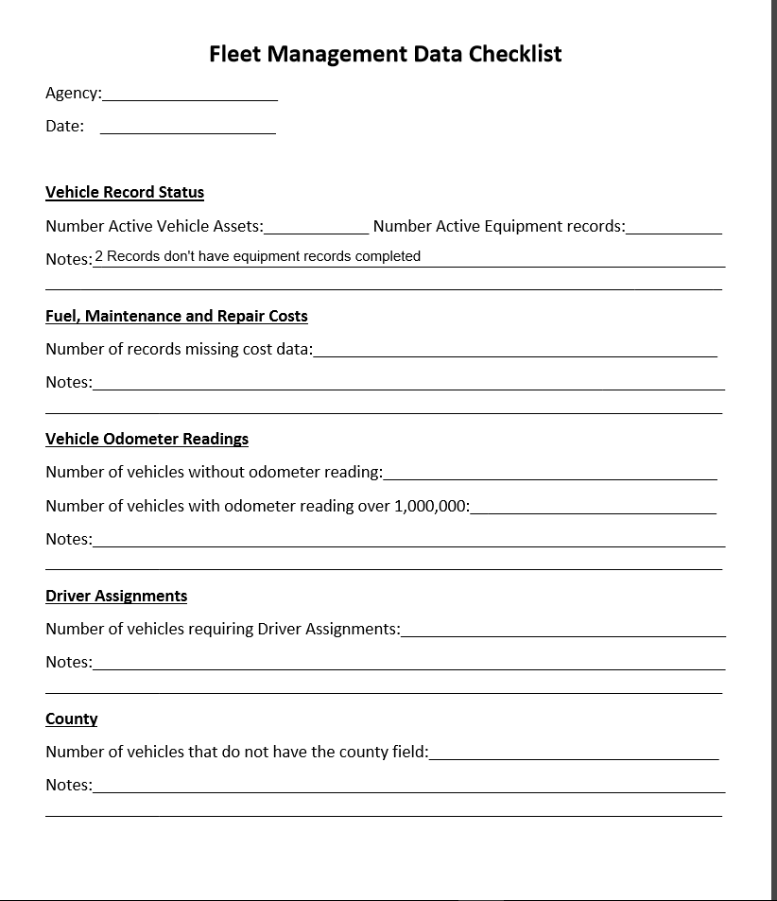
Perform Self Audit
The Fleet Management Data Checklist is used by agencies and BFM to perform audits.

Slide 62
Data Elements
The Asset/Fleet report is used to audit the following data elements:
Accurate Asset and Equipment Record statuses
Fuel, Maintenance, and Repair data of vehicles
County field on the Asset Record
Accurate vehicle mileage readings
Assignment Type of vehicles and Driver Assignments
Notes:
Add audit sheet and as we go through the reports refer back to fields audit sheet

Slide 63
Fleet/Asset Report
The Fleet/Asset Report provides audit relevant information from the Asset and Fleet Management modules within MAGIC
Fuel, Maintenance, and Repair Costs
Current Odometer and Miles Driven
County
Active vehicle asset count
Assignment Type and Driver’s Assignment
  T-Code: ZPM_ASSET_FLEET
Notes:
This report can be exported , sorted and filtered.

Slide 64
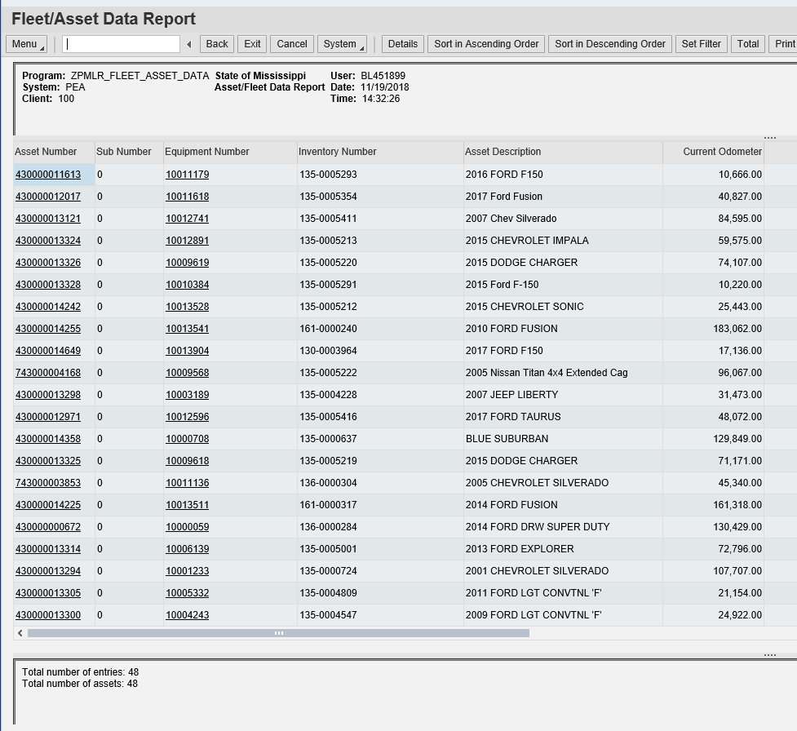
Fleet/Asset Report
Notes:
To execute the report you must have the fleet coordinator role/property officer
Sub assets should not be taken into consideration
The report output will display a list of active vehicle asset records for the user’s authorized agency

Slide 65

Display Active Equipment Records
  T-Code: IE36
  The Display Active Equipment Record (IE36) report is used to audit the active equipment record count.
  The Functional Location must be populated in order for the equipment record to display on this report.

Slide 66
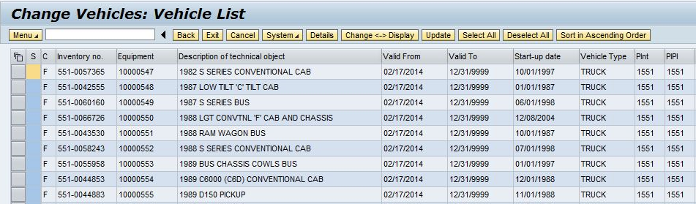
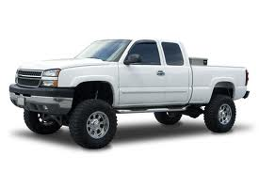
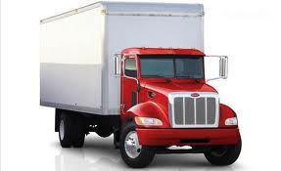

Display Active Equipment Records
Notes:
Double click the line to open up the record.
The layout can be modified to include or exclude the fields displayed

Slide 67

Vehicle and Equipment Mismatch Report
T-Code: ZFAM_VEHICLE_EQ_STAT
This report is used to view the status discrepancies between Vehicle Asset Records and Equipment Records. Status discrepancies must be corrected in order to have a passing audit.
Property Officers and Fleet Coordinators should communicate when setting up new vehicles and completing vehicle disposals.
Notes:
Even though the number of active assets and equipment records match, discrepancies may exist between statuses of an agency's fleet records.

Slide 68
Vehicle and Equipment Mismatch Report
Records highlighted in green indicate a discrepancy between Asset and Equipment statuses.
Notes:
The report displays the asset records and corresponding equipment records. The mismatch records are highlighted in Green.
If the asset record is active and the equipment record is inactive, reactivate the equipment record using transaction IE02. Do not complete this step for sub assets.
If the asset record is inactive and the equipment record is active, deactivate the equipment record using transaction IE02.

Slide 69
Analytics Reports
Assignment Cost and MPG
Displays Fuel, Maintenance, and Repair Costs for multiple vehicles
Gives cost of ownership analysis
State Auditor’s Report
Displays the vehicles for an agency
Vehicle Disposal Forecast
Displays multiple vehicles and their current odometer value

Slide 70
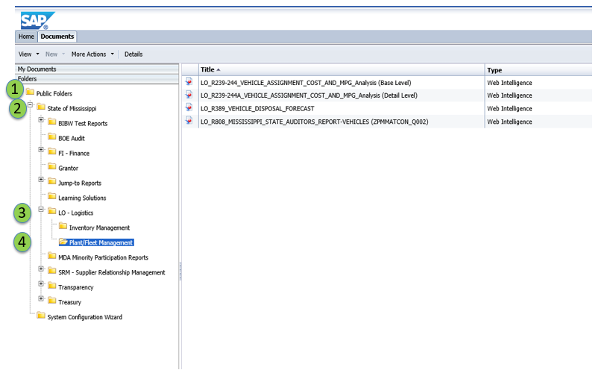
Analytics Reports
Notes:
Locate BI/BW reports from Analytics tab

Slide 71
Exercise 5
Fleet Data Audit
Scenario Objective: An agency needs to perform their weekly audit of vehicle data. Using the Vehicle Data Cleanup job aid, perform an audit for agency 9955.

Slide 72
Maintaining Vehicle Data
  Unit Objectives:
  Maintaining Vehicle Data
  Maintenance and Repair
      Post Historical Maintenance Orders
      Historical Order Report
  Measurement Readings
      Measurement Document Tolerances
      Collective Entry Posting
      Measurement Document Report
  Correcting FuelMan Errors
  Ending a Driver Assignment
  Deactivating an Equipment Record

Slide 73
Maintaining Vehicle Data
Historical Postings
Maintenance and Repair (IW61)
Correcting FuelMan Posting Errors
FuelMan Logger Report (ZPMFMI_FuelManLogger)
Historical Order Reporting (IW38)
Fuel, Fuel cost, Odometer Reading (IK22)
Measurement Document Report (IK18)
Post Odometer Reading (IK11)
Odometer Reading Reversal
Measurement Document Report (IK18)
Change or End Driver Assignment
Create a Driver’s Assignment (ZPMFME_DAV_INIT)
Perform Agency Approval for Driver Assignment (ZPMFME_DAV_REQ)
End a Driver’s Assignment (ZPMFME_DAV_END)
Equipment Record Deactivation
Change Equipment Record (IE02)

Slide 74
Post Historical Maintenance Orders
  Used to document the cost of operating a vehicle.
  Entered into MAGIC to report on maintenance, repair, and fuel entries.
  Does not obligate budget; bypasses financial postings, but crucial for maintenance reporting.
Types of Historical Postings
Maintenance and Repair (IW61)
Fuel Consumption, Fuel Cost, and Odometer reading (IK22)
Historical Postings Reports
Maintenance and Repair (IW38)
Fuel Consumption, Fuel Cost, and Odometer reading (IK18)

Slide 75
  Maintenance and Repair
T-code: IW61
Fleet Coordinators are required to manually enter maintenance and repair costs
for vehicles that are not linked to FuelMan or agency interface.
These entries capture:
Business Area
Vehicle that received maintenance
Type of maintenance performed
Date maintenance occurred
Priority
Cost of labor and/or material

Slide 76
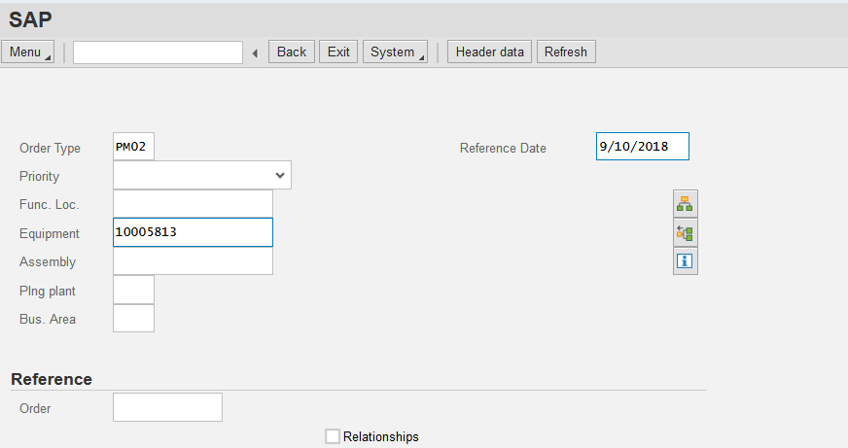
Maintenance and Repair:
Create Historical Maintenance Orders (IW61)
Order Types
  PM01 - Repairs (unplanned)
  PM02 - Maintenance (planned)
Reference Date
  Date activity was performed
Equipment Number
  Vehicle receiving maintenance

Slide 77
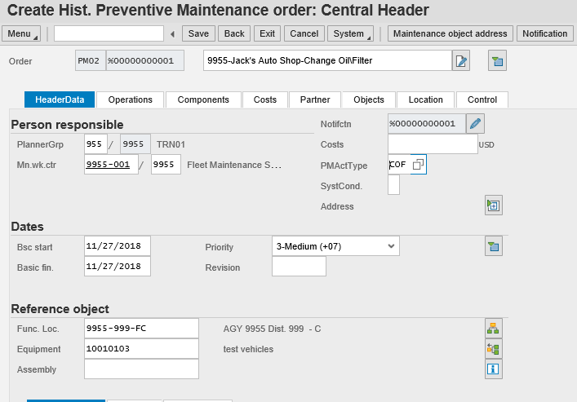
Maintenance and Repair:
Header Data
Description
  Should contain agency number, vendor, activity type
PMActType
  Required to post a historical maintenance order
  Drives statistical cost collection
  Determines the type of maintenance performed

Slide 78
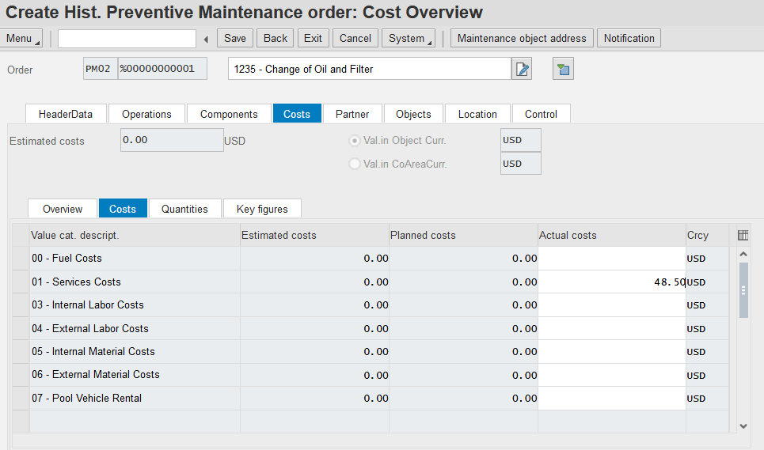
Maintenance and Repair:
Costs
Service Costs - Should be entered for repairs done at an outside shop
Internal Labor Cost - Employee hourly salary
x number of hours spent on maintenance
Internal Material Cost - Cost of parts used to perform internal labor

Slide 79
Exercise 6
Create Historical (Statistical) Order and Post Statistical Costs – IW61
Scenario Objective: After an oil change by a contract vendor, an historical (statistical) order is generated to statistically capture the maintenance costs on the vehicle.

Slide 80
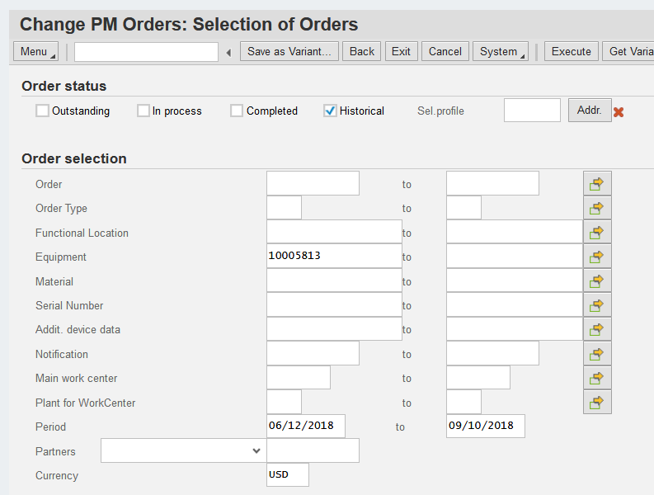
Historical Order Report
T-Code: (IW38)
Historical PM Orders entered via IW61 can be queried using this report.
The most common data elements used for reporting are:
  Order Type
  Equipment number
  Period (Date range)

Slide 81

Collective Entry Posting
T-Code: IK22
This transaction allows manual entries of:
  Odometer Readings
  Fuel Quantity
  Fuel Cost
Historical (statistical) Measurement documents for these postings may only
be entered after Measuring Points have been created.
These entries are required for non-FuelMan purchases and agencies that use on-site fueling stations.
Notes:
This t-code will be used if the fuel postings have to be entered manually.
IK22 posts measurement documents for all three measuring points at the same time.

Slide 82
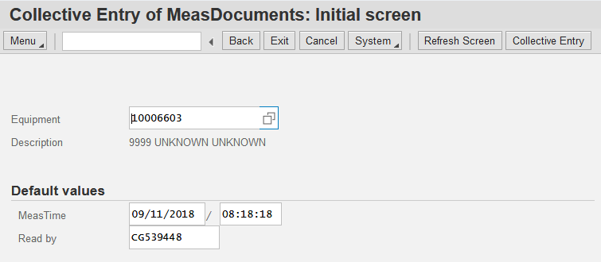
Collective Entry Posting
Equipment Number
MeasTime – Date and time of fuel purchase

Slide 83
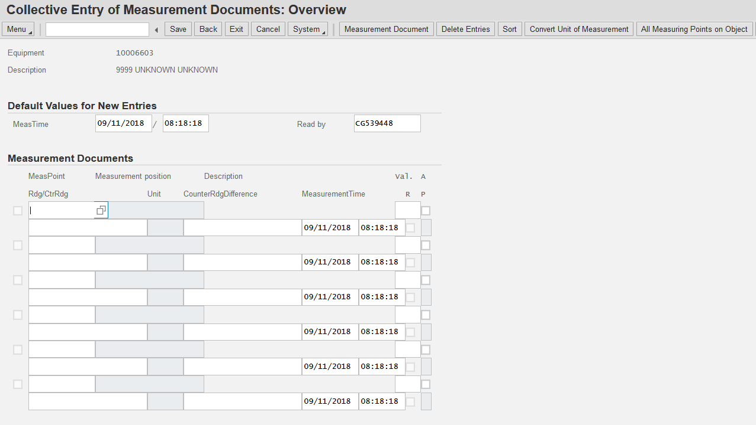
Collective Entry Posting
All Measuring Points on Object must be selected.

Slide 84
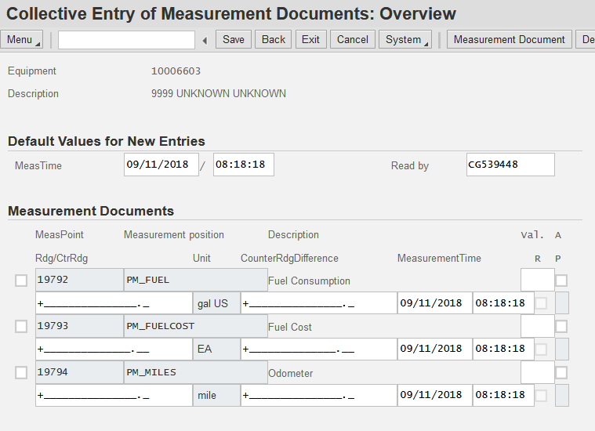
Collective Entry Posting
Three Measurement Documents are created for:
Fuel quantity purchased (in gallons)
Cost of fuel purchased
Odometer reading at the time of fueling
Notes:
Fuel Consumption & Fuel Cost – adding to the total
Odometer – replacing the total

Slide 85
Measurement Document Tolerances
MAGIC will validate to ensure entries are within daily tolerance limits.
Per day
Maximum 1,000 miles per day
Maximum 100 gallons of fuel per day
Per 30 days
Maximum 10,000 miles per 30 days
Maximum 1,500 gallons of fuel per 30 days
!
  New odometer entries cannot be higher than a later date’s posting.

Slide 86
Exercise 7
Create Measurement Documents for Equipment – IK22
Scenario Objective: Manually enter the fuel posting for 2 weeks prior to the current date. The odometer value was 4000 miles, fuel cost was $40, and fuel consumption was 15 gallons.

Slide 87
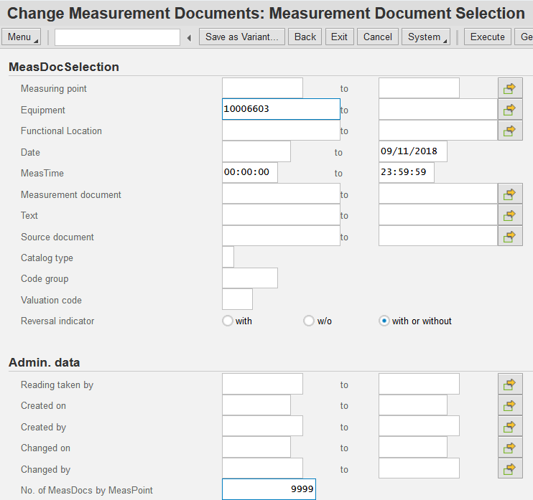
Measurement Document Report
T-Code: IK18
This report allows saved Measurement Documents entered via IK22 to be reviewed for accuracy:
  PM_Miles
  (Odometer Readings)
  PM_Fuel
  (Fuel Quantity)
  PM_FuelCost
  (Fuel Cost)
Notes:
User can select “with or without” in the Reversal indicator field.
To increase the amount of documents displayed put 9999 in the No. of MeasDocs by MeasPoint field.

Slide 88
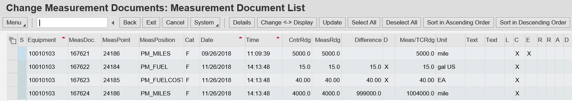

Measurement Document Report
Notes:
In order to correct/review odometer postings, filter on PM_Miles in the MeasPosition column.
Review the values in Meas/TCRrdg column to determine erroneous postings (million mile rollover).
User can drill into the posting to set the reversal indicator.

Slide 89




Correcting FuelMan Posting Errors
The Fuel Access Interface runs weekly (Tuesday 6:00 PM) and posts automated fuel and maintenance data to all State vehicles linked to FuelMan
All state-owned vehicles should be assigned a Fuelman card linked to the vehicle’s Inventory Number
Fleet Coordinators should monitor errors weekly using transaction code: ZPMFMI_FUELMANLOGGER
The Main Work Center and Measuring Points must be entered on the Equipment Record to post costs and statistical data

Slide 90
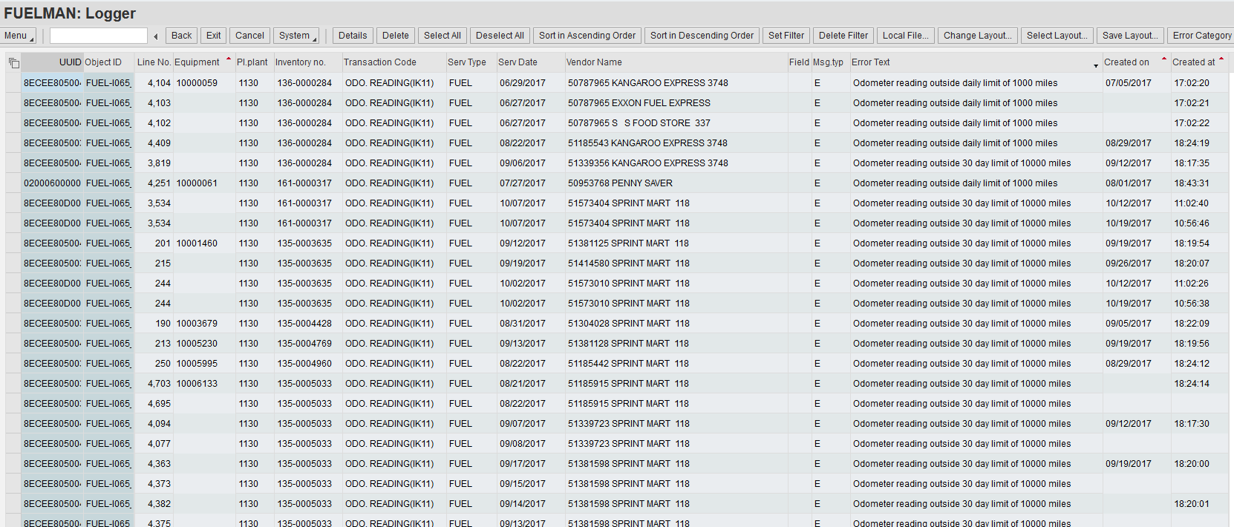
Correcting FuelMan Posting Errors
The FuelMan Error Report identifies:
  Vehicle Inventory Number
  Service Type (Fuel, Maintenance, or Repair)
  Service Date
  Vendor Name
  Error Text (based on tolerance limits)

Slide 91

Correcting FuelMan Posting Errors
Data corrections include:
  Reverse Odometer Readings (IK18)
  Create an Odometer Entry (IK11)
  Complete/Update the Equipment Records (IE02)
  Create Measuring Points (IE02)
Please contact the MASH Help Desk for guidance at:
mash@dfa.ms.gov

Slide 92
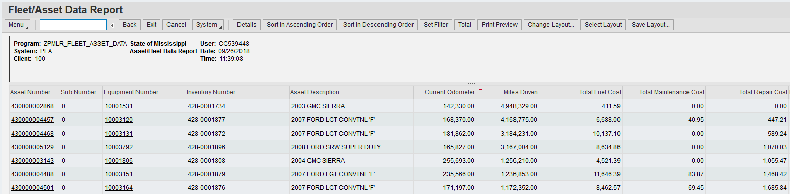
Odometer Reading Reversal
Fleet Managers can review inadequate mileage on Equipment Records
by executing the ZPM_Fleet_Asset Report.
Vehicle odometer readings with a value of 1,000,000 Miles Driven or
more must be corrected to reflect the vehicles true odometer.

Slide 93

Odometer Reading Reversal
Incorrect mileage postings most likely occur due to:
  Erroneous entry at the fueling stations
  Conversion odometer is greater than a later date’s posting
  Current posting is less than a previous posting
Fleet Managers should encourage all authorized personnel operating a motor
vehicle to enter the correct odometer reading at the pump
Vehicle operators should only use the FuelMan card assigned to the vehicle

Slide 94
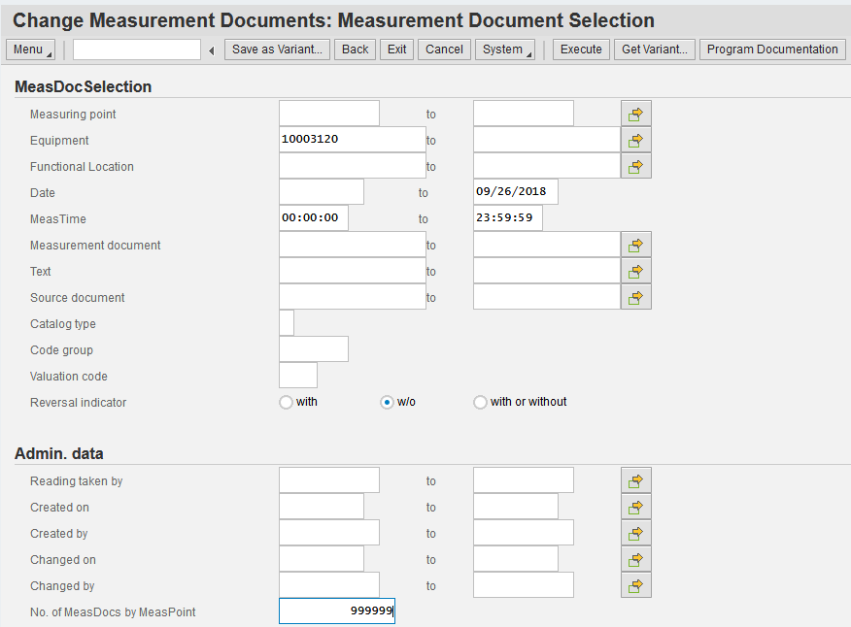
Odometer Reading Reversal
Once the vehicle has been identified, the Equipment Number can be used to query
and reverse the entry via IK18
Notes:
Populate the No. of MeasDocs by MeasPoint with “999999” to capture all entries

Slide 95
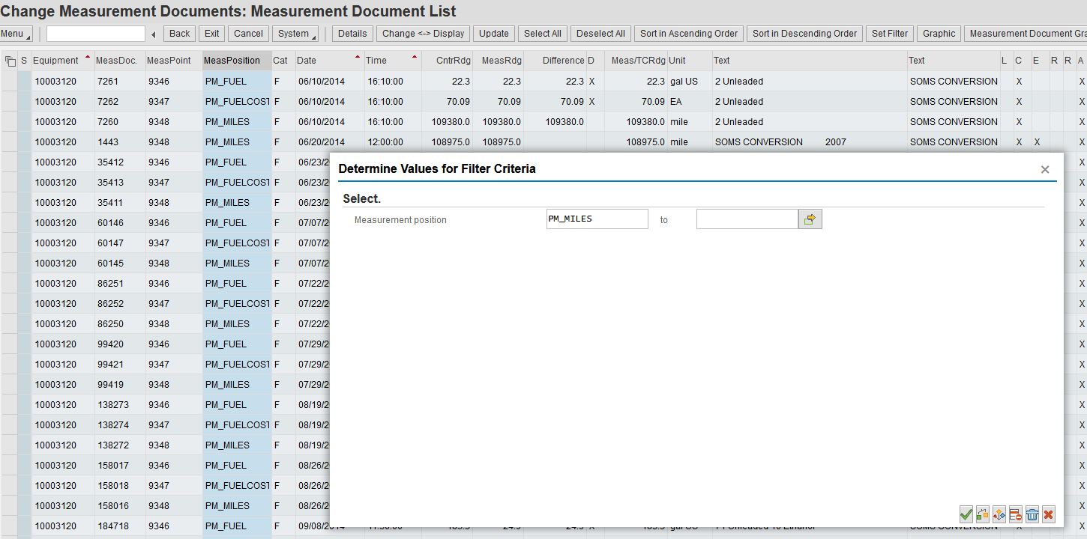
Odometer Reading Reversal
The MeasPosition filter criteria
must be set to PM_Miles

Slide 96
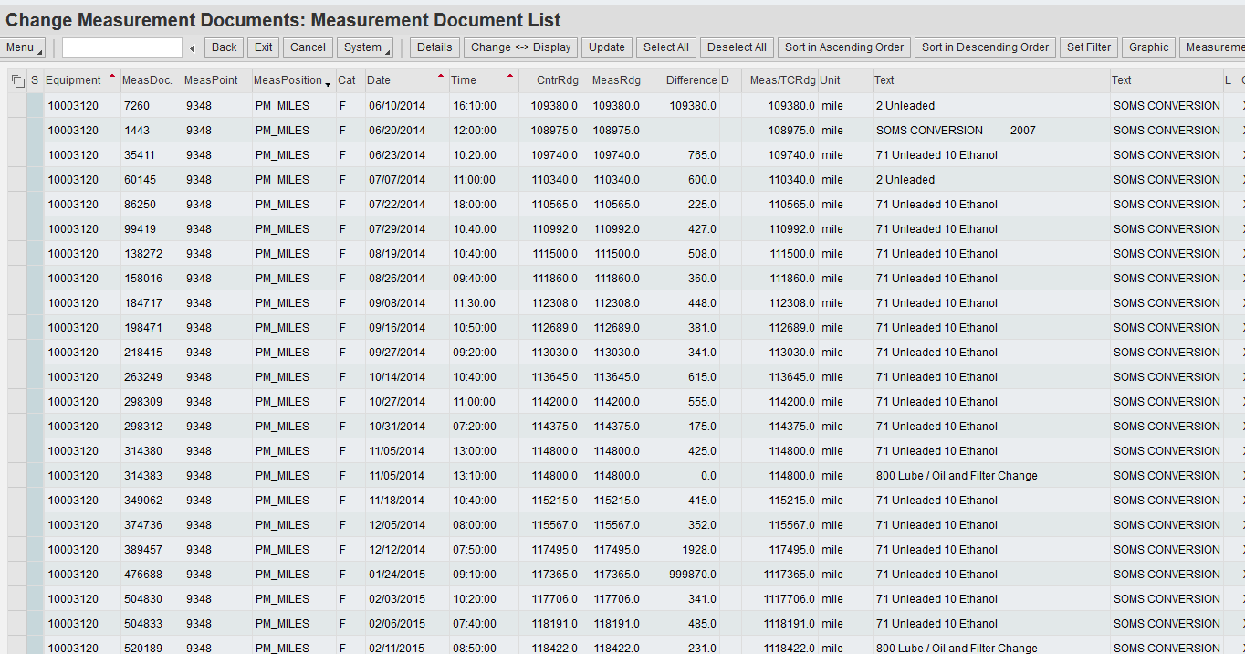
Odometer Reading Reversal
Coordinators must locate the Counter
Reading posting with less miles than a
previous posting.
Notes:
Note: The faulty counter reading will display 999XXX in the Difference ID column.

Slide 97
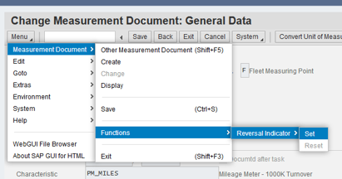
Odometer Reading Reversal
To reverse the odometer, the Reversal
Indicator must be set and then saved.

Slide 98
Exercise 8
List Measurement Documents and Set Reversal Indicator – IK18
Scenario Objective: One of the Measurement Documents was entered incorrectly. Generate a list of Measurement Documents for the equipment (vehicle) and set the Reversal Indicator.

Slide 99

Change or End a Driver’s Assignment
Driver Assignments are modified via transaction code ZPMFME_DAV_END
This process is used to end the current assignment by updating the end date.
Driver Assignments may be ended due to:
  Employee’s resignation or termination
  Revocation of driving authority (violation of agency or BFM policies)
  Commuter vehicle replacement
  Change in vehicle Assignment Type
  Loss of Driver’s License

Slide 100
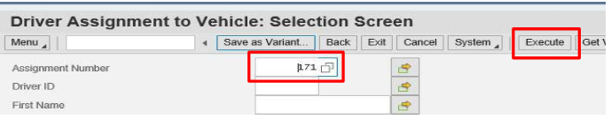
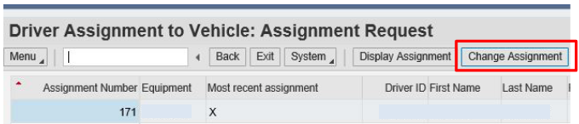
Change or End a Driver’s Assignment
Existing driver assignments are identified using
the Assignment Number.
Fleet Managers will then select “Change Assignment”.

Slide 101
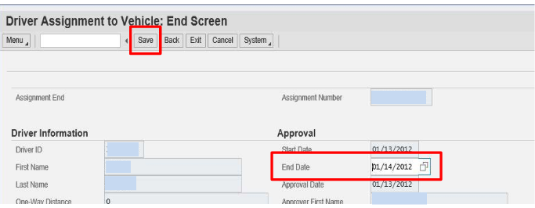
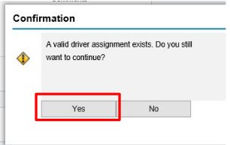

Change or End a Driver’s Assignment
The End Date will be applied and the record can be
“Saved” and confirmed.

Slide 102

Deactivating an Equipment Record
Vehicle Equipment Records must be deactivated once the vehicle asset
has been disposed (sold or transferred).
Property Officers and Fleet Managers should
communicate regularly when setting up or disposing of
Asset and Vehicle Equipment Records.
It is important to have the same status for Asset and Equipment Records.
  Uneven record statuses are considered a discrepancy and will not pass a vehicle audit.

Slide 103

Deactivating an Equipment Record
Equipment records are deactivated
via transaction IE02.
Notes:
Add notes to explain the process

Slide 104
Exercise 9
Deactivate Equipment Record
Scenario Objective: The vehicle was wrecked, and it needs to be deactivated.

Slide 105

Questions?
Contact the MASH Help Desk for guidance at mash@dfa.ms.gov

