Slide 1
Introduction to Information Technology Procurement
www.its.ms.gov

Slide 2
ITS Law: Responsibilities & Authority
Legislative Information
ITS Statute: Title 25, Chapter 53
Code Sections 25-53-1 through 25-53-201
Goals:
minimize duplication, reduce costs, and improve efficiency
ensure maximum competition between manufacturers and suppliers
www.its.ms.gov

Slide 3
ITS Law: Responsibilities & Authority
By Law, ITS must:
Adopt rules, regulations, and procedures governing the acquisition of computer and telecom equipment and services
Review and approve (or disapprove) all IT procurements by agencies and IHLs
Execute all contracts for IT equipment and services (ITS Executive Director is “contracting agent” for all technology contracts)
Advertise competitive specifications for dollar amounts established in 31-7-13(c) using total lifecycle cost
ITS delegated to IHLs to issue procurement without ITS involvement up to $250,000
Award to the “lowest and best”
www.its.ms.gov

Slide 4
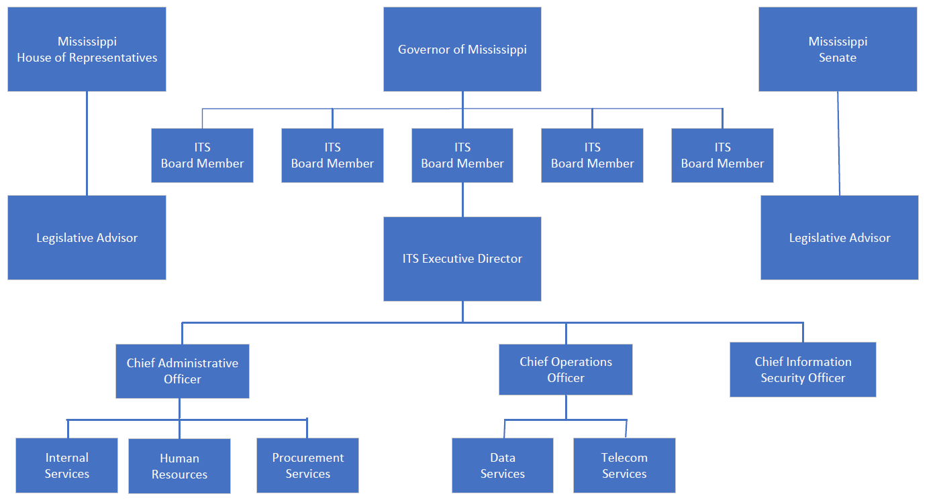
ITS Organization
www.its.ms.gov

Slide 5
ITS Board
Role of ITS Board
Hire ITS Executive Director
Set technology direction for state government
Monitor strategic IT projects undertaken by agency and IHL customers
Adopt rules and regulations for fulfilling the procurement and strategic IT oversight charges in ITS legislation
Approve procurements, including exemptions, above the Director Approval Threshold
www.its.ms.gov

Slide 6
ITS Purview and Scope
ITS Purview Includes:
State Agencies
Institutions of Higher Learning
Other political subdivisions (e.g., cities, counties, K-12 Schools, Community Colleges), on request
ITS Scope Includes:
All information technology (i.e. computers, telecommunications)
Hardware, software, and services
www.its.ms.gov

Slide 7
ITS Rules and Regulations
ITS website: www.its.ms.gov
Procurement Handbook – updated October 2022
“Procurement” Channel
“Procurement Handbook”
Filed with the Secretary of State’s Office
www.its.ms.gov

Slide 8
Total Lifecycle Cost
Total committed costs of the project, not just the initial or up-front costs
Includes all costs associated with obtaining, maintaining and operating technology for its projected lifecycle:
Initial costs: purchase price, freight, installation, training, etc.
Ongoing costs: post warranty maintenance, support, upgrades, on-site vendor personnel, recurring usage charges, hosting, etc.
www.its.ms.gov
Procurement Handbook Reference: 005-400

Slide 9
Agency Delegation
ITS has delegated to Agencies:
Non-telecom Projects < $5,000
Non-telecom Projects between $5,000 and $75,000, with 2 quotes (i.e., sole source certification is NOT delegated)
Must select the low quote
EPL purchases within EPL dollar limits
www.its.ms.gov
Procurement Handbook Reference: 015-010

Slide 10
IHL Delegation
ITS has delegated to IHLs:
Non-telecom Projects < $5,000
Non-telecom Projects between $5,000 and $250,000
EPL purchases within EPL dollar limits
www.its.ms.gov
Procurement Handbook Reference: 015-010

Slide 11
Board Approval Threshold
MS Code 25-53-5(k) allows the ITS Board to set rules and regulations governing the contracts/dollar amounts that require their approval; some are delegated to the ITS Executive Director.
Lifecycle of Consulting Services Purchase > $500,000: requires ITS Board Approval
Lifecycle of Purchase > $1,000,000: requires ITS Board Approval
ITS Board approval is required prior to issuance of a competitive procurement that is expected to exceed Director Approval limits
www.its.ms.gov

Slide 12
Board Approval Threshold
To present to the ITS Board:
Customer must submit a Business Case to be included as a part of the Board Meeting materials.
Completed Business Case must be received by the preceding month’s Board meeting (schedule is on our website)
Blank Business Case template is on our website
Presenting agency must be in compliance with the Enterprise Security Policy and have obtained an IT Security Risk Assessment within 3 years.
https://www.its.ms.gov/services/security/state-government-resources
www.its.ms.gov

Slide 13
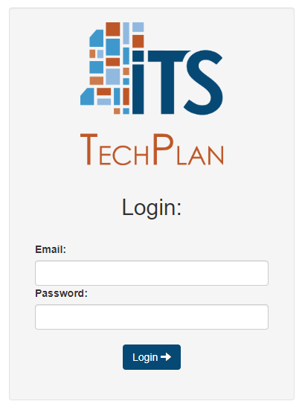
Director Approval Threshold
Lifecycle of Purchase < $250,000: approved by the ITS Executive Director
Lifecycle of Purchase > $250,000 but < $1 million: requires an approved IT Plan; approved by ITS Executive Director
TechPlan System – used to submit IT Plans
Use your state issued e-mail and a self-set password
www.its.ms.gov
Procurement Handbook Reference: 018-030

Slide 14
IT Plans
MS Code 25-53-21(a) requires the development of long-range plans by agencies, boards, and commissions for the efficient and economical performance of IT activities in state government.
Due by September 1 of each year
Reflect broad-based intentions and actions of using IT to fulfil the agency’s mission, enable governmental initiatives, and support business goals and objectives.
Helps ITS prepare the State of Mississippi Strategic Master Plan for Information Technology
www.its.ms.gov

Slide 15
Express Products List (EPL)
What is an Express Products List?
Multi-vendor, catalog-type awards for “routine” technology items
EPLs meet state requirements for legal IT public purchases (advertised & awarded)
Customers can use EPLs free of charge, with no involvement from ITS
ITS requires that customers contact 2 or more vendors
Document, document, document at time of purchase
www.its.ms.gov
Procurement Handbook Reference: 011-030

Slide 16
Express Products List (EPL)
Each EPL has their own Instructions for Use that must be followed
Low quote must be selected
Some Purchase Orders in MAGIC will route to ITS for review
PO must be coded with the EPL Number and a copy of the applicable EPL pages should be attached for an audit trail
Items on the EPL are based on customer demand; ITS does not support or endorse the products
Price negotiation is acceptable. Many vendors price based on a quantity of one; ask about volume discounts or quantity pricing.
www.its.ms.gov

Slide 17
Express Products List (EPL)
Current EPLs - Dollar Limit Per Project Per Fiscal Year:
IT Hardware - $200,000
Two Way Radio - $200,000
NASPO Software Value Added Reseller - $250,000
Microsoft - $500,000
GIS - $250,000
Cabling - $150,000
E-911 - $500,000
NASPO Cloud Solutions - $0.00
Security Assessment - $250,000
www.its.ms.gov
Updated 1/3/2023

Slide 18
Procurement Requests
A request form is needed in order to initiate a project. All forms are on our website.
“Procurement” Channel
“Procurement Request Forms”
Fill in what you know but don’t agonize over every blank; your ITS project manager will work with you to obtain additional information, if needed
Send it in sooner rather than later; contact ITS early in your planning process.
www.its.ms.gov

Slide 19
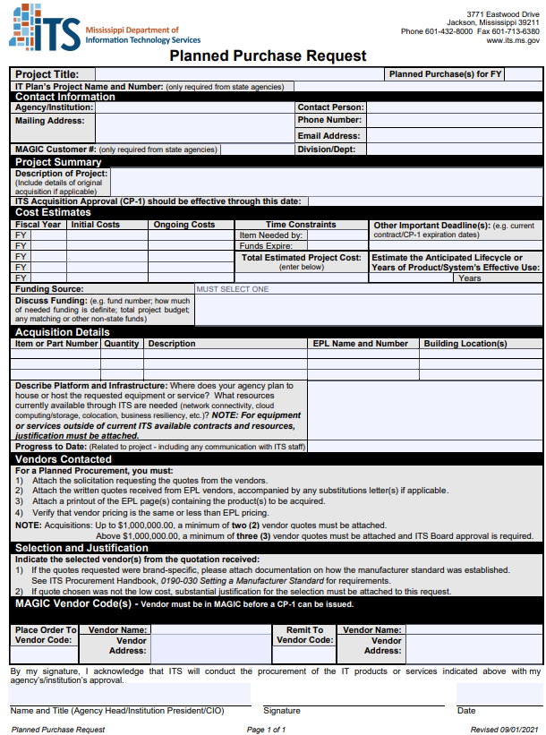
Planned Purchase
Utilized for EPL purchases that go over the delegated limit (dollar amounts on former slide)
Submit Planned Purchase Request form, solicitation submitted to vendors, and quotes received to projects@its.ms.gov.
www.its.ms.gov

Slide 20
Planned Purchase
ITS will do a thorough review of the solicitation, quotes, EPL pages, and verify pricing.
All equipment or software must appear on the current EPL price lists.
Purchase < $1,000,000 = minimum of two quotes
Purchase > $1,000,000 = minimum of three quotes and ITS Board approval
Approval is in the form of an ITS CP-1 Acquisition Approval Form
www.its.ms.gov
Procurement Handbook Reference: 013-080

Slide 21
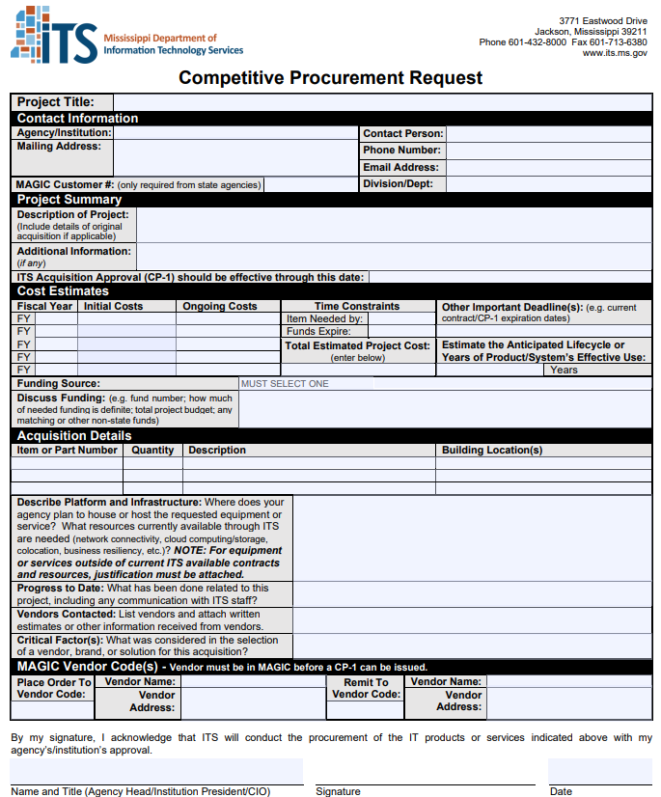
Competitive Procurement
Utilized for specialized/unique purchases that require public advertised by law.
Submit Competitive Procurement Request form and technical specifications to projects@its.ms.gov.
www.its.ms.gov

Slide 22
Competitive Procurement
ITS Project Manager will facilitate the procurement process and will guide agency from beginning to end.
ITS typically uses:
Project-specific Request for Proposals (full technical review with public advertisement)
General RFP and Letter of Configuration (full technical review to a vendor pool; can shorten timeframe)
Invitation for Bid (awarded solely on cost)
ITS resources are available to help write technical specifications.
Proposal Confidentiality Agreements are required to be signed for all participants involved in the drafting and evaluation of the RFP and responses.
www.its.ms.gov

Slide 23
Competitive Procurement
Proposal Evaluation and Scoring
Requires open and competitive specifications to ensure maximum competition, to the fullest extent practicable.
Awards to “lowest and best” i.e. cost + technical score
“Best” is determined by compliance of vendor’s proposal with the technical specifications
ITS is not required to do blind evaluations.
Consensus scoring: ITS + customer team determine one score for each requirement; better representation of a true score rather than a numerical average of evaluator scores.
www.its.ms.gov
Procurement Handbook Reference: 018-010

Slide 24
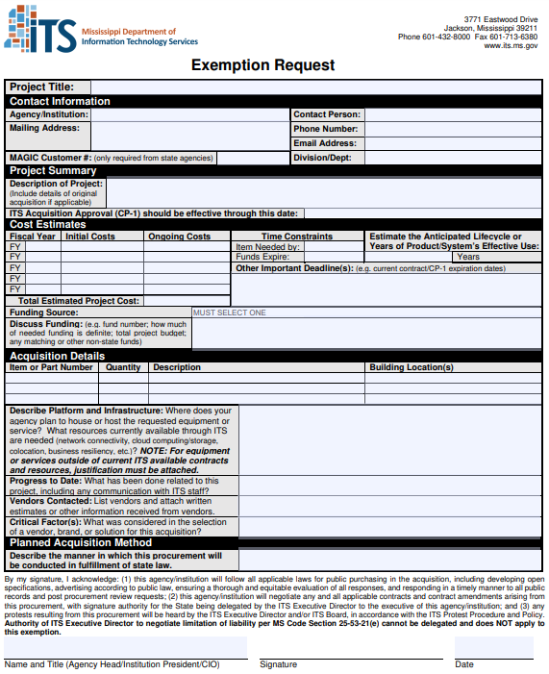
Exemption
Utilized when an agency wishes to conduct their own procurement without ITS
Submit Exemption Request form to projects@its.ms.gov.
Cannot Exempt a Sole Source
www.its.ms.gov

Slide 25
Exemption
Exemption must be granted before an advertisement is issued for the procurement.
CP-1 is issued for the estimated dollar amount; if proposals come in higher, agency must request a subsequent CP-1 to increase the authority.
After the agency executes a contract, it should be submitted to ITS for ITS to create a MAGIC Contract.
All Public Purchasing Laws must be followed.
Exemptions should also be requested if the agency wishes to issue for Request for Information
Any protests must be heard by the ITS Executive Director.
Same Board approval and Director approval thresholds apply.
www.its.ms.gov
Procurement Handbook Reference: 013-040

Slide 26
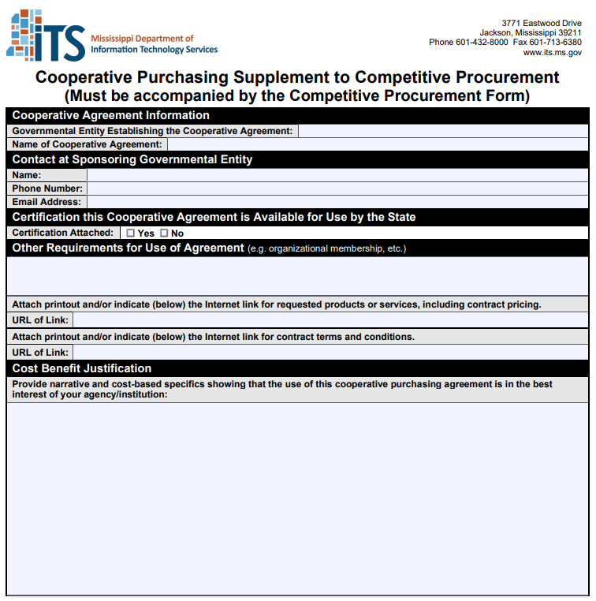
Cooperative Purchasing Agreement
Utilized when another local, state, or federal government entity established a procurement mechanism (example: NASPO, MiCTA, NASACT, NCPA, E&I Cooperative).
Submit Competitive Procurement Request AND Cooperative Purchasing Supplement to projects@its.ms.gov.
www.its.ms.gov
Procurement Handbook Reference: 011-070

Slide 27
Cooperative Purchasing Agreement
31-7-13(m)(xxix) allows for use of cooperative purchasing agreements by certified purchasing offices; or they have to be approved by OPTFM.
There is no delegation for agency use; all Cooperative Purchases of technology must be approved by ITS.
Use of the NASPO SVAR is not considered a Cooperative as it has been approved for statewide use.
www.its.ms.gov
Procurement Handbook Reference: 011-070

Slide 28
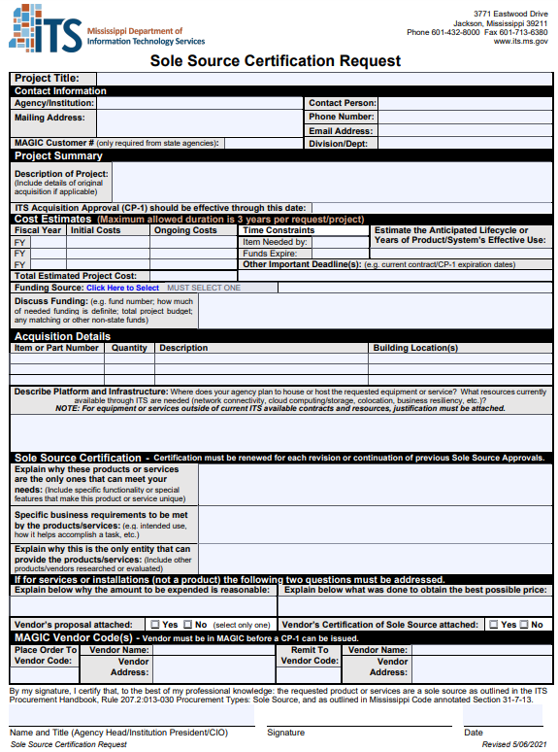
Sole Source
Utilized when items are available only from one source.
Purchase > $5,000 requires ITS approval since you cannot get 2 quotes.
Submit Sole Source Request, quote, and vendor sole source letter to projects@its.ms.gov.
www.its.ms.gov

Slide 29
Sole Source
ITS reviews agency justification and vendor declaration to conduct research to verify that no other competing product/service exists.
ITS drafts a “Notice of Intent to Certify Sole Source” and, after agency approval, advertises the state’s intent to sole source and publishes the certification to our website.
ITS advertises on Tuesdays; objections are due two weeks after the first advertisement, by law.
www.its.ms.gov
Procurement Handbook Reference: 013-030

Slide 30
Sole Source
MS Sole Source Requirements
The product or services being purchased must perform a function for which no other product or source of services exists,
The purchaser must be able to show specific business objectives that can be met only through the unique product or services, AND
The product or services must be available only from the manufacturer and NOT through resellers who could submit competitive pricing for the product or services.
An explanation about why the amount to be expended is reasonable, and
An explanation regarding the efforts by the purchaser to obtain the best possible price.
www.its.ms.gov

Slide 31
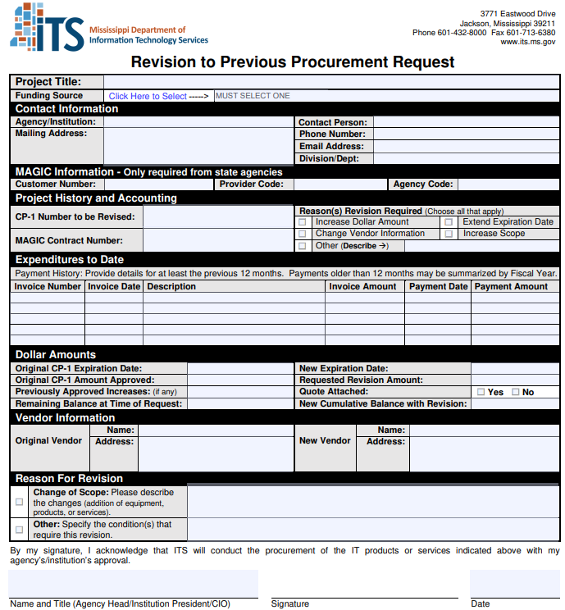
Revision
Utilized when changes to an ITS issued procurement is needed.
Submit Revision Request to projects@its.ms.gov.
www.its.ms.gov

Slide 32
Revision
When a revision is needed:
CP-1 and/or contract is about to expire
Vendor name or address change
Change Order for additional work or functionality
Add funding
www.its.ms.gov

Slide 33
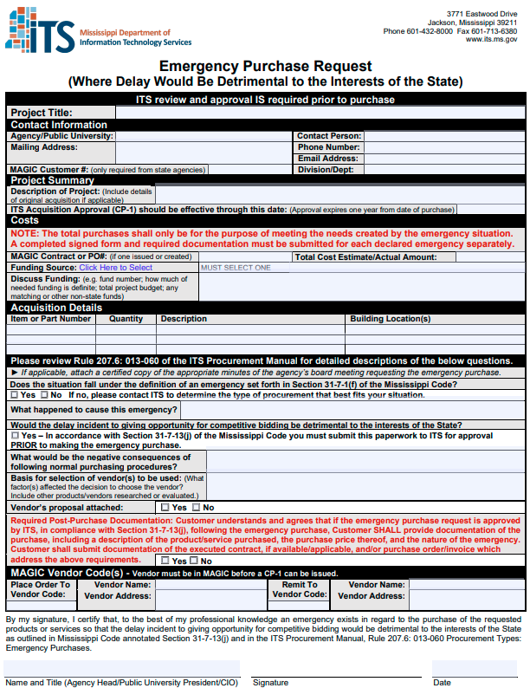
Emergency
Utilized when an agency has determined that an emergency exists and a procurement process would be detrimental to the state.
Two types:
Delay would threaten health, safety, or property
Delay would be detrimental to the Interest of the State
Submit Emergency Request to projects@its.ms.gov.
www.its.ms.gov

Slide 34
Emergency
ITS has adopted MS Code Section 31-7-13 (j) as its emergency purchase procedure.
Emergency declaration must be made by agency head.
If emergency threatens health or safety of a person or preservation of property then prior approval is not needed.
Agency should make their purchase without following bid requirements and submit paperwork to ITS afterwards.
All other emergency situations require prior approval from ITS before issuing a Purchase Order.
The emergency definition applies only to events that could not reasonably have been anticipated; failure to plan does not fall within the definition of an “emergency”.
www.its.ms.gov

Slide 35
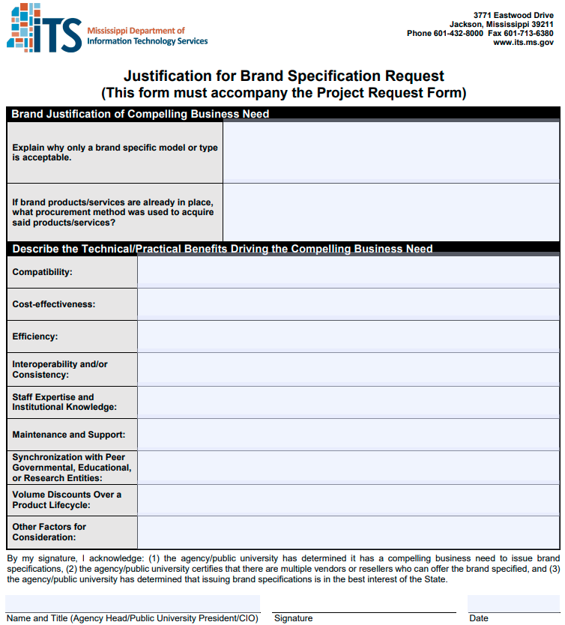
Brand Specific
Open and competitive specifications are encouraged; exceptions can be granted when deemed best interest of the state.
Customer must submit justification for using Brand Specifications.
Must have multiple resellers of product.
Approved on a case-by-case basis.
www.its.ms.gov
Procurement Handbook Reference: 019-030

Slide 36
Project Contracts
ITS highly suggests contracts for equipment or software maintenance; the decision for a contract is up to the agency.
ITS may have a Master Agreement or the underlying RFP & proposal may be enough to protect the agency.
For equipment with no services, the P.O. may suffice
If a contract is needed, ITS will:
Prepare a draft to be included in the procurement for vendors to review before responding to any solicitation.
Provide experience in technology contracts; agency input and approval of the contract is crucial.
Lead the negotiations with the awarded vendor
ITS has its own in-house General Counsel for negotiations.
www.its.ms.gov

Slide 37
Project Contracts
The ITS Executive Director acts as Contracting Agent
Signs all technology contracts “on behalf of”
Customer agency signature is at agency’s option
Has the authority to limit a vendor’s liability when deemed to afford the State reasonable protection
Customer signs acceptance of contract
ITS Executive Director, as Contracting Agent, must be party to amendments, change orders, terminations, or other contract actions
Agency is responsible for contractual obligations, financial, and other
Agency responsible for day-to-day management of project and business decisions
www.its.ms.gov

Slide 38
Final Steps
ITS will issue a CP-1 Approval Document via e-mail for all approvals documenting the services or licenses, amount, and timeframe. This document is the form used to notify the agency that ITS has approved the request for purchase.
ITS will create a MAGIC Contract on behalf of the agency for the agency to issue Purchase Orders and render payments.
The CP-1 will indicate that a contract, if applicable, is executed and ITS will upload the contract to Transparency via MAGIC.
www.its.ms.gov

Slide 39
ITS Procurement Contacts
Stephanie Hedgepeth
Procurement Services Director
(601) 432-8237
Stephanie.Hedgepeth@its.ms.gov
Tabatha Baum
Procurement/Contracts Manager
(601) 432-8072
Tabatha.Baum@its.ms.gov
Alec Shedd
Procurement Manager
(601) 432-8162
Alec.Shedd@its.ms.gov
Michelle Smith
Procurement Process Manager
(601) 432-8057
Michelle.Smith@its.ms.gov
Robert Martinez
Quick Turn-Around Team Leader
(601) 432-8002
Robert.Martinez@its.ms.gov
Khelli Reed
Solicitation Team Leader
(601) 432-8194
Khelli.Reed@its.ms.gov
www.its.ms.gov

Slide 40
Additional ITS Contacts
Procurement Help Desk
isshelp@its.ms.gov
Project Submission
E-mail
projects@its.ms.gov
ITS Website
www.its.ms.gov
Kim White
Procurement Administration Team Leader
(601) 432-8211
Kim.White@its.ms.gov
Renee Murray
Vendor Management Manager (eGov, MSP, EPL)
(601) 432-8118
Renee.Murray@its.ms.gov
Kevin Gray
Policy and Planning Coordinator
(601) 432-8048
Kevin.Gray@its.ms.gov
www.its.ms.gov

